Slide 1
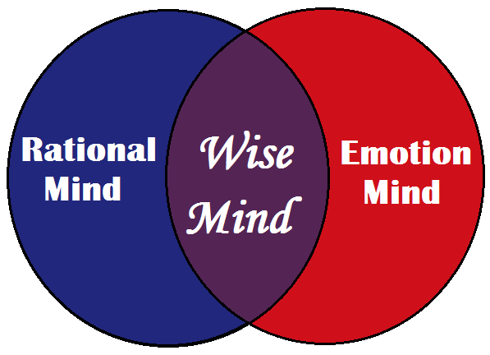
Character Strong—February 20
Objectives:
Students will identify their own character and ways they could improve it.
Students will understand what Reason and Wise Mind are.
Students will understand the three states of mind.

Slide 2
Last Week’s Character Dare! Truth: What do you think about our most recent dare? Dare: Reflect on your experience with the most recent dare.

Slide 3
This week’s character Dare!

Slide 4
Reason Mind
The Reason Mind is logical, calculated, task-oriented and rational; lacks emotion.
Discussion Questions:
What jobs do you think require a Reason Mind?
What problems might come if you live in a Reason Mind ALL the time?
Example: If your house is on fire and you only operate in a Reason Mind, you might think to yourself as you stand inside of your burning house, ‘Where did this fire start? How many rooms has it spread to? How did this fire start?’ This is where emotions would be handy, and the Emotion Mind would kick in and scream, ‘Get out of the house!’”
3) Partner up and come up with three examples of moments in your lives where you would want to include emotions in your choices.

Slide 5
The ultimate mindset is to live in the “Wise Mind,” where you can balance emotion and reason at the same time.
SCENARIO: Your baseball team is playing their final game for the state championship. Your team is down by two runs and you have no outs and a runner on 2nd and 3rd base. You’re up next.”

Slide 6
What happens if you are only in an Emotion Mindset at this point in the game?
What happens if you are operating with a Reason Mindset at this point in the game?
**In these situations you want to be in a Wise Mind, where you are balancing both emotion and reason at the same time.

Slide 7
Exit Ticket!
Write down:
One time I was in Emotion Mind this week was…
One time I was in Reason Mind this week was…
One time I was in Wise Mind this week was…

