Slide 1
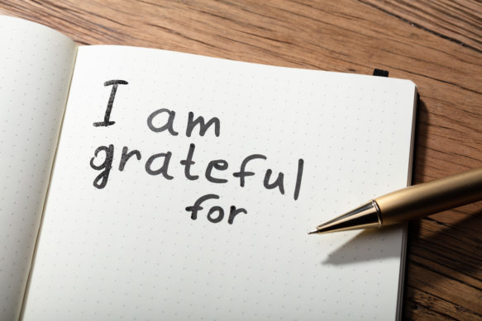
GRATITUDE
Objectives:
Students will reflect on their own character and identify ways they could improve it.
Students will understand the importance of gratitude at school and at home.
Students will understand the benefits that come from practicing gratitude each day.

Slide 2
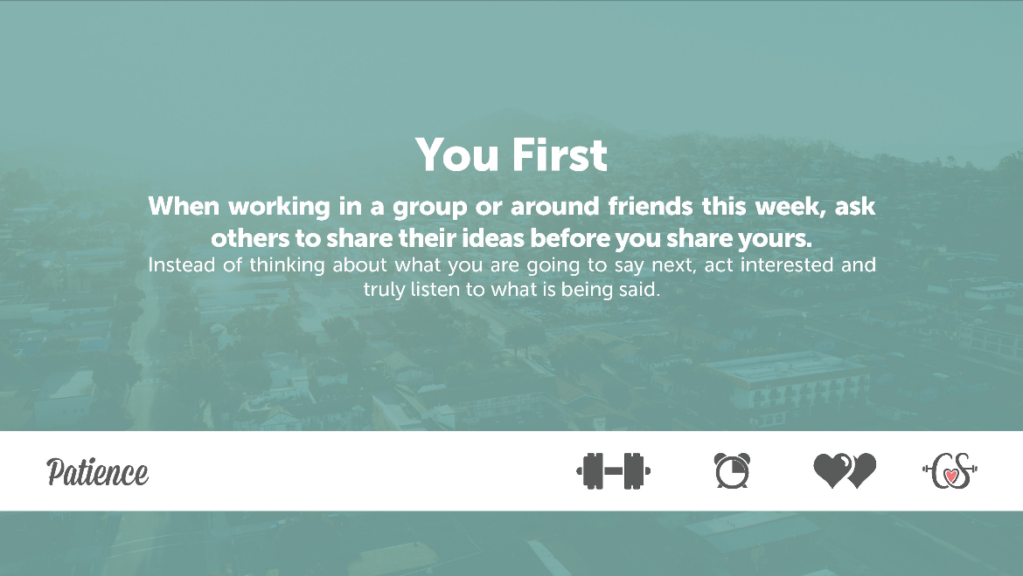
Truth: “What do you think about our most recent Dare?”
Dare: “Reflect on your experience with our most recent Dare.”

Slide 3
This week’s Character Dare

Slide 4
The Power of Gratitude video
Our activity today is called a “Gratitude Journal”
After watching the video, take out a piece of paper
Write down three things that you are thankful for in your life
Notes:
Teacher: Give examples of 1-2 things you are grateful for in your life.

Slide 5
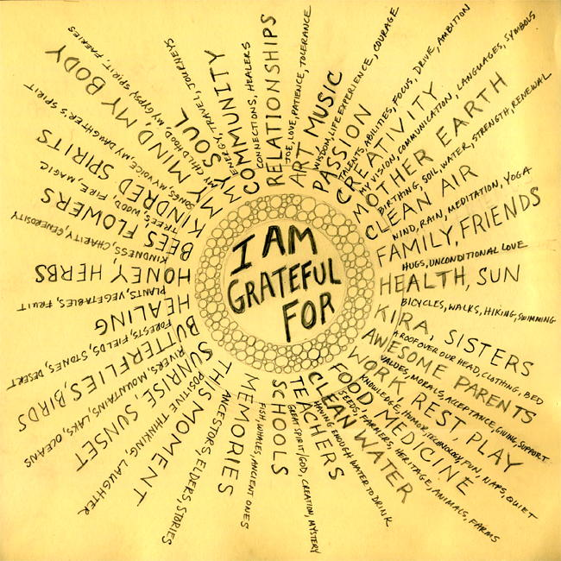

Slide 6
Share your list with your elbow partner or in your group
Now, pick one thing that you are thankful for from your list to share out loud with the class.
Notes:
options: students can create and decorate a small poster or notecard to post in the class anonymously, or the class can create one large poster.

Slide 7
What did you notice from hearing the different things that people shared out loud? Were there any similarities? If so, why do you think that is?
Do you think there could be a benefit of keeping a gratitude journal where you would write down three things that you are grateful for each day?

Slide 8
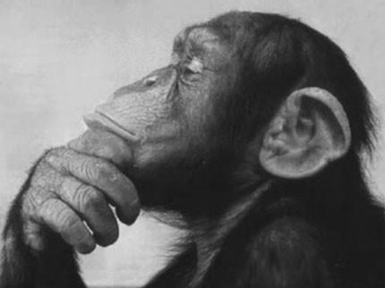
One of the ways to make gratitude a habit is to practice sharing your gratitude with others.
Who could you thank today, sometime before you go to bed, for all that he/she/they have done for you?

