Slide 1
Building Diamondback Community in the Classroom

Slide 2
Teachers Make Sure You Have
Tape
Colored pencils/markers
Octagons (should’ve been delivered to you)

Slide 3
Octagon Example
1. Answer to question 1
8. Answer to question 8
2. Answer to question 2
Directions:
Your teacher will hand out an octagon to you, please put your name in the center.
On the following slide you will be asked to answer 8 questions. You will write each answer to each question on a side of your octagon
Your Name
7. Answer to question 7
3. Answer to question 3
6. Answer to question 6
4. Answer to question 4
5. Answer to question 5

Slide 4
Octagon Questions
You will have 5 minutes to answer these questions, if you finish early color or add designs to your octagon!!
What is your favorite outside of school activity?
Would you rather explore space or the ocean?
What is your favorite school subject?
What is your dream job?
Cats? Dogs? Or Neither?
What is your favorite color?
What is your biggest strength?
What is your favorite kind of food?
1. Answer to question 1
8. Answer to question 8
2. Answer to question 2
Your Name
7. Answer to question 7
3. Answer to question 3
6. Answer to question 6
4. Answer to question 4
5. Answer to question 5

Slide 5
It can be hard…
Sometimes it can feel hard to relate to others or feel like you are alone when you look around the classroom, but you are likely related to others in more ways than you think!
Today we are going to see how many connections to others we can make using our octagons, it is really important that you follow directions, calmly walk around the classroom, and listen for your teacher’s quiet signals.

Slide 6
Octagon Snake Build
You are going to go around the room and find another person who has an answer that is the same or like one of yours on your octagon.
Once you find someone you will connect your octagons together using tape. When you have found one connection you and your new connection will need to find others to connect your octagons to!
The Goal: Get the whole classes octagons connected through similar answers!!
Hint: octagons can be rotated around to make multiple connections on multiple sides!
Sam
4. Firefighter
4. Firefighter
David
8. BBQ
8. BBQ
Linda

Slide 7
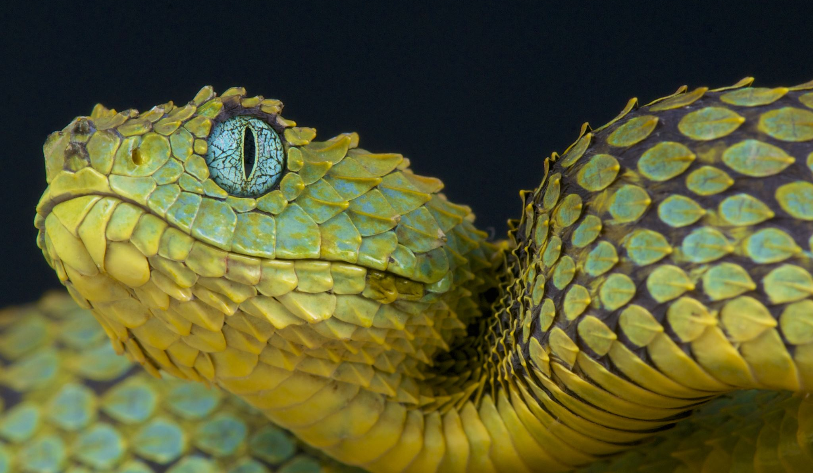
Final Product!!
Good job! As a class you were able to work together to connect everyone in the class in one way or another! You created an octagon class snake!
Time to Reflect!
Turn and Talk to a partner, answer the following questions
Was it difficult or easy to find something in common with another person in the class?
As the snake got longer with more octagons, what became more challenging? How did the class overcome these challenges?
Did you learn anything new about someone in the class?

Slide 8
What is Inclusion??
With building our class octagon snake, we were practicing inclusion!
Inclusion is embracing all people regardless of race, gender, disability, medical or other need.
It is about giving equal access and opportunities and getting rid of discrimination and intolerance.
Ways YOU can be inclusive at school:
Inviting someone new to sit with you at lunch
Making sure everyone has a turn to play in games at lunch
Working with someone quiet in class

Slide 9
Challenge!!
This next week try to include someone in any way possible at school or at home each day!
If any teacher or staff member witnesses you being inclusive, you will earn a stamp for tolerance!

