Slide 1
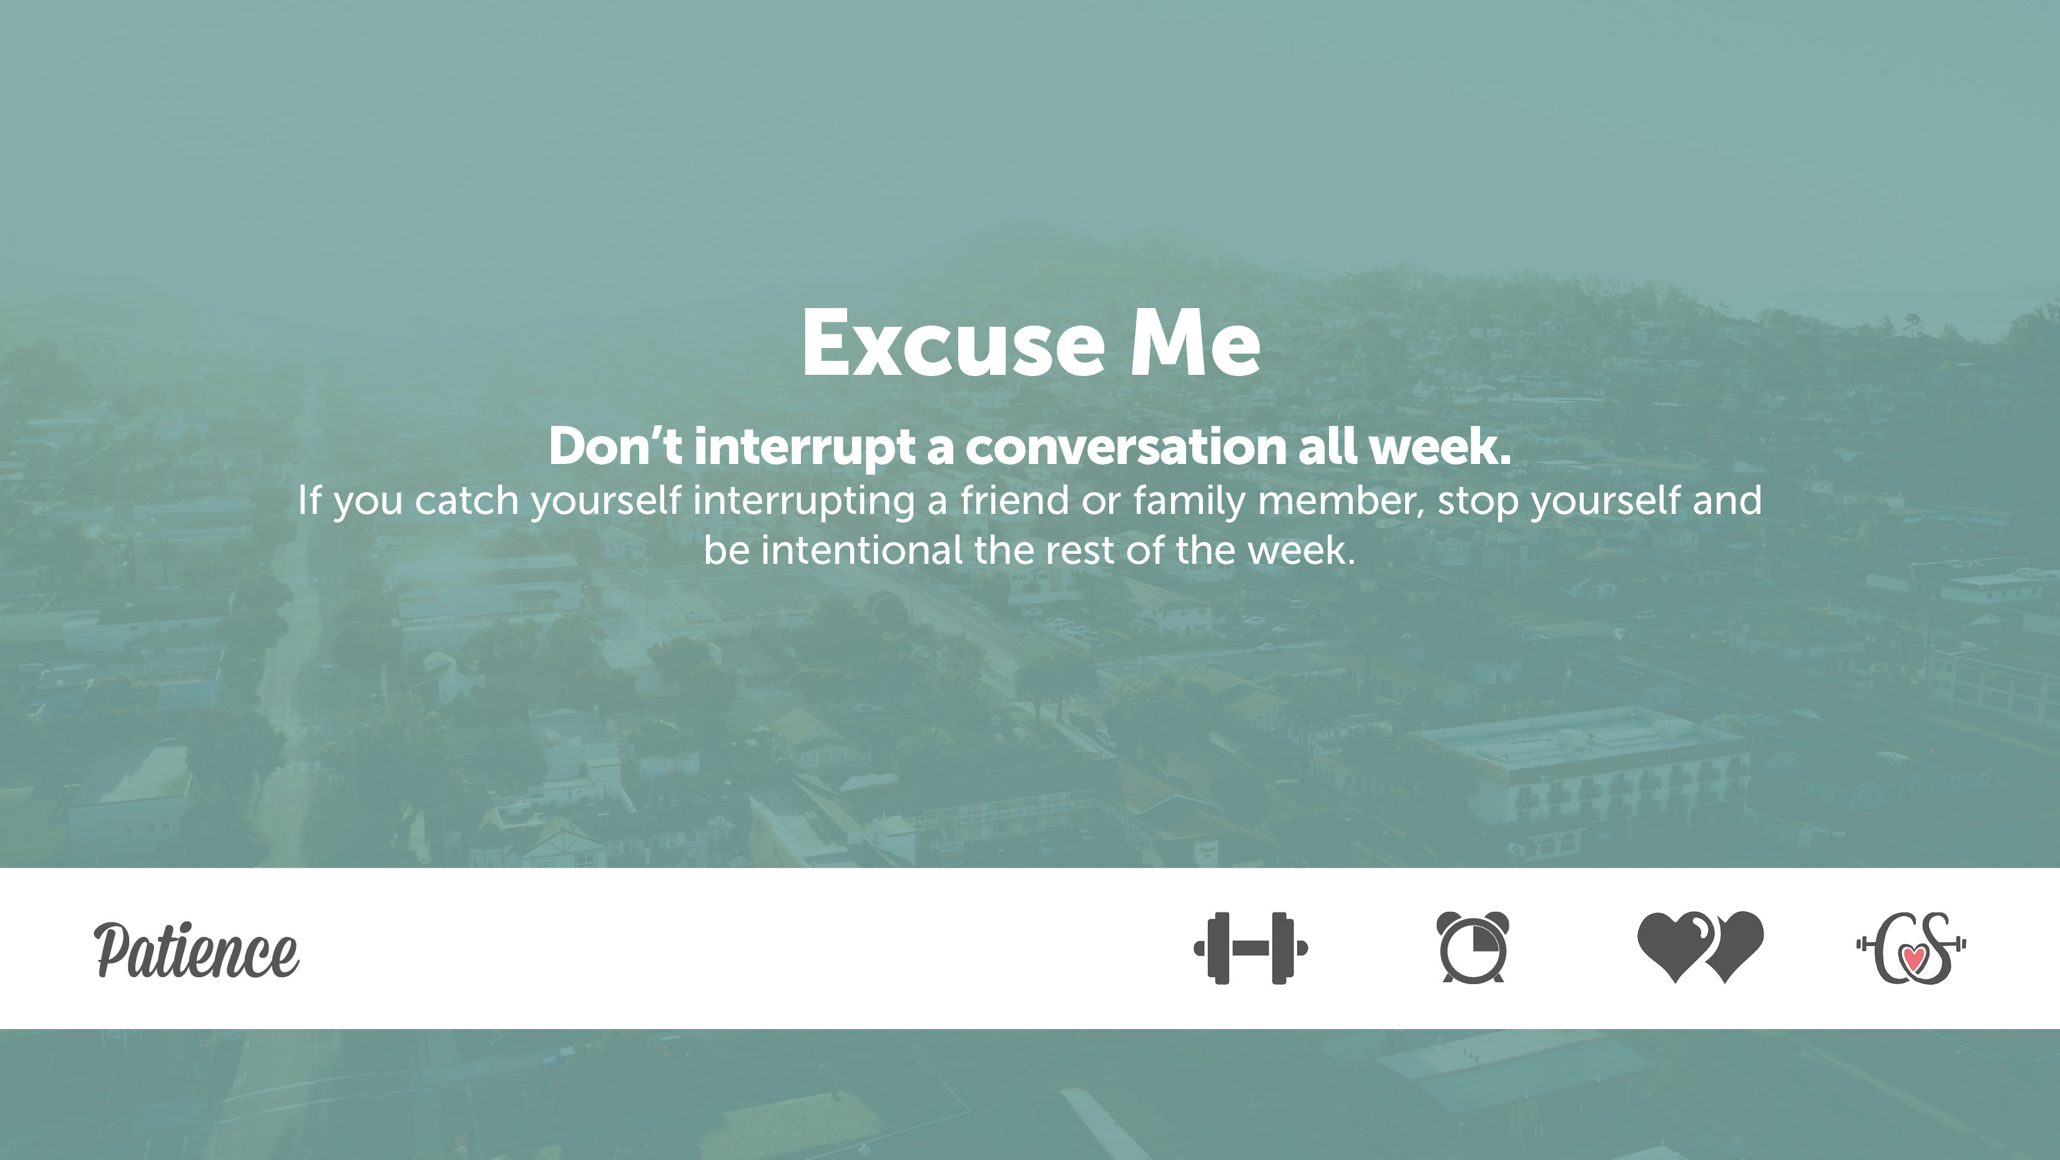
Objectives:
Students will reflect on their own character and identify ways they could improve it
Students will present a 30 second speed, becoming more self-confident when speaking and sharing in front of their peers.
Students will develop empathy for their peers by learning about what in their lives are meaningful and important
Character Dare:
Last week’s Character Dare
Turn and talk with a partner about last week’s dare
TRUTH: What do you think about last week’s Dare?
Dare: Reflect on your experience with last week’s Dare

Slide 2
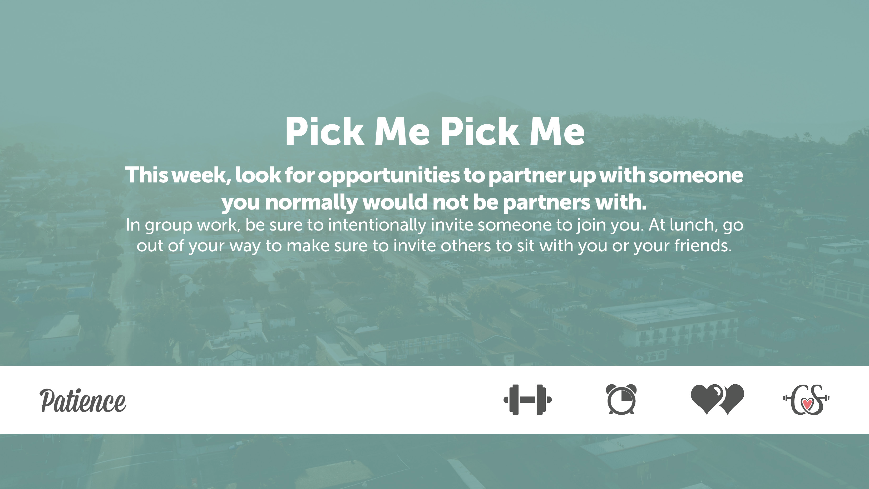
This Week’s Character Dare

Slide 3
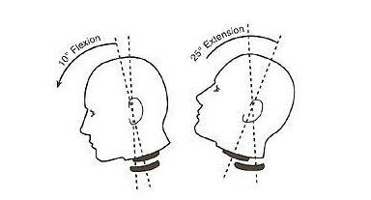
Today, we will share our 30-second speeches about the objects that are most important to us. First we will go over expectations of the audience.
What does good listening look like?
(S.O.F.T.E.N)

Slide 4
S.O.F.T.E.N.
S- Smile or Serious
O- Open Posture
F- Forward Lean
T- Time or Touch
E- Eye Contact
N- Nod in Agreement

Slide 5
To be fully engaged and good listeners, you should not have cell phones, laptops or earbuds.
Respectful means no giggling or laughing at inappropriate times, making sure we clap when the speaker is finished, and remaining attentive towards the speaker when he/she is up front.

Slide 6
We will do an individual rehearsal before we present in front of the entire class. Take the next to minutes to share your 30-second speech with a partner as a warm-up before we say them to the whole class
Now we will begin presentations

