Slide 1
Washoe County School District: Lesson 2- Bullying/Cyberbullying & Online Safety

Slide 2
Lesson Objectives
Our objectives for today’s lesson:
To identify bullying behavior in person and online
To promote online safety
To recognize the harm to the victim, harasser, and to society
To promote empathy toward victims of bullying

Slide 3
Shared Agreements
We can be different
We can talk differently
We have the right to be ourselves
We will respect the opinion of our peers even if we don’t agree
We may see things differently than someone else
We will honor the differences each of us brings to the lesson

Slide 4
Shared Agreements Cont.
We will respect the confidentiality of others - What is said here stays here - what is learned here leaves here
We will listen with open ears
We will use respectful language. We avoid teasing, name calling, hitting, throwing shade (putting others down, etc.)
We will treat each other the way we would like to be treated
We will speak up if we see others being treated unfairly
We know that our differences make us interesting and unique
*These are examples- generally six to eight agreements will suffice- you may use any of the examples if appropriate.

Slide 5
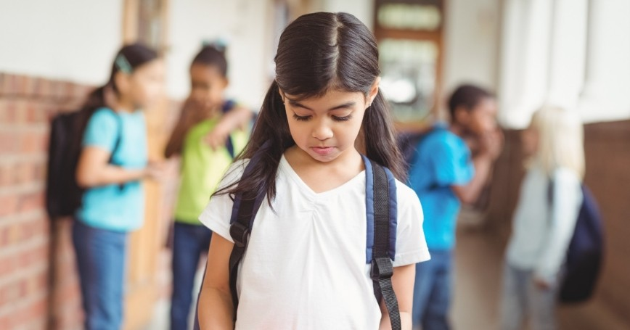
Opening Reflection
How does this statement apply to bullying?

Slide 6
Lesson Activity
Bullying Warning Signs- What bullies do?
What is your definition of bullying?
What is your definition of cyberbullying?
How can you stay safe online?

Slide 7
Bullying Definitions
What is Bullying? Definition: When someone does or says something intentionally hurtful, intimidating, or threatening and they keep repeating the behavior even after they are asked to stop (SafeVoice). | What is Online/cyberbullying? Definition: An aggressive, intentional act carried out by a group or individual, using electronic forms of contact, repeatedly and over time against a victim who cannot easily defend him or herself (Olweus Bullying Prevention Program, 2018). | How can you stay safe online? Possible options: Block the sender Don’t respond to messages Tell at least three people that cyberbullying is occurring (suggestion- tell 2 adults/1 peer) Change passwords/hide passwords and do not share with others Resist the urge to try to reason with the cyberbully
Facilitators: Read the definition. Point out the correct answers on the large sticky labels on the wall | Repeat this step with Online Bullying | Review this area in relationship to the student answers on the large sticky paper

Slide 8
Cyberbullying Activity
Looking at this visual, take a few minutes to jot down some of the ways that you have witnessed cyberbullying in schools and communities? How was the bullying done (i.e., in a chat room, via flaming, with a meme, through a text, with an avatar, Instagram, etc.)
Cyberbullying

Slide 9
What Bullying Really Looks Like

Slide 10
Closing Reflection
Popcorn Closing: (time permitting) Quickly share a word to describe how you felt about today’s lesson.

Slide 11
Check-in/Questionnaire
Complete Lesson 2 Questionnaire

Slide 12
Thank You!
www.msudenver.edu/weeac/

