Slide 1
Washoe County School District: Lesson 1- Introduction to Civil Rights and Me! You…Seeing Me Exercise

Slide 2
Lesson Objectives
Our objectives for today’s lesson:
To apprise students of where they can go if they need support in the District
To anchor the upcoming social-emotional work, and establish a culture of positive regard and safety
To lay the foundation for diversity, inclusivity, and acceptance

Slide 3
Shared Agreements
We can be different
We can talk differently
We have the right to be ourselves
We will respect the opinion of our peers even if we don’t agree
We may see things differently than someone else
We will honor the differences each of us brings to the lesson

Slide 4
Shared Agreements Cont.
We will respect the confidentiality of others - What is said here stays here - what is learned here leaves here
We will listen with open ears
We will use respectful language. We avoid teasing, name calling, hitting, throwing shade (putting others down, etc.)
We will treat each other the way we would like to be treated
We will speak up if we see others being treated unfairly
We know that our differences make us interesting and unique
*These are examples- generally six to eight agreements will suffice- you may use any of the examples if appropriate.

Slide 5
Closing Reflection Activity
Seeing Me….Seeing You
What do you think Seeing me…Seeing you means?

Slide 6
Lesson Activity
Lost on a deserted island

Slide 7
Reflection
Popcorn Closing: (time permitting) Quickly share a word to describe how you felt about today’s lesson.

Slide 8
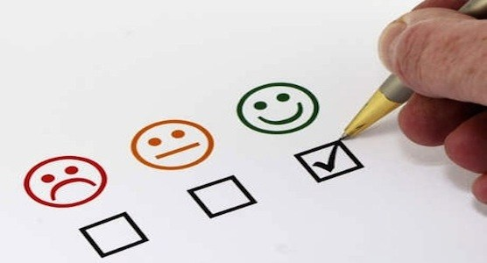
Check-in/Questionnaire
Complete Lesson 1 Questionnaire

Slide 9
Thank You!
www.msudenver.edu/weeac/

