Slide 1
Strength
I can explain my i-Ready Growth

Slide 2
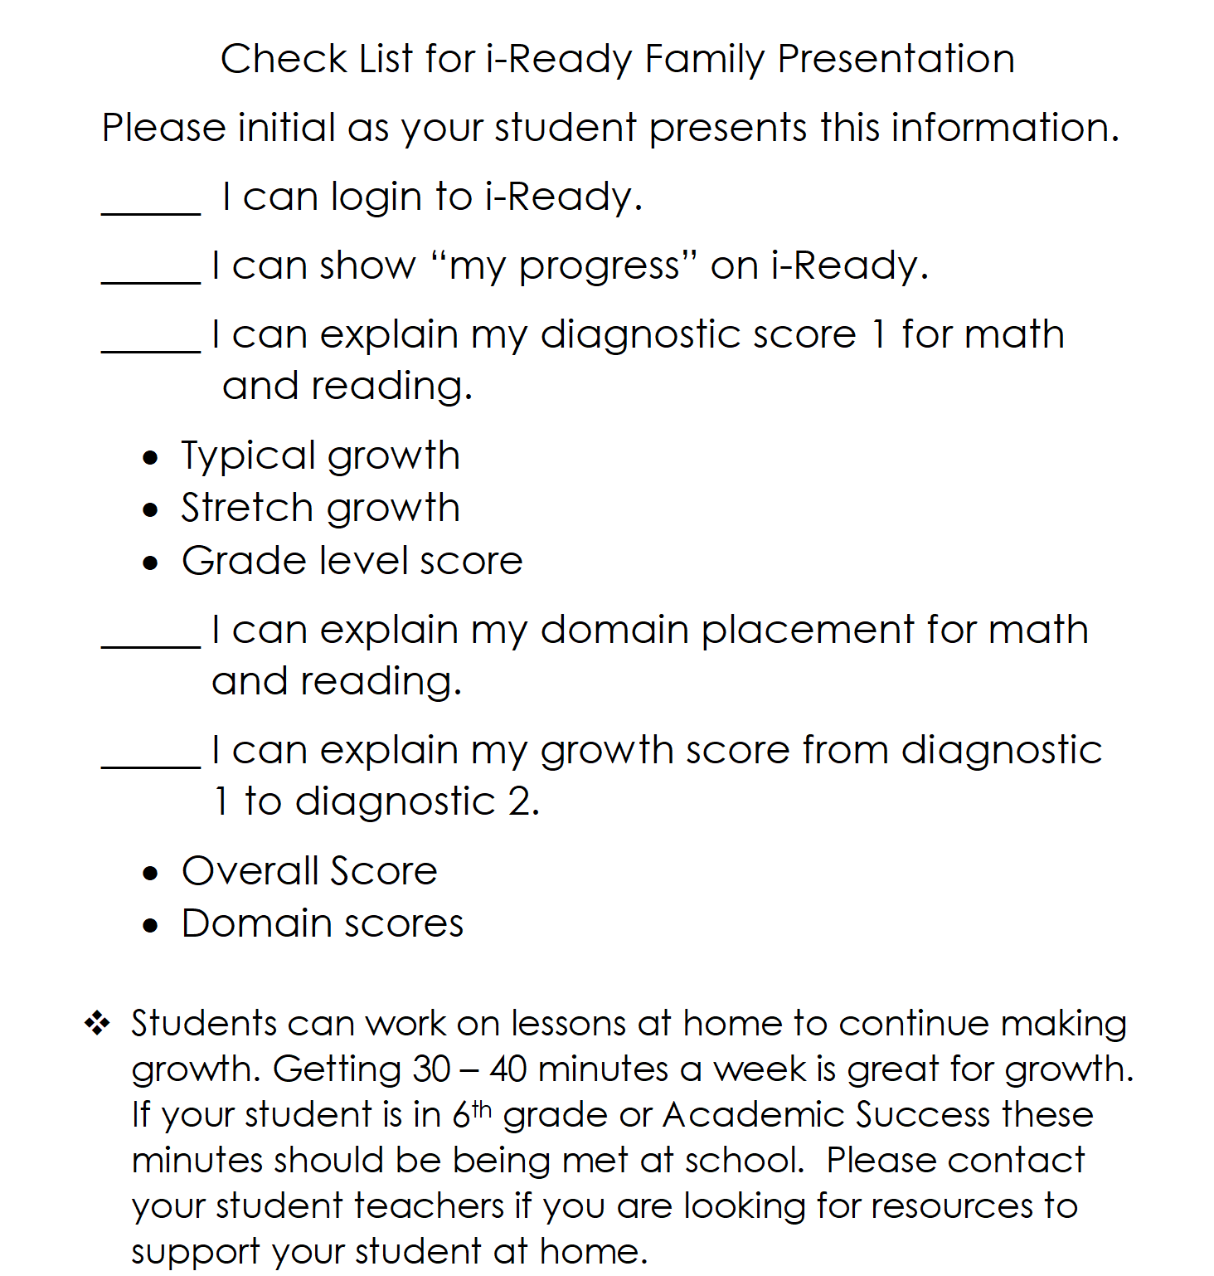
Sharing Your i-Ready Data
You will be sharing your i-Ready data with your families.
Today we will be going through what and how you will be sharing this information.
Please follow along on the “Check List for i-Ready Family Presentation”.

Slide 3
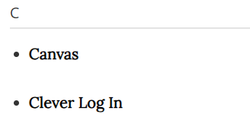
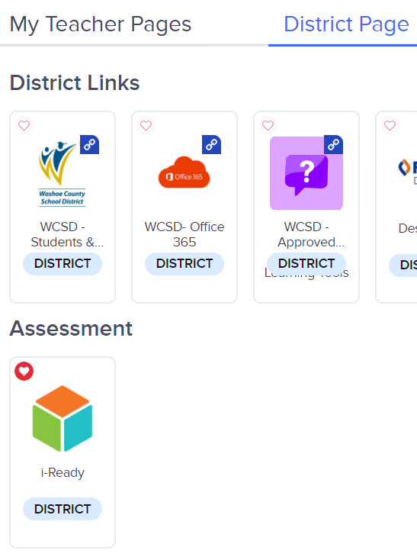
Do you know how to log in to i-Ready?
Go to WCSD website and click on students and parents
Scroll down and select Clever
Once in Clever select District page and
then under assessment select i-Ready

Slide 4
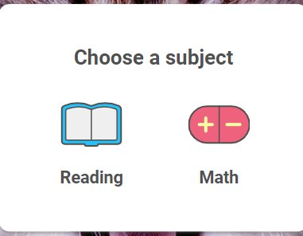
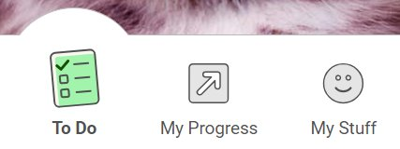
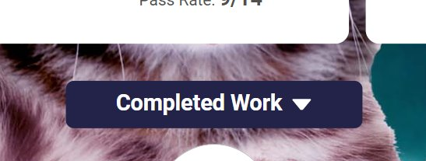
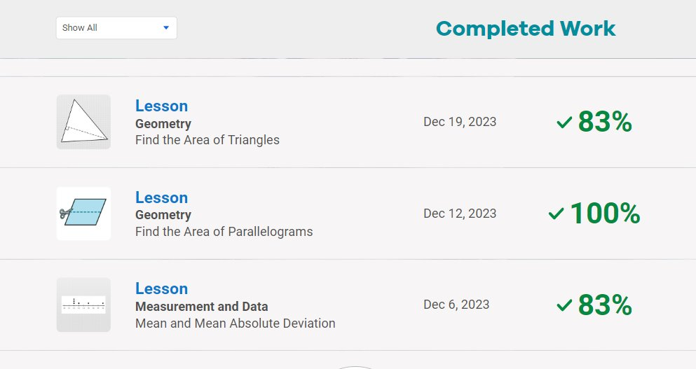
Do you know how to see your progress?
Step 2. Click
My Progress
Step 1.
Step 3: Click
Completed Work
Step 4: Scroll through

Slide 5
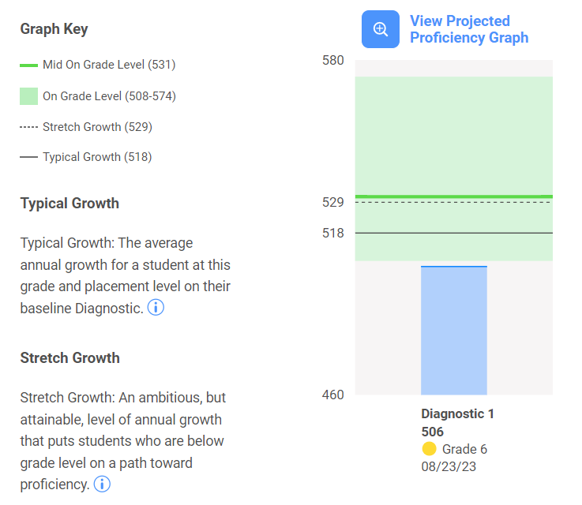
Do you know what your Diagnostic score means?
There are 4 scores on this part of your diagnostic that are important. 1) Diagnostic 1 Score
2) Your Typical Growth Goal Score
3) Your Stretch Growth Goal Score
4) Grade Level Score

Slide 6
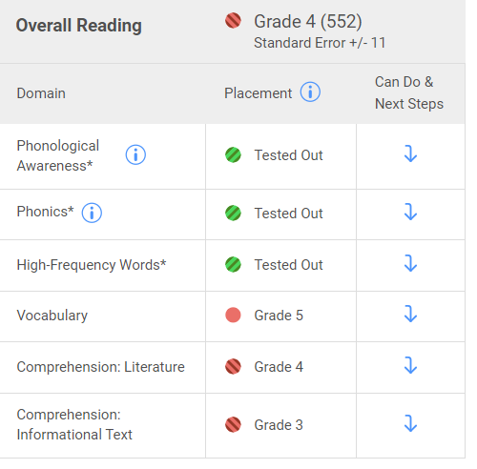
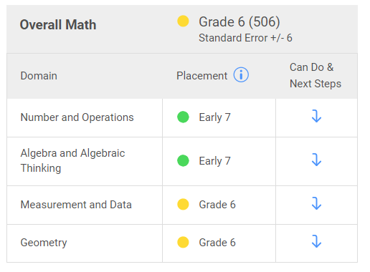
Do you know how you placed in each domain?

Slide 7
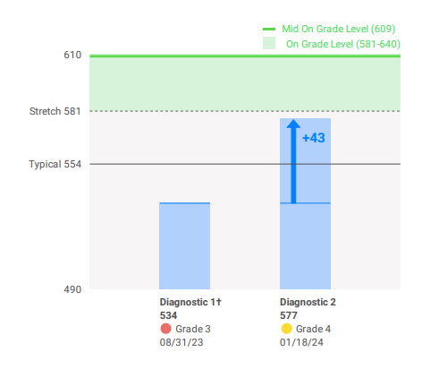
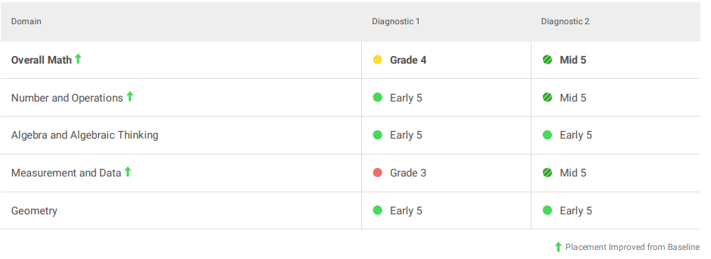
How much did you grow?
Your side-by-side scores let you compare you diagnostic 1 to your diagnostic 2.
You can even see which domains you grew in as well.

Slide 8
Check List for i-Ready Family Presentation
You will now take home your i-Ready data and share your growth with your families.
Return this completed check list by Thursday, February 8th for 3 STRIKE signatures in strength, responsibility, and knowledge.

