Slide 1
How to Get Started with Paper
Notes:
Welcome Teachers! We hope your utilize this presentation in a lesson when introducing students to Paper for the first time!

Slide 2
Own Your Learning!
Use Paper when you…
Need help writing a thesis statement.
Want to understand today’s lesson better.
Want feedback on your writing assignment.
Need support but your teacher is unavailable.
Are stuck on a homework problem.
Notes:
Teacher Talk Track
Paper is here to help you succeed! There are so many ways that you can use Paper’s live help and review center throughout the day in your classroom. If you are stuck on a HW problem or need help writing your thesis statement, you can start a live help session with a tutor who will be there instantly to collaborate with you.
If you want feedback on your written work, such as any type of essay, resume or college application, submit that to the review center.
Lastly, if you’re looking to understand today’s lesson or brainstorm ideas about a project, Paper tutors are here to support you!
Paper is also great for when you need feedback or support, but I am busy with another student or it’s after school hours.
Paper encourages you to Own Your Learning and use the platform how it will most benefit you!

Slide 3
Logging Into Paper
Go to app.paper.co
Search for your school
Login with your school info
Notes:
In this section you and your students will explore how to log into Paper, how students complete their profile when logging in for the first time, and a look at their Student Dashboard.

Slide 4
Tablets or Mobile Devices?
Notes:
A two-screen experience: Students often work from two devices simultaneously. For instance, they may complete an assignment on their laptop while quickly researching questions online from their phone. Paper’s easy-to-use app helps students get this kind of quick mobile support whenever they need it.
Instant updates: Students can get real-time updates on their essay submissions via push notifications or quickly message a tutor with a question if they prefer phone- and messenger-based communication.
Equitable access: Paper’s app provides support for students who don’t have ready access to a laptop or desktop. It meets students exactly where they are—whenever they need extra help

Slide 5
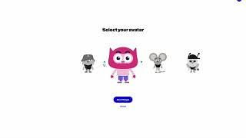
Getting Started: Learner Profile Set-Up
Notes:
A two-screen experience: Students often work from two devices simultaneously. For instance, they may complete an assignment on their laptop while quickly researching questions online from their phone. Paper’s easy-to-use app helps students get this kind of quick mobile support whenever they need it.
Instant updates: Students can get real-time updates on their essay submissions via push notifications or quickly message a tutor with a question if they prefer phone- and messenger-based communication.
Equitable access: Paper’s app provides support for students who don’t have ready access to a laptop or desktop. It meets students exactly where they are—whenever they need extra help

Slide 6
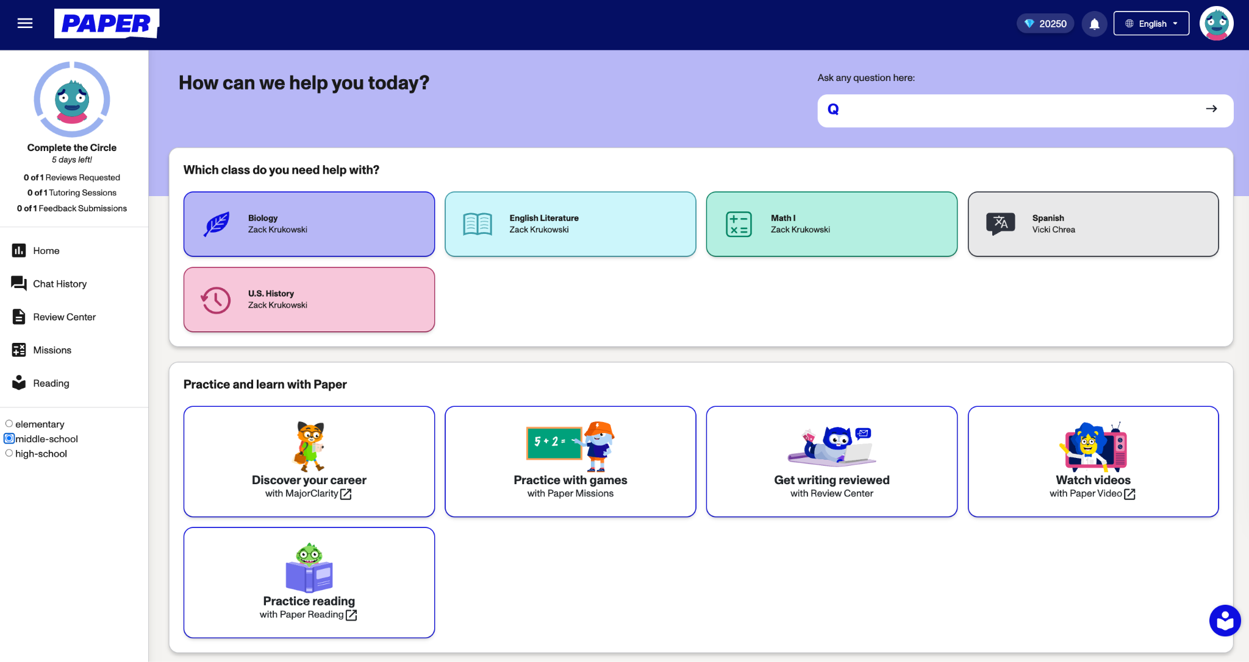
Your Student Dashboard
Language Preference
Change the language on the platform using this dropdown
Achievements
Complete weekly challenges to earn trophies, points, and badges
Live Help
Get help from a Tutor!
Major Clarity
College and Career Readiness Tool
Paper Reading
Reading Fluency Practice
Paper Missions
Interactive math practice
Review Center
Upload a written piece of work and receive feedback
Paper Videos
Educational video lessons
Notes:
Teacher Talk Track
This is what students will see each time they log in to Paper.
First, students can adjust their platform language using the drop down at the top of the screen.
On the left hand side (click) we have the Achievements section where students can earn trophies, points, and badges for completing weekly challenges. You can see your earned badges by clicking the avatar in the upper right hand corner then clicking profile.
Next (click) we have our live help section. Students can ask questions related to topics they have learned in their classes three different ways. They can use the question matcher at the top, choose a class/subject then click the chat with a tutor button, or click chat with a tutor on the side menu for more general questions. Let’s say we clicked on the math class, the chat with a tutor - within 30 seconds you will be paired with a tutor.
Below that (click) is Paper Missions, providing students with a better, more fun way to practice math outside of the standard pen and paper approach.
Then, (click) there is our review center where students can upload a pdf or document to receive feedback.
(Click) Paper Videos houses recorded lessons of various topics created by educational content experts that can be watched individually or as a whole class.
(Click) We also have Paper Reading, where students can practice their reading fluency with online texts.
Lastly, (Click) we have MajorClarity where students can explore college and career options.

Slide 7
Using Live Help
Notes:
In this section you and your students will explore how to start a conversation with a Tutor, the different features in the Live Help, and examples of good questions to ask your tutor!
There is also an opportunity to practice using the Live Help with your class!

Slide 8
What to know before getting started…
Notes:
Paper’s Live Help tutors are REAL PEOPLE! There are a few important things to remember before starting a session with one of them. Let’s hear what this Paper tutor has to say about the Student Code of Conduct!
*Play video.

Slide 9
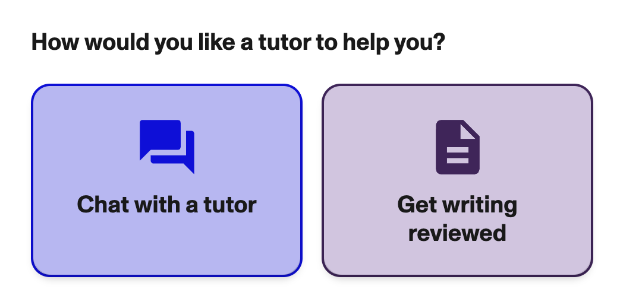
Start a Conversation!
There are 2 ways to start a conversation with a Tutor using Live Help!
1
Type your question and get matched with the right tutor!
Select the subject you need help with and click “Chat with a tutor”
2
Notes:
There are 2 ways to begin a Live Help with a Paper Tutor. All of them will get you connected to a Tutor within 30 seconds.
The question matcher which allows you to type any question and get matched with a tutor in the appropriate subject area.
Using the subject tiles, then clicking Chat with a tutor.

Slide 10
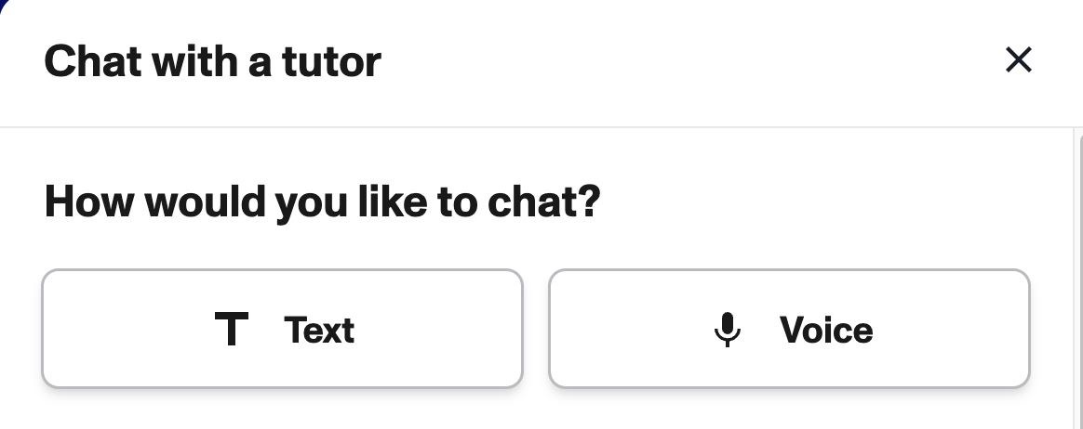
Choice: Text or Voice
Text will allow you to type out messages to the tutor. Voice will allow you to both type and record audio messages to the tutor.
Notes:
You will have the choice between typing messages or having the option to send audio messages with your tutor! Make your choice, then be connected with your tutor in under 30 seconds.

Slide 11
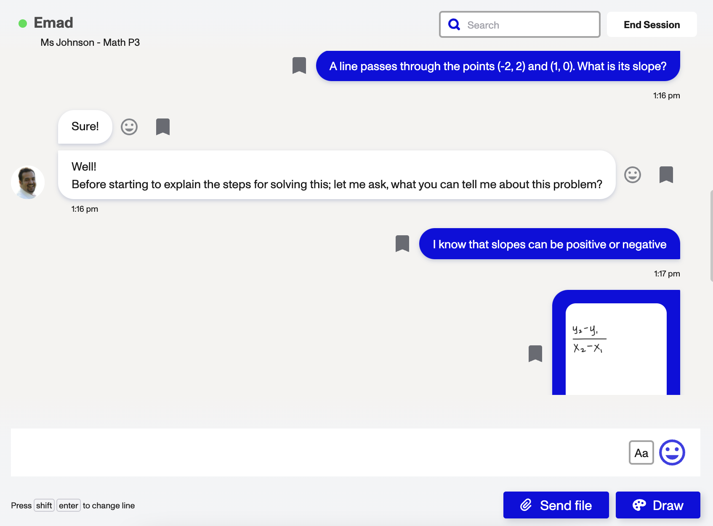
Features in Live Help
React to a Message
- Click the play button to have the text read aloud.
- Bookmark the comment for easy access at a later time.
- Respond with an emoji.
End Your Session
Start a Session
You can either…
1. Type out your question.
2. Click the microphone icon for Voice Notes.
3. Click the sound wave icon for Speech to Text.
Tools to Show Your Work
- Use the camera to send a picture of your work.
- Share a file or screenshot.
- Draw or record a video on the whiteboard.
Symbols Keyboard
Use the symbols keyboard to send equations.
Notes:
Teacher Talk Track
This is an example of a live help with a tutor, Emad- as you can see, the live help looks similar texting or sending media on social media, so let’s take a look at some of the features
(CLICK) The bottom box is where students are able to type out a problem or prompt.
The microphone can be used to record a full audio message of the student speaking out their question or problem. The sound wave icon should be used for speech to text if you don’t want to type everything but still want your message written out on the screen.
(CLICK) You can take and send a picture of your work with the camera button, upload and send a file like pdf or screenshot of your work, or draw on a collaborative whiteboard.
(CLICK) To send equations, you can use this keyboard for advanced functions and symbols.
(CLICK) If students want help reading the message from the tutor, they can press the play button. Emojis can be used to react to things the tutor has said, thumbs up for agreement and a question mark for confusion) and bookmark any messages that you will find useful to review in the future by hovering over the messages! All of the interactions with tutors are recorded and available in students’ history, so you will always be able to come back to it to review your sessions.
(CLICK) Once you received the help you needed and finished with the session you can end a session. You will be prompted to provide some feedback on how they enjoyed the session, and return to their dashboard.

Slide 12
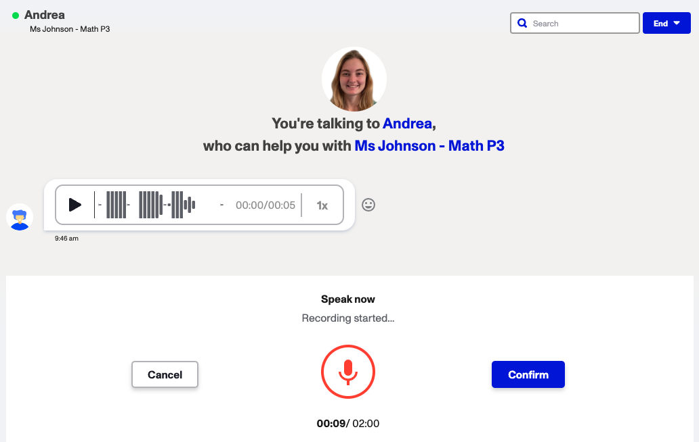
If you chose Voice…
Notes:
Listen to audio messages your tutor sends you by clicking the play button on the message they have sent.
To record your own response, click the microphone and speak. When you are finished, click confirm. Then, send your message.

Slide 13
Sentence Starters to get the conversation going:
Can you help me write a hypothesis?
Will you walk me through how to solve my math problem?
How do I structure an essay?
Can you help me understand what happened during a historical event?
Will you help me study for my upcoming test?
I need help brainstorming ideas for my writing assignment.
Check out more Sentence Starters here!
Notes:
Sometimes it’s hard to start conversations with people online, but our tutors remove all the pressure! They may even say hi first!
Review with your students the right and wrong ways to communicate with a Paper Tutor.
Teacher Talk Track:
You are encouraged to bring a specific question to their tutoring session, instead of asking for generic help with a subject.
Tutors reinforce and reiterate what you have learned in class. They will not provide new lessons or instruction to you. Be patient as they will push your thinking!
Paper Tutors are friendly and want to help you succeed. Please be respectful throughout the conversation.

Slide 14
Try it out as a class!
Follow along with your teacher as they log in to their dashboard and begin a Live Help session with a Paper Tutor.
Help your teacher decide on a friendly conversation starter and a clear question to ask!
Then work as a group to respond to the tutor and find the answer.
Notes:
Some students may feel pressure to start a session, but when you model it in your classroom, these same students can see how easy it is to connect with a Paper tutor.
Login to Paper with your Teacher account and start a Live Help with a tutor. Ask your students to provide you with ideas on how to start the conversation and interact with the tutor as a class with prompts from your students.

Slide 15
Using Review Center
Notes:
In this section you and your students will explore how to submit their writing assignments for tutor feedback.

Slide 16
Review Center
Upload Your Work
Select a file from your computer or upload a file from Google Drive
Notes:
Teacher Talk Track
Click on the Review Center then click “Upload new work”
Now we are going to take a look at the Review Center. In this stage, we are going to practice uploading a new writing piece. This is the screen you will see when you click “Upload new work”
They can upload written work by browsing their device for a pdf or Word document or by connecting their Google Drive and choosing a pdf, Google doc or Google slides from there.

Slide 17
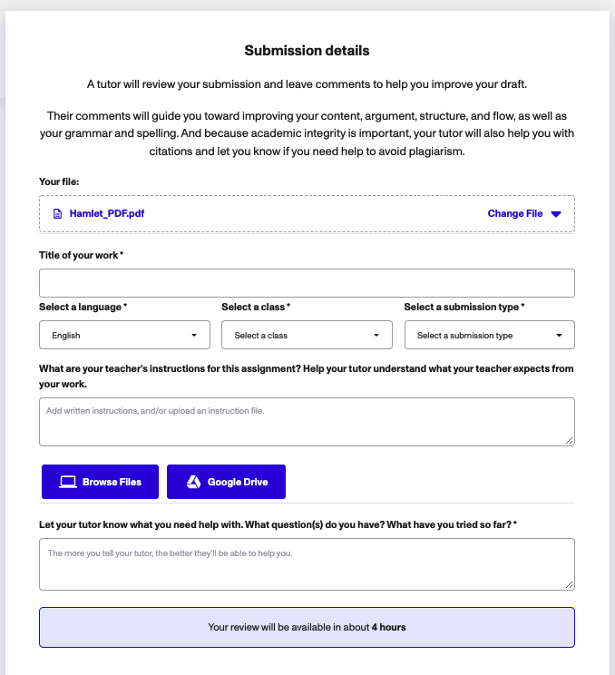
Title
Type the title of your written work
Select a Submission Type
Choose what kind of submission you are uploading
Change Language
Is your paper written in English, Spanish, or French?
Add Instructions and Rubric
(optional, up to 3)
Include your teacher’s instructions and rubric for the assignment
Select a Class
Choose the course the written work is for
Questions You Have
Ask your tutor to focus on specific skills you want to work on
Return Time
Here you can see how long it will take to receive your feedback from the tutor
Notes:
Teacher Talk Track
After you upload your work, students can answer a couple of questions to give your reviewer more guidance to provide better feedback.
Students can see their file at the very top of this page, (click) followed by a space to type the title of their work.
(click) Students can select the language the written work is in and the course they are submitting it for. (click)
Students will also choose what type of submission they are uploading.
(click) MOST IMPORTANTLY, they can upload a copy of the teacher’s instructions or rubric. This allows our essay reviewers to provide feedback that is closely aligned to what the teacher is looking for. We get a lot of teachers concerned that the feedback reviewers provide will not be what they want. With these instructions and rubrics, the feedback we’ve received has been spot on! So say goodbye to reading first drafts and hello to time saved!
(Click) If there is anything specific you would like for the tutor to focus on within your writing, you can type that in this box at the bottom of the page.
(Click) At the very end, you will see the amount of time it will take to receive your assignment back with feedback.

Slide 18
Using Paper Reading
Notes:
In this section you and your students will explore how to practice fluency on Paper Reading. Complete a teacher-assigned reading or choose your own text for a free read!

Slide 19
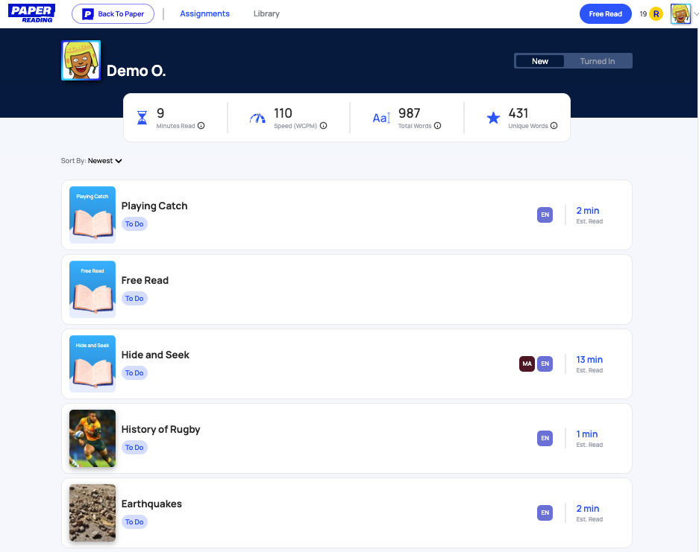
Getting Started
Student Library
Select a pre–created story from the library to read aloud
Free Read
Choose any book you want and read aloud
Back to Paper
Head back to your Paper Student Dashboard
New Assignments
Find your reading tasks that you have been assigned
Reader Data
Personalized Reader Statistics that update after you read
Turned In Assignments
Find your completed reading tasks
Notes:
Teacher Talk Track
This is the student’s dashboard on the Paper Reading Platform
(Click) On the first screen of the dashboard, students will see the New Assignments created and assigned to them by their teacher. Students will click on the Assignment they want to complete. (Click) They can also view any assignments they have already completed and submitted by clicking the Turned In tab. (Click) As you complete more reading tasks, you will see your personalized reading results and data update! Reader Data is a great track of your reading growth and progress. (Click) In addition to completing assigned reading tasks, students also have to option to complete a Free Read. This allows students to pick up any digital or print text they want to read and receive personalized feedback. During this task, students can read aloud, and will answer an summative comprehension question.
(Click) Lastly, students have access to a Student Library that allows students to a text to read aloud. These can be filtered by grade band, so students can select a text to read that is appropriate for their reading level. The student library is great for independent reading and reading at home.
(Click) For students to return to their Paper Student Dashboard, click the Back to Paper button. Next we will take a deeper look at completing these different assignment types and highlighting the features available to students!

Slide 20
Completing an Assignment
Step 1
Choose your Assignment
Select the reading task you want to complete.
Notes:
Teacher Talk Track
To start an assignment, students will first select the assignment they want to proceed with completing.

Slide 21
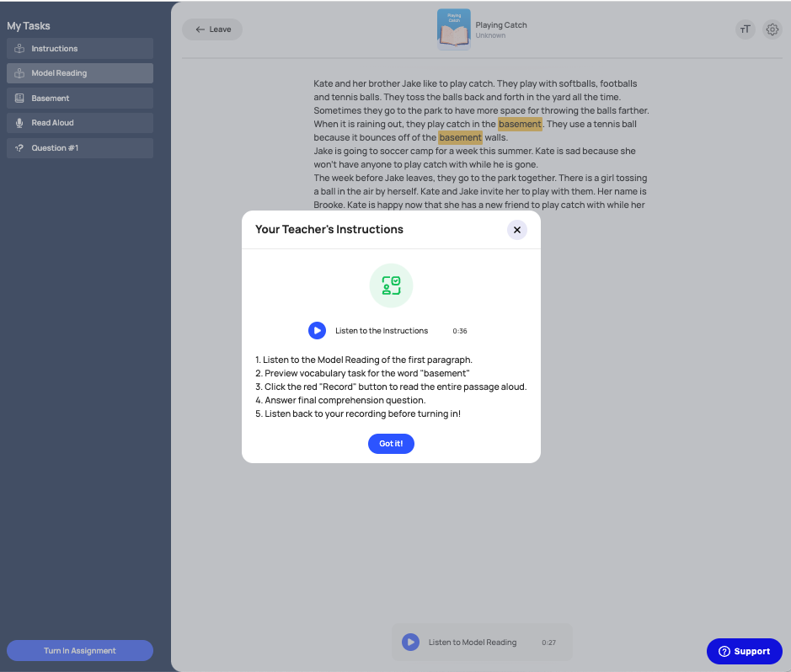
Completing an Assignment
Step 2
Listen to the Instructions
Press the Play button to listen to your teacher’s instructions aloud
Read the Instructions
Read through the task’s instructions to ensure to you complete all steps
Notes:
Teacher Talk Track
When you start a new reading task, the assignments instructions will appear first. (Click) Read through the instruction to make sure you know to complete all aspects of the assignments before turning it in. (Click) If you teacher recorded directions to you to listen to, you can do so by clicking the Play button!

Slide 22
Model Reading
Listen to Model Reading
Press the Play button to listen to a Model Reading of the Passage
You can pause, rewind or jump to a specific part of the reading to listen.
Notes:
Teacher Talk Track
Model Reading is available when your teacher has recorded themselves reading the passage, or a portion of the passage aloud. This can be helpful for the reader to hear appropriate pronunciation, intonation, and speed. (Click) To listen to a Model Reading, click the Play button at the bottom. (Click) As you listen you are able to rewind, pause, jump forward and relisten to the recording using the controls at the bottom.

Slide 23
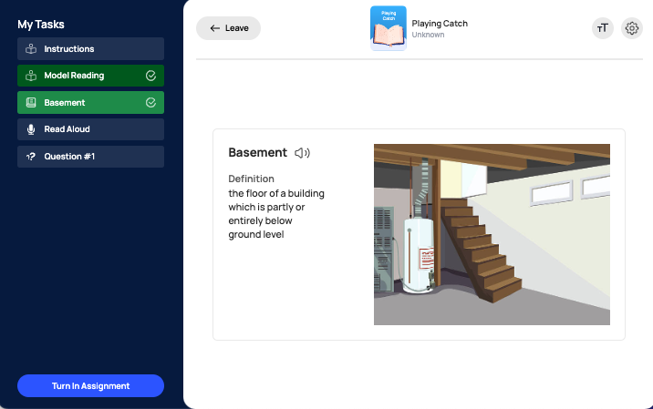
Preview Vocabulary
Preview Vocabulary
Read the definition, listen to the pronunciation aloud by clicking on the Speaker button, and view a picture to help understand.
Notes:
Teacher Talk Track
If there are terms in your passage that your teacher feels you may need support you, they can create an “Preview Vocabulary” task. You will see the definition to the word, can listen to the pronunciation by clicking on the speaker, and view an image your teacher included to provide more understanding.

Slide 24
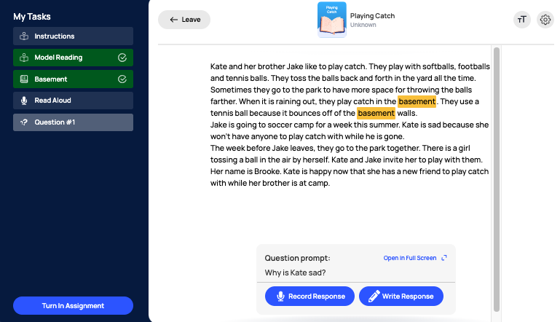
Comprehension Questions
Response Type
You have the choice to record your answer aloud or type it.
Comprehension Questions
After reading the passage, answer assigned comprehension questions.
Notes:
Teacher Talk Track
Another task that may be a part of your assignment answering Comprehension Questions. Teachers can assign one or multiple comprehension questions as part of a reading assignment. (Click) Students will see assigned Comprehension Questions located at the bottom of their passage.
(Click) Students have 2 different methods they are able to answer the comprehension questions.
They can either “Record Response” which allows them to verbally answer, and the teacher can listen back to their response.
The other way is “Written Response” which means students can type their answer.
Depending on the preferences of the teacher, the students often have the ability to choose whichever method works best for them.

Slide 25
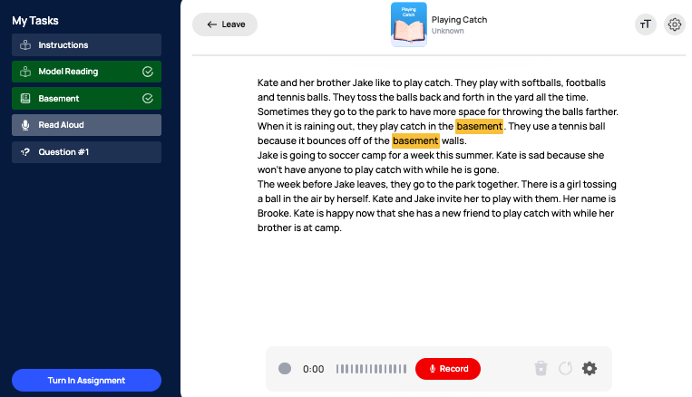
Reading Aloud
Recording
As you record you will see a green volume indicator, the length of the recording so far, and the ability to Pause the recording. You will press Pause when you are also finished recording
Read Aloud
Press the Record button to record yourself reading the passage aloud. You will get a 3 second countdown before you begin!
Finalize Recording
After you Pause your recording, you can press Play to listen back, Continue recording the passage, or Start Over
Notes:
Teacher Talk Track
Paper Reading allows students to record themselves reading aloud. (Click) At the bottom of a passage they will see the Read Record button, and once they click the button a 3 second countdown will appear. It is recommended that students read in a quiet spot or use headphones with a microphone so their reading is a as clear as possible.
(Click) As they are recording, they will see the time stamp showing how long the recording is for. If you want your students to stop recording at a specific time, they will see it at the bottom.
The green bar shows the volume of the students’ reading, the more the green bar shows the louder the student is reading. This helps to ensure students know how well their voice is being heard.
Lastly, whether the student is finished with the recording or just needs to break, they will click the Pause button. After they click the pause button they will see more recording options pop up.
(Click) After they pause, students can relisten to the recording, continue with their reading and recording, or delete the recording and start over.

Slide 26
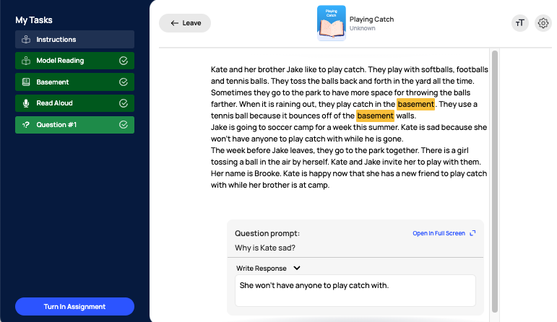
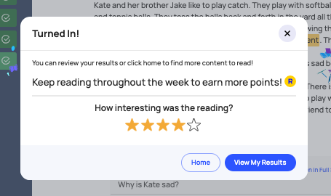
Turn In an Assignment
Rate your Reading Select the number of stars to reflect how interesting the reading was
Turn In Assignment
Press Turn in Assignment when you are complete
View My Results
See your immediate data driven feedback from the assignment!
Notes:
Teacher Talk Track
The final step is to Turn In the Assignment with the blue button in the button right hand corner. (Click) (Click) The student will then be prompted to provide their feedback on their interest level of the reading. This helps the teacher to know and analyze student and class interests on certain books or readings. The student will also be able to see their results and interest of read alouds, which is helpful when choosing future texts.
(Click) Lastly, students can either return home to their Paper Reading Dashboard, or click View My Results to receive immediate feedback and results on their reading.

Slide 27
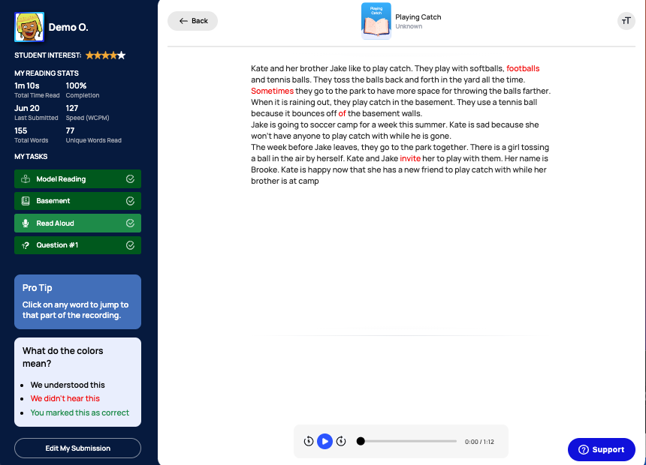
Viewing Your Results
Reading Stats
See the details of your reading, like how long you read, how many total worlds you read, and the percentage complete!
Miscues
See the words or phrases you missed when reading! If they are marked in red, it means they were not heard in your recording
Back
Click to go to your Dashboard
Recording
Listen to your recording to hear your fluency, intonation, and to reflect on your reading!
Notes:
Teacher Talk Track
One of the amazing features of PAper Reading is that students get immediate feedback on their reading. (Click) They see their Reading Stats from that passage, include Words Correct Per Minute, the percentage read, length of time read, and total words read. (Click) In the main passage, students see their miscues marked in red. Students can analyze the miscues from the passage the better practice for next time. (Click) To reflect on their expression, fluency, and prosody students have the option to listen back to their recording to reflect on their reading.
(Click) Students click back to return to their dashboard.

Slide 28
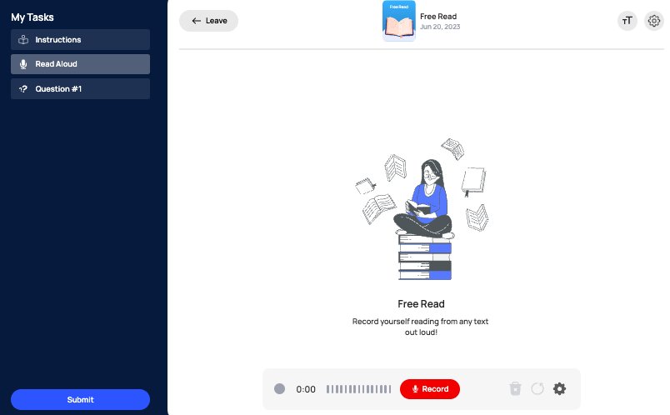
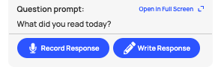
Free Read
Free Read
Select any book, digital or print to read aloud
Comprehension Question
Tell about what you read about.
Record Record yourself reading your text aloud
Submit
Notes:
Teacher Talk Track
In addition to teacher assigned reading tasks, students also have the opportunity to to select their favorite digital or print text to read aloud through Free Read. (Click) Just like with any other reading assignment students have the opportunity to record their reading any any text. (Click) Students will record their read aloud at the bottom and pause it when they are finished. (Click) After reading students will summarize what they read, through a written or recorded response.
(Click) Students submit when they are finished.

Slide 29
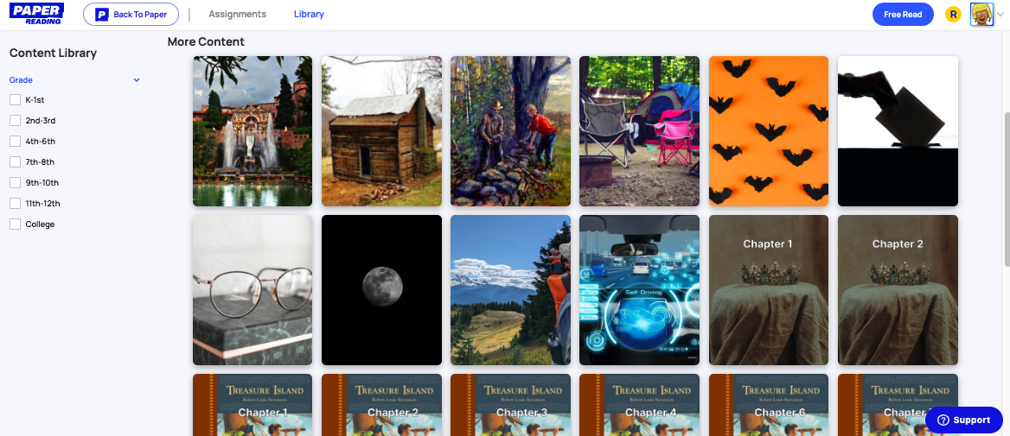
Read from the Student Library
Library
Select a text to read from the Student Library
Click a Story to Read Aloud
Filter by Grade Level
Notes:
Teacher Talk Track
Paper Reading also provides students access to a variety of digital texts through the student library. Students click “Library“ in their top bar. (Click) Students then see a variety of books and texts available for them to read aloud. (Click) They also have the option to filter down based on their grade level to select more appropriate texts for their abilities. (Click) When they find a text they like students simply click the reading and are prompted to begin an assignment

Slide 30
Using Major Clarity
Notes:
In this section you and your students will explore how to use MajorClarity.

Slide 31
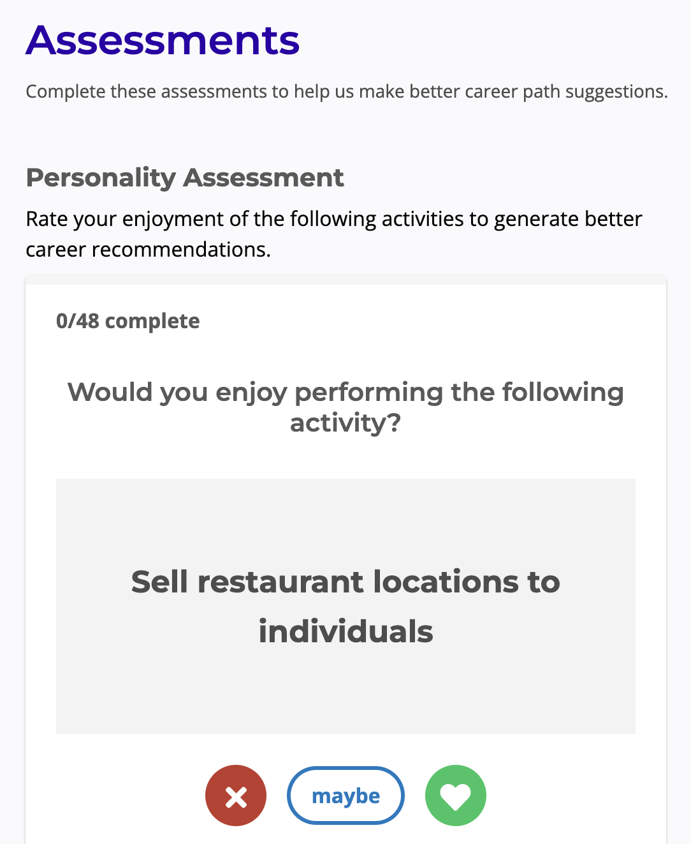
Start by filling out your Personality Assessment
Question Responses
Respond to each question as it appears by disagreeing, staying neutral, or agreeing.
Notes:
When you log in to the MajorClarity for the first time you will be prompted to fill out a Personality Assessment. Use the response options underneath each question to answer the way that best matches your feelings.

Slide 32
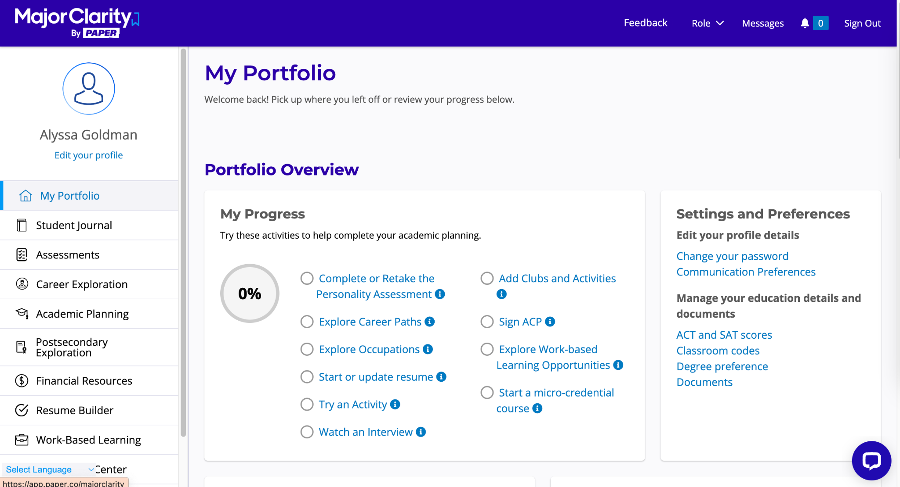
Student Name
My Portfolio
Keep track of your activity and progress within MajorClarity.
Assessments
Take a Personality or Learning Style Assessment.
Career Exploration
Learn about various career paths with interactive resources.
Postsecondary Exploration
Learn about college opportunities you’re interested in.
Resume Builder
Get help with creating/writing a resume.

Slide 33
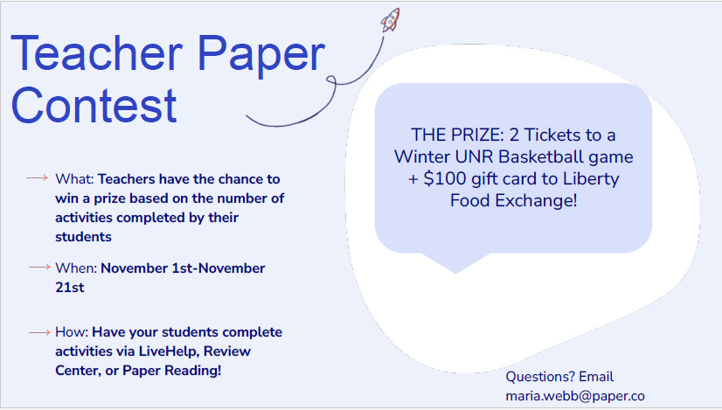
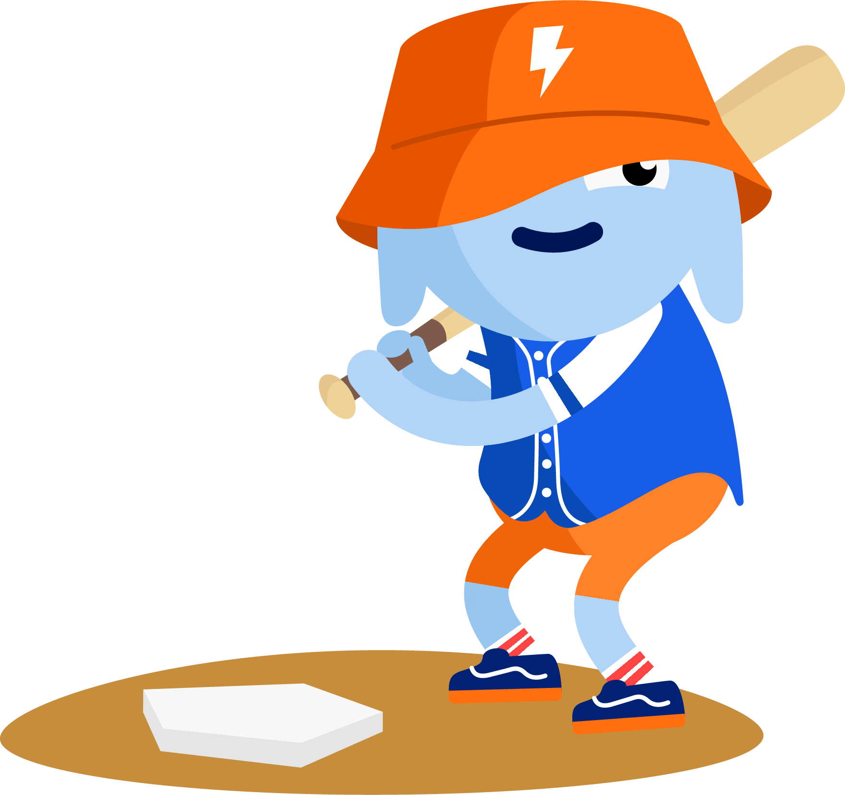
Try it!
Notes:
Utilize Paper in the classroom and win a contest!!

