Slide 1
Depoali Procedures & Expectations Review
Fall 2023

Slide 2
In your advisory notebook or on a separate piece of paper create a 5x5 grid (like below).

Slide 3
Depoali Procedures and EXPECTATIONS Review BINGO
Today we will be reviewing our school’s procedures and routines.
Fill in your grid with words or phases that are apart of our procedures and routines at Depoali. For example, one square on your grid might have the words “S.T.R.I.K.E. Matrix”.
As you listen to today’s review you will mark each square you get on your grid.
You will earn signatures for “bingos” as we review.

Slide 4
Turn to your neighbor or group and tell them what the S.T.R.I.K.E. matrix is.

Slide 5
What is S.T.R.I.K.E.?
S. T. R. I. K. E. is our school-wide behavior plan with guiding principles that help us in our choices and actions. These guiding principles can help you determine your goals and values.
We use the S. T. R. I. K. E. matrix to help create a positive, predictable and consistent safe learning environment for all students.
The teachers and staff at Depoali Middle School will be teaching and reinforcing these guiding principles throughout year.
You will participate in reflection assignments and activities to help you build you character and reinforce your values through the guiding principles in the S.T.R.I.K.E. matrix.

Slide 6
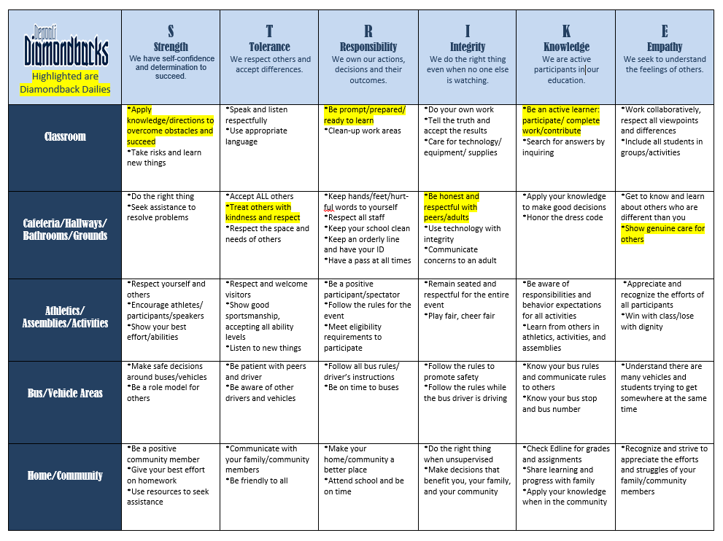
On page 10 in your planner, are your Diamondback Dailies. These are actions you can take everyday to help create a positive and safe learning environment for all students.

Slide 7
So, what does this mean for you?
Teachers and ALL staff members will be on the lookout for students who are meeting the expectations of S. T. R. I. K. E.
Signatures may be earned in each area of the matrix where you are meeting the expectations.
Your goal is to earn at least five signatures a week.
You can earn one signature a week from your families for meeting your home goal.
Signatures will be totaled each Monday and recorded during Advisory class.
For every 10 signatures you earn weekly you will receive one raffle ticket to be entered in a random S.T.R.I.K.E. drawing.
Signatures are required for all mid and end of quarter rewards.
We will be having our first end of quarter reward this Friday, October 13th.

Slide 8
As we all work to demonstrate this guiding principles it is essential, we all follow our school-wide policies and procedures.
Let’s Review!

Slide 9
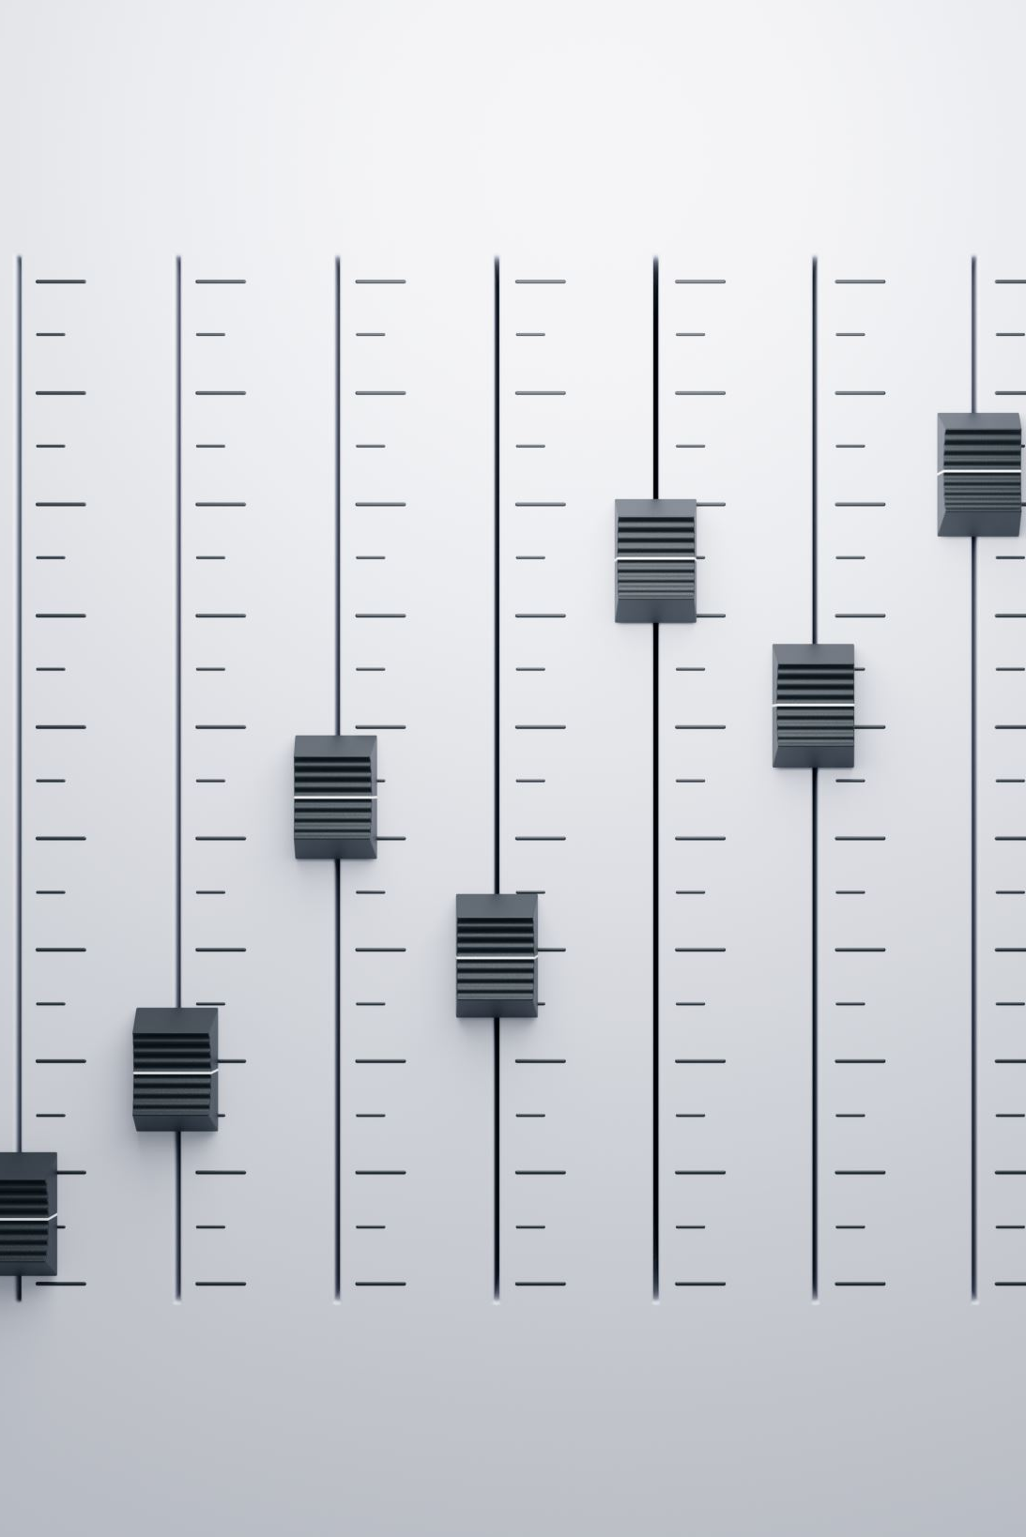
Levels of Volume
For the various activities we do throughout the day there are different levels of volume that are appropriate for each activity.
Level 0-Silent
Level 1-Whisper
Level 2-Indoor speaking voice
Level 3- Outdoor speaking voice

Slide 10
WCSD Electronic Devices Policy
Teachers and administrators reserve the right to confiscate a student’s electronic device if it is interfering with curriculum/instruction.
Electronic devices shall not be brought into classrooms during assessments, semester exams, or other testing situations.
Cell phones are to be "off and away" in lockers throughout the school day. Students may access cell phones during lunch if they adhere to WCSD policy.
Students must have explicit and direct instruction from their teacher to use electronic devices including ear buds.

Slide 11
It is important that all students remember it is illegal to take photos, videos, or audio recordings of another person on a school campus without their permission.
NRS 393.400 Surreptitious electronic surveillance; exceptions. [Effective July 1, 2018.]
1. Except as otherwise provided in subsection 2, it is unlawful for a person to engage in any kind of surreptitious electronic surveillance on any property of a public school without the knowledge of the person being observed.
2. Subsection 1 does not apply to any electronic surveillance:
(a) Authorized by a court order issued to a public officer, based upon a showing of probable cause to believe that criminal activity is occurring on the property of the public school under surveillance;
(b) By a law enforcement agency pursuant to a criminal investigation;
(c) By a peace officer pursuant to NRS 289.830;
(d) Which is necessary as part of a system of security used to protect and ensure the safety of persons on the property of the public school; or
(e) Of a class or laboratory when authorized by the teacher of the class or laboratory.

Slide 12
Disciplinary action will be taken for misuse of cell phones:
1st Offense: Student is asked to put phone in their locker and parents are notified.
2nd Offense: Phone is confiscated by admin until parent pick up of device can be arranged.
3rd Offense: Student is placed on a phone contract and required to check their phone in the office at the beginning of each day for a determined amount of time.
Electronic Devices Consequences

Slide 13
WCSD Dress Code Policy

Slide 14
WCSD Dress Code Policy Violations

Slide 15
Attendance
When your entire Advisory is present your will earn a letter in Depoali. Once your Advisory spells Depoali you will get a reward (as decided on per your team).
You have the amount of days you are absent plus one day to acquire and complete your late work. If you’re absent on a Monday and Tuesday, you have until Friday to complete your missing work and turn it in for full credit.
Our goal this year is to ensure that all students are absent less than 10% of the school year.
At 4, 8, and 10 absences your family will receive calls from teachers and administration regarding absences, attendance letters listing additional interventions, and you will be put on a 20 day attendance monitor after the second attendance letter.
We follow a progressive discipline policy regarding tardies. If you become consistently tardy to class you will be required to conference with teachers, administration, and will receive tardy detentions.

Slide 16
Restroom, Water and Passes
Use the restroom during passing (to go to the restroom, not to play in the restroom)
If you need to use the restroom during class you will need to fill out a pass in the back your planner and get permission from your teacher. Sign-out before leaving the classroom and leave your planner in the classroom when you go to the restroom.
You will take the designate lanyard for the class when going to the restroom, to get water or to go to your locker.
You can bring your own water bottle to carry with you. You are not allowed to carry in other drinks besides your water bottle. For example, Prime Hydration, Red Bull, Starbucks, etc.

Slide 17
Emergency Procedures
Fire Drills and Evacuations
When the alarm sounds all talking/noise stops.
Quietly line up in a single file line at the door.
Wait for your teacher to give you permission to exit the classroom.
Your teachers in each class will give you information of where your designated evacuation areas are located.
If the building is evacuated while you are at lunch or during passing, go to your designated advisory area and line up.
Once you are in your designated evacuation area, stand quietly in line while attendance is taken.
You are at a level 0 the entire time during an emergency.

Slide 18
Emergency Procedures
Code Red
Stop all classroom activities and lock door(s).
Cover windows.
Remain silent.
Your teacher will direct you to a place in the classroom out of line of sight of the door.
If a student is outside of a classroom, find a concealed place to hide.
Code Yellow
Shelter in place-no movement until cleared.
Continuation of classroom activities with locked door(s).
Cover windows.
Code Blue
Medical Emergency
School is placed in a Code Yellow-no passing until cleared.

Slide 19
Breakfast/Lunch Procedures and Expectations
Students who come into the cafeteria must stay in the cafeteria until the bell rings. There will be no in-and-out.
Students sit in the cafeteria for lunch using a volume no higher than two.
Students must stay in cafeteria for the first 10 minutes of lunch, then students may go outside the the basketball courts/field or library.
Once students have chosen a lunch location students must stay there for the remainder of the lunch period.
ALL food and drink needs to be consumed in the cafeteria.
Food or drink deliveries will not be accepted and thrown into the trash.
If you cut the lunch line you will be sent to the back of the line.
Be responsible and show integrity by cleaning up after yourself when you finish your lunch.
You will be asked to help clean the cafeteria if you are throwing food or leaving a mess.

Slide 20
Extracurricular Activities/Athletics
Follow the S.T.R.I.K.E. Matrix
No food or drinks in the gym
Students must stay in the student section during games unless accompanied by a parent/guardian.
If you are going to attend any high school games, you must attend with a parent or legal guardian.
Student must remain in the gym for the entire event.
Students will need administration permission during a game to go to the vending machine.
Students must be present at school that day to attend a game after school.

Slide 21
Depoali Procedures and EXPECTATIONS Review Bingo
Discuss with your group or as a whole class the following questions:
How did you do on your bingo card?
What words/phases/ideas were you missing?
Why is it important that we have certain procedures and expectations in place school-wide?

