Slide 1




5th Annual
To High School and Beyond!
– Grad Lightyear

Slide 2

What is the WCSD Career Expo?
It is a unique event where…
You and 5,000+ 8th graders will become “Career Aware”.
You will learn about high demand jobs and educational opportunities.
You will interact with multiple industry through hands-on activities.
You will see that the academic, technical, and social skills you are learning in the classroom apply to available careers.
You will be exposed to career opportunities that will help make better high school decisions to best prepare you for lifelong success!

Slide 3

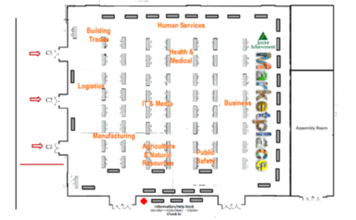

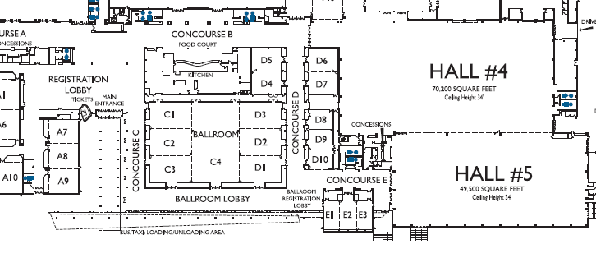







Expo Waiting Area

Slide 4

Opportunities Awaiting…
Come Experience
Intuit Team Building Activity
  It’s game time! Learn about personal finance by choosing your own adventure & competing with your classmates & friends.
Career & Technical Education (CTE) Hands-On Activities
  Check out Career Tech Education! Participate in hands-on activities to give you an idea of what CTE is all about.

Slide 5




More Opportunities Awaiting…
Experience the Expo Hall
  Interactive Industry/Career & High School Signature Academy Tables
  Representatives from Multiple Businesses
  Practice Interviewing Skills
  Earn Expo Cash
  Trade in Expo Cash at the
  Receive a Raffle Ticket
    Choose your most interested prize & drop the raffle ticket in the box.
      If you win, your prize will be delivered to your school.

Slide 6



How It Works
In the Expo Room students will:
  Choose two companies to “apply” to
  Approach each company with interview sheet (included in Student Expo Booklet)
  Engage in a brief interview, ask questions and make some notes
  Demonstrate interviewing tools – handshake, eye contact, be engaged, present your best professional self and receive Expo Cash.
With cash in hand, enter the Marketplace -
  Choose a vender to speak with
  Answer two brief questions about finances
  “Pay” for your product with Expo Cash and a receive Raffle Ticket (the more cash you have, the more tickets you get!)
  Choose the prizes you are most interested in winning and drop your raffle tickets in the box! Prizes delivered to schools.

Slide 7



Intuit Team Building Activity
Come learn about Personal Finance
Participate in a fast-paced choose your own adventure game
Go through multiple game stations to learn about different areas of personal finance
Talk with other students and facilitators
Follow instructions so everyone has a chance to complete the game
Fill out your scorecard at each game station
Make sure to turn in your feedback card at the end of the game

Slide 8



Career & Technical Education Activities
Participate in hands-on activities related to CTE classes offered in high school
Rotate through 2 small-group activity stations to explore different career pathways

Slide 9



Lunch & Activities
Student’s lunch will be buffet style. Go through the line and take what you will eat.
Finish your meal & clean up your area.
Interact with others and enjoy the
hands-on exhibits.
Be respectful & have fun!!

Slide 10
Bus Procedures
Listen carefully to your chaperones.
Do not load until directed to do so.
All busses will be full, so be considerate of others.
Make sure you load with your assigned group - remember your bus #.
Bus #’s will be in the windows (Bus 1, Bus 2, etc.).
Upon arrival, collect all personal items & wait patiently until dismissed/greeted by Expo staff.
Listen attentively and follow all directions/instructions.
The bus will return after you are finished with the Expo. Enjoy!

Slide 11


What Do I need to Bring or Leave?
Bring
  Bring a writing utensil
    A golf pencil will be provided at the Expo
  Cell phones - only used if permissible by your staff.
Leave
  Bags or Backpacks
    You will receive an Expo bag when you arrive
  Outside food and drinks

Slide 12



Student Expectations
Be respectful of other students and adults.
Present your best professional self.
Engage in activities.
Interact with Exhibitors/Vendors.
Be courteous.
Do not touch or take anything unless permission is granted by an adult.
The use of cell phones and/or electronics devices are prohibited, unless approved by your chaperone or Expo personnel.
Stay with your chaperones at all times.
Ask questions?
Do not leave any room you are
assigned to unless you have
permission and are escorted by
a chaperone, including the restroom.
Chaperones will monitor your
behavior.
Once in the lunchroom, please
line up in an orderly fashion to get your lunch.
Always pick up after yourself

Slide 13


Professional Introduction
Introduce yourself - “Hello, my name is (first name, last names). It’s nice to meet you.”
During the introduction, extend your hand for a handshake.
  The Proper Handshake:
    Firm, but not bone crushing
    Lasts about 3 seconds
    May be “pumped” once or twice from the elbow
    Is released after the shake, even if the introduction continues
    Includes good eye contact with the other person
Go ahead & practice with a classmate!

Slide 14

Time To Leave
Meet your chaperones to get back on the bus
Look for someone holding up your bus #
Place your completed Career Expo booklet in your bag that may need to be turned in at the school.
Before our final departure, attendance will be taken on the bus...not in the hallway.
If a student is missing, Expo personnel will be notified immediately.
After an exciting day, enjoy your bus ride back to school.

Slide 15


Thank you for attending the…

