Slide 1
Career Day Activities

Slide 2
Famous Failures
https://www.youtube.com/watch?v=zLYECIjmnQs
Discussion: How do you think these well known people became successful in their careers? What type of attitude do you think it took?

Slide 3
Activity one:
Lets look at your Career Role Models (worksheet)
Now that you have looked at your career role models get with a shoulder partner and discuss the different career titles you listed.
Circle the one thing you believe is the most important to be successful (right side of WS). Write one sentence on the bottom of the page….

Slide 4
Activity Two: Career Alphabet
Please get into pairs with your shoulder partner. You will only need one worksheet per group (orange paper on the back of “Career Role Model WS”)
I will set a timer for 5 minutes.
You and your partner will try to come up with 3 different career titles for each letter of the alphabet. Remember, you are naming career/job titles, NOT names of businesses.
You will work together to fill in as many of the blanks as possible in 5 minutes. You do NOT need to go in order. You can skip around as much as you’d like. Try not to let other groups around you see or hear your answers.
I will give you a warning when you have 1 minute left.
At the end of 5 minutes I will tell you all to put down your pencils/pens and count how many career titles you have written down.
The group with the most career titles wins!
(NOTE: If groups finish before the 5 minutes is over, then the first group to finish wins)
I will check the winner’s list of careers to make sure they are all real careers.

Slide 5
Presentation Behavior
Lets discuss appropriate behavior for the presentations using the STRIKE Matrix.
Hand out green student worksheet BEFORE they leave for the first speaker
The green worksheet needs to be brought back to advisory for a grade after you attend all 3 speaker sessions
There is also an activity we will be doing with it later in the day

Slide 6
Enjoy the speakers!
Speaker One - 9:00 – 9:30
Speaker Two - 9:34 – 10:04
Speaker Three - 10:08 - 10:38
Back to Advisory

Slide 7
Thank you Notes
Turn to the back of the green presenter worksheet “Writing Your Thank You Notes”
Lets go over how to properly write a thank you note
Its now your turn:
Pick one of the speakers you enjoyed listening to and write your thank you note to them on the blue sheet
Turn in the note to me when you are done

Slide 8
Fail Your Way To Success
https://www.youtube.com/watch?v=_uL6NP38hbk
Written Response: Do you think it is ok to fail?
Why or why not? Name one thing you have failed
And what you did to overcome it

Slide 9
Activity Three: Work Habits
Good work habits are important in any job you have. Right now your job is going to school. Where could you work to improve your habits?
Please fill out the pink worksheet titled “Work Habits”
Include how you will improve on the two habits you picked

Slide 10
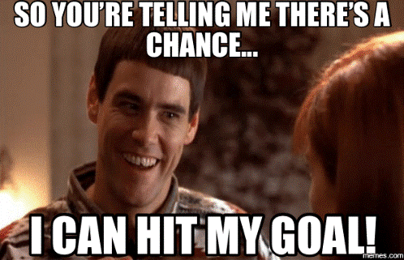
Activity Four: Goal Setting
What a goal needs to be…. Lets look at the pink worksheet titled Goal setting ( the back of Work Habits WS)
Now its your turn to write some goals for yourself
You will do 3 in each area
After your have written your goals you will rank them
On the bottom of the page write two complete sentences on why you think having goals is important

Slide 11
Wrapping it all up
Now that you have discussed careers that interest you, you have heard why having failures is ok, and you planned out your goals write a reflection on why education and careers are important. Also include how your day to day choices will impact your future.
Minimum of one paragraph (5-6 complete sentences)

