Slide 1




Slide 2
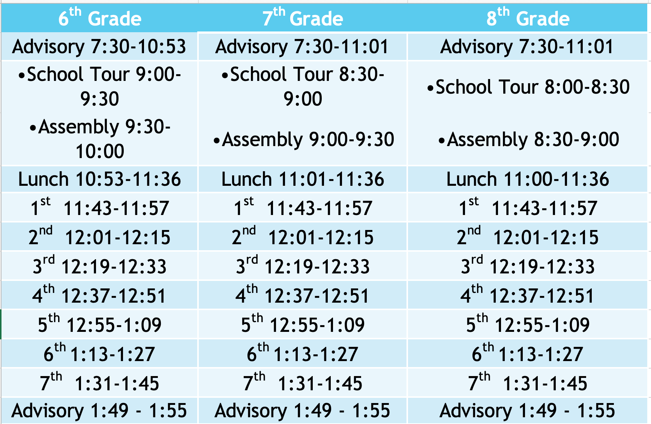
Monday, August 14th

Slide 3
Agenda
Ice breakers and Name Tags/Name Tents
Building Community by Recognizing Values
S.T.R.I.K.E. Matrix
Levels of Volume
School Tour
7th/8th Grade Assembly
Planner Scavenger Hunt
WCSD Electronic Devices Policy
WCSD Dress Code Policy
Attendance
Safety Procedures
Emergency Procedures
Behavior Grading Rubric
Lockers
Breakfast/Lunch Procedures
Extracurricular Activities/Athletics

Slide 4
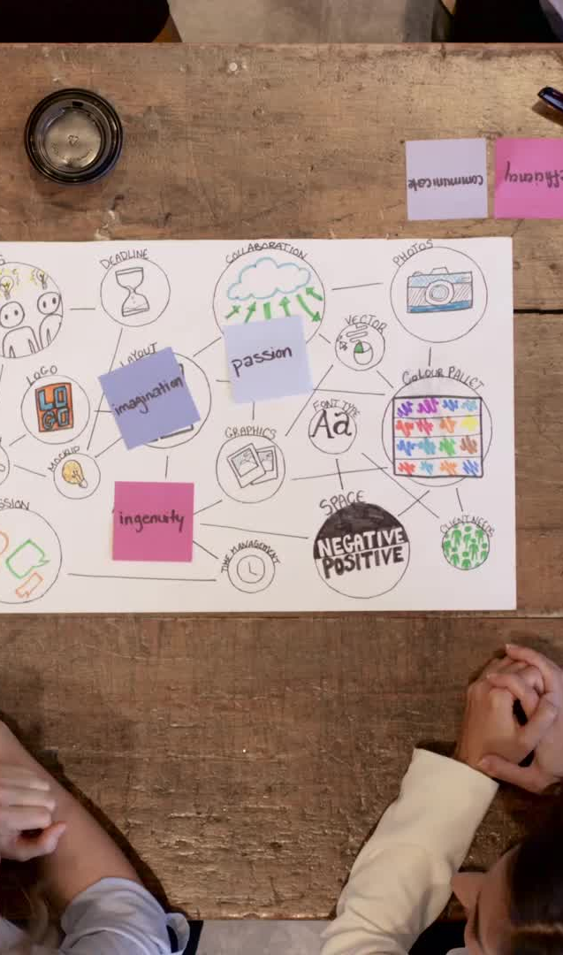
Building Community by Recognizing Values
On your guided note-taker list your three strengths you bring to school.
Share these three strengths with your group. As a group share common strengths heard with the class. Your teacher will record ideas on the whiteboard. If ideas are repeated, a check mark will go next to them.

Slide 5
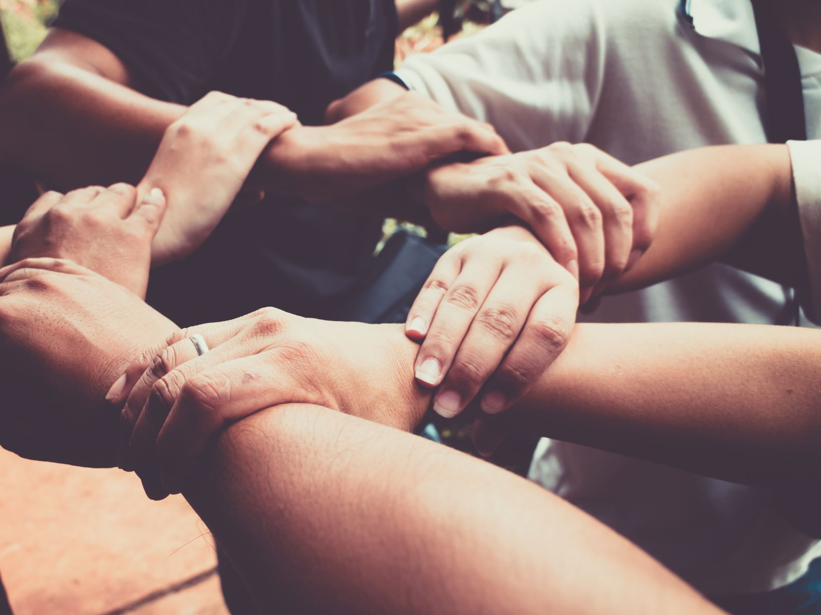
Building Community by Recognizing Values
You just listed character strengths (your behaviors, beliefs and personality that help others understand who you are) that you bring to school to help build our community.
Each of us has personal values. Our values guide our actions and choices we make as seen through our character. For example, if you value honesty you would tell the truth.

Slide 6

Building Community by Recognizing Values
Looking at your character strengths write down a personal value you have. For example, I am a good listener. I value other’s opinion or respect others.
Share your personal values with your group.
As a group share common values you heard with the class.

Slide 7
What is S.T.R.I.K.E.?
S. T. R. I. K. E. is our school-wide behavior plan with guiding principles that help us in our choices and actions. These guiding principles can help you determine your goals and values.
We use the S. T. R. I. K. E. matrix to help create a positive, predictable and consistent safe learning environment for all students.
The teachers and staff at Depoali Middle School will be teaching and reinforcing these guiding principles throughout year.
You will participate in reflection assignments and activities to help you build you character and reinforce your values through the guiding principles in the S.T.R.I.K.E. matrix.

Slide 8
So, what does S.T.R.I.K.E. stand for?
List each guiding principle on your note-taker as they are presented.
As each letter is introduced, as a class see if you can connect each guiding principle to a value that was shared earlier.

Slide 9



STRENGTH
S: Strength – we have self-confidence and determination to succeed

Slide 10

TOLERANCE
T: Tolerance – we respect others and accept differences

Slide 11


RESPONSIBILITY
R: Responsibility – we own our actions, decisions, and their outcomes

Slide 12

INTEGRITY
I: Integrity – we do the right thing, even when no one else is watching

Slide 13


KNOWLEDGE
K: Knowledge – we are active participants in our education

Slide 14

EMPATHY
E: Empathy – we seek to understand the feelings of others

Slide 15

S.T.R.I.K.E and Values
How do the guiding principles in S.T.R.I.K.E. demonstrate the community values we listed together as a class?
Record answers on your note-taker and share as a class.

Slide 16
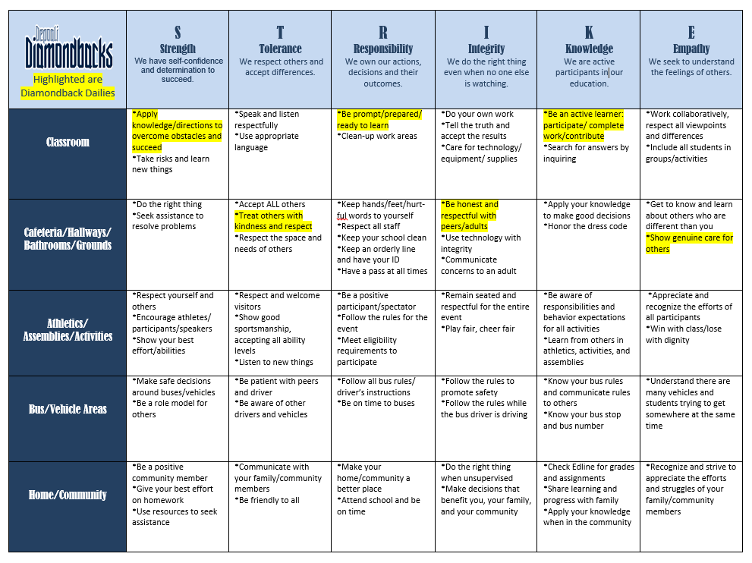
*Turn to page 10 in your planner, highlight or circle the Diamondback Dailies. Diamondback Dailies are actions you can take everyday to help create a positive and safe learning environment for all students.

Slide 17
So, what does this mean for you?
Teachers and ALL staff members will be on the lookout for students who are meeting the expectations of S. T. R. I. K. E.
Signatures may be earned in each area of the matrix where you are meeting the expectations.
Your goal is to earn at least five signatures a week.
You can earn one signature a week from your families for meeting your home goal.
Signatures will be totaled each Monday and recorded during Enrichment class.
For every 10 signatures you earn weekly you will receive one raffle ticket to be entered in a random S.T.R.I.K.E. drawing.
Signatures are required for all mid and end of quarter rewards.
We will look more into Positive Reinforcement Levels during our Planner Scavenger Hunt.

Slide 18

School Tour
We will soon be taking a tour of the school. It is important as we walk around the school to be responsibility in controlling the level of volume in your voice.

Slide 19

Levels of Volume
For the various activities we do throughout the day there are different levels of volume that are appropriate for each activity.
Level 0-Silent
Level 1-Whisper
Level 2-Indoor speaking voice
Level 3- Outdoor speaking voice

Slide 20
Levels of Volume
As your teacher reads the activities below hold up your fingers (0,1,2,3) of the level of volume you would use.
  Entering the Classroom
  Exiting the Classroom
  Partner Work
  Playing soccer
  Eating lunch in cafeteria
  Before school in amphitheater
  Walking in hallway when class is in session
  During passing
  Before an assembly
  During an assembly
  Before, during and after a drill (until all cleared)

Slide 21

Planner
Scavenger Hunt
Let’s explore more of our school’s expectations and procedures by using our planner as a resource.
Your planner is used in every class, every day.
This is where you collect signatures and should ALWAYS be out for each class.
Complete the Planner Scavenger Hunt your teacher passes out to you.
We will go over answers as a class when everyone is finished.

Slide 22
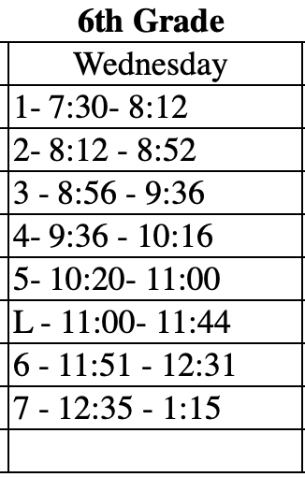
Bell Schedule Addition on PAGE 1
You should have edited the 6th grade bell schedule for Wednesday.
Check to make sure you edited the 6th Grade Wednesday periods to look like this:

Slide 23
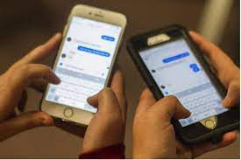
WCSD Electronic Devices Policy
The Washoe County School District is proud to be a 21st century District and promotes the responsible and thoughtful use of personal electronic devices to support student achievement.
Electronic devices can be disruptive and interfere with student learning, to include the disruption of the learning of those are not in possession of such devices.

Slide 24
WCSD Electronic Devices Policy
Teachers and administrators reserve the right to confiscate a student’s electronic device if it is interfering with curriculum/instruction.
Electronic devices shall not be brought into classrooms during assessments, semester exams, or other testing situations.
Cell phones are to be "off and away" in lockers throughout the school day. Students may access cell phones during lunch if they adhere to WCSD policy.
Students must have explicit and direct instruction from their teacher to use electronic devices including ear buds.

Slide 25

It is important that all students remember it is illegal to take photos, videos, or audio recordings of another person on a school campus without their permission.
NRS 393.400 Surreptitious electronic surveillance; exceptions. [Effective July 1, 2018.]
1. Except as otherwise provided in subsection 2, it is unlawful for a person to engage in any kind of surreptitious electronic surveillance on any property of a public school without the knowledge of the person being observed.
2. Subsection 1 does not apply to any electronic surveillance:
(a) Authorized by a court order issued to a public officer, based upon a showing of probable cause to believe that criminal activity is occurring on the property of the public school under surveillance;
(b) By a law enforcement agency pursuant to a criminal investigation;
(c) By a peace officer pursuant to NRS 289.830;
(d) Which is necessary as part of a system of security used to protect and ensure the safety of persons on the property of the public school; or
(e) Of a class or laboratory when authorized by the teacher of the class or laboratory.

Slide 26
Disciplinary action will be taken for misuse of cell phones:
1st Offense: Student is asked to put phone in their locker and parents are notified.
2nd Offense: Phone is confiscated by admin until parent pick up of device can be arranged.
3rd Offense: Student is placed on a phone contract and required to check their phone in the office at the beginning of each day for a determined amount of time.
Electronic Devices Consequences

Slide 27
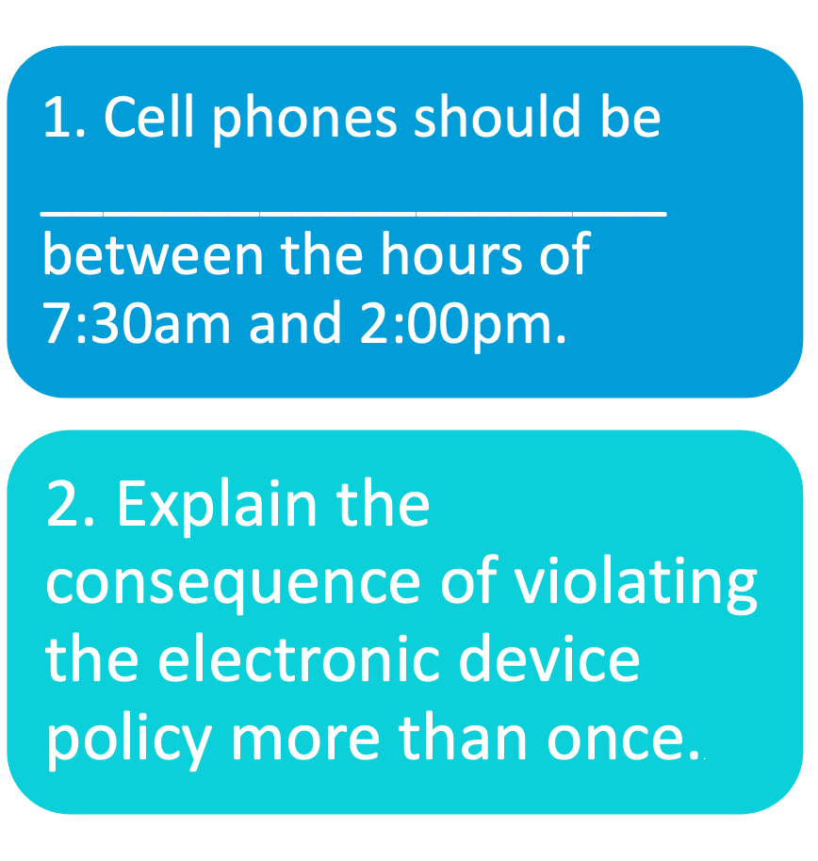
Answer the following questions on your note-taker and discuss as a class..

Slide 28

WCSD Dress Code Policy
Turn to page 3 in your planner and we will review the dress code policy.

Slide 29

WCSD Dress Code Policy

Slide 30
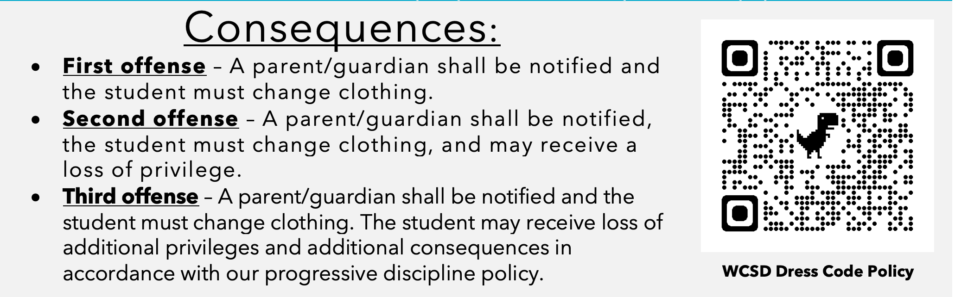
WCSD Dress Code Policy Violations

Slide 31
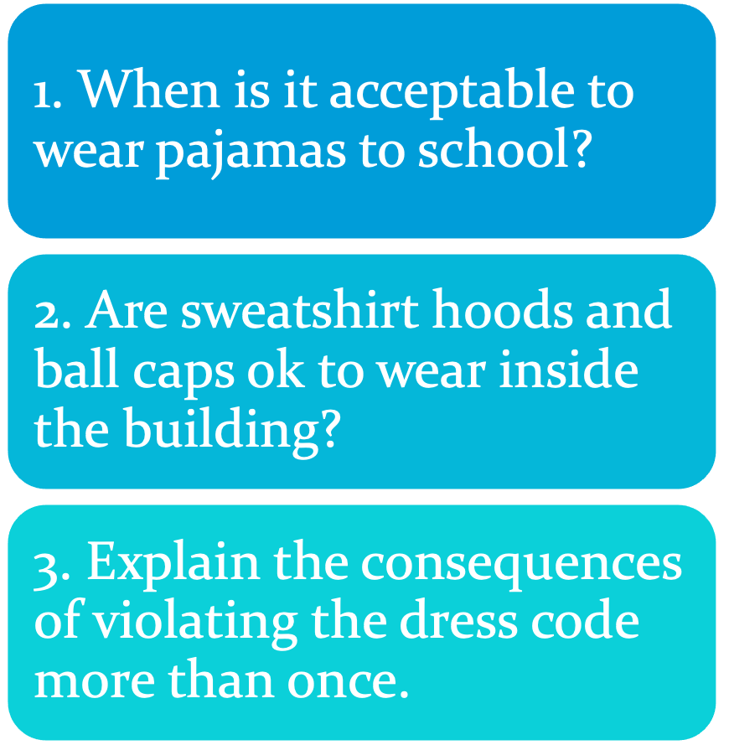
Answer the following questions on your note-taker and discuss as a class..

Slide 32

Attendance
Students who come to class on time and consistently will receive additional signatures and incentives for exemplifying Responsibility in the STRIKE matrix.
When your entire Advisory is present your will earn a letter in Depoali. Once your Advisory spells Depoali you will get a reward (as decided on per your team).
You have the amount of days you are absent plus one day to acquire and complete your late work. If you’re absent on a Monday and Tuesday, you have until Friday to complete your missing work and turn it in for full credit.
Our goal this year is to ensure that all students are absent less than 10% of the school year.
At 4, 8, and 10 absences your family will receive calls from teachers and administration regarding absences, attendance letters listing additional interventions, and you will be put on a 20 day attendance monitor after the second attendance letter.
We follow a progressive discipline policy regarding tardies. If you become consistently tardy to class you will be required to conference with teachers, administration, and will receive tardy detentions.

Slide 33

Safety Procedures
Bathrooms and Water
Use the restroom during passing.
If you need to use the restroom during class you will need to fill out a pass in the back your planner and get permission from your teacher. You will not be using the passes at the bottom of each date in the planner.
Sign-out before leaving the classroom and leave your planner in the classroom when you go to the restroom.
You will take the designate lanyard for the class when going to the restroom, to get water or to go to your locker.
You can bring your own water bottle to carry with you. You are not allowed to carry in other drinks besides your water bottle. For example, Prime Hydration, Red Bull, Starbucks, etc.
Hand Sanitation Stations are located throughout the school for you to use frequently.
Wash your hands frequently and after using the bathroom.

Slide 34
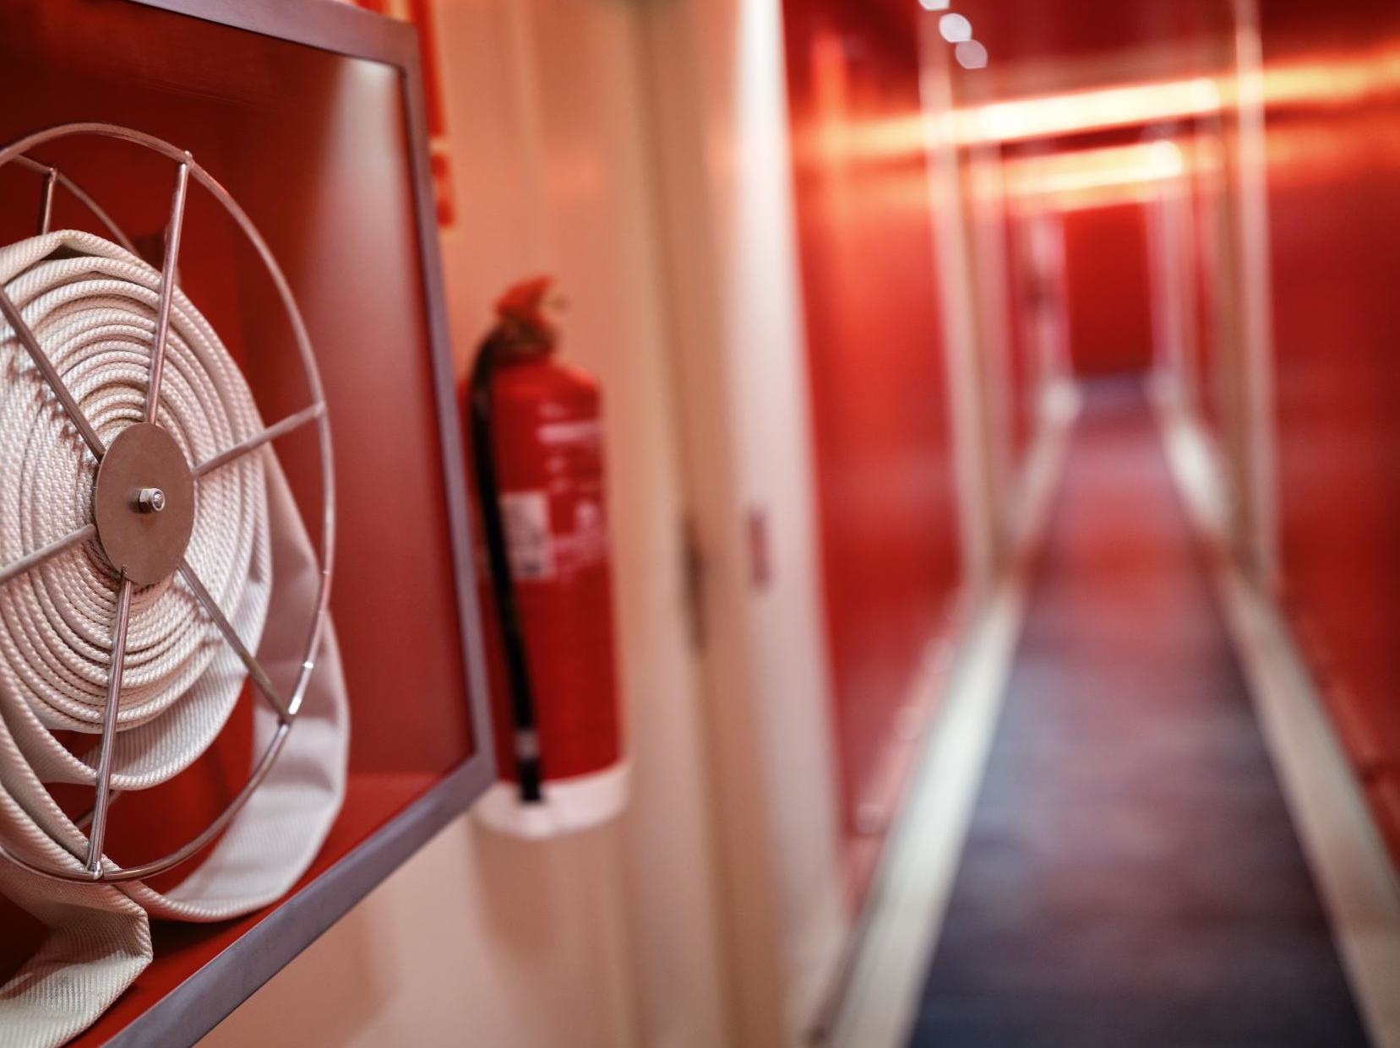
Emergency Procedures
Fire Drills and Evacuations
When the alarm sounds all talking/noise stops.
Quietly line up in a single file line at the door.
Wait for your teacher to give you permission to exit the classroom.
Your teachers in each class will give you information of where your designated evacuation areas are located.
If the building is evacuated while you are at lunch or during passing, go to your designated advisory area and line up.
Once you are in your designated evacuation area, stand quietly in line while attendance is taken.
You are at a level 0 the entire time during an emergency.

Slide 35
Emergency Procedures
Code Red
Stop all classroom activities and lock door(s).
Cover windows.
Remain silent.
Your teacher will direct you to a place in the classroom out of line of sight of the door.
If a student is outside of a classroom, find a concealed place to hide.
Code Yellow
Shelter in place-no movement until cleared.
Continuation of classroom activities with locked door(s).
Cover windows.
Code Blue
Medical Emergency
School is placed in a Code Yellow-no passing until cleared.

Slide 36
Safety/Emergency Procedures
Answer the following questions on your note-taker and discuss as a class.
When is the best time to use the restroom?
Where do you go if there is an evacuation of the building during a non-class time?

Slide 37
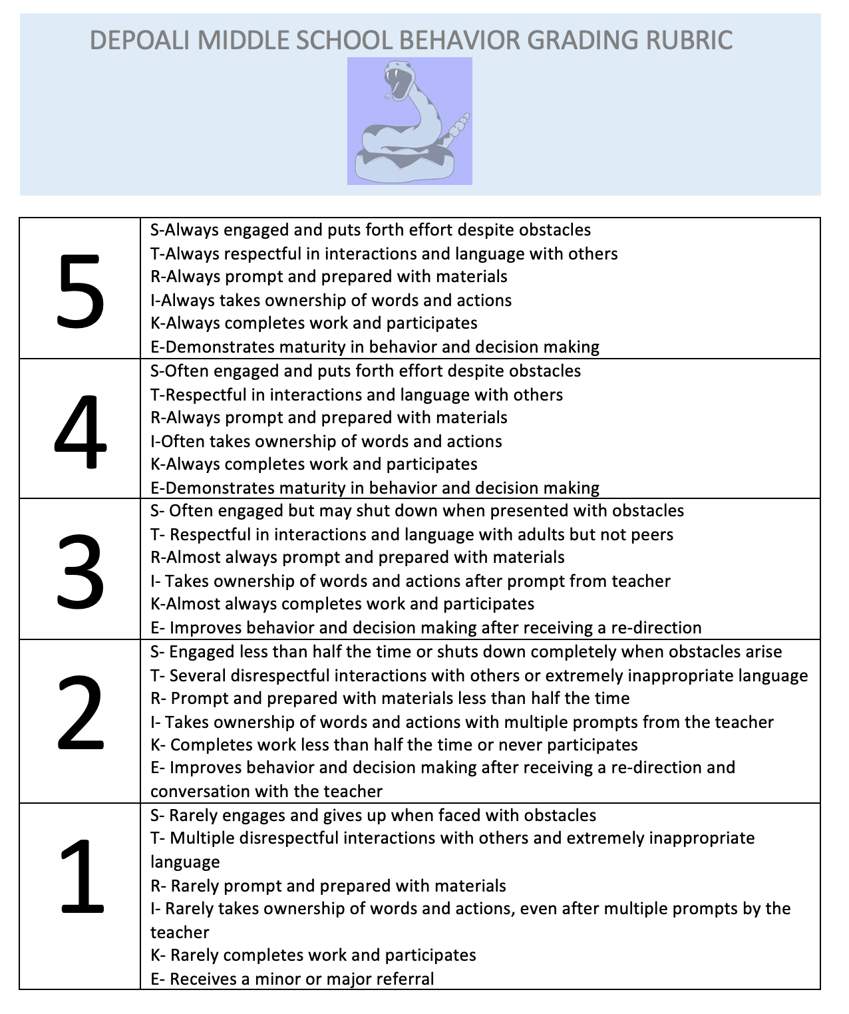
Behavior Grading Rubric
Behavior grades will be given weekly in each class based on a 5-point scale.
The Behavior Grading Rubric follows the S.T.R.I.K.E. matrix.

Slide 38
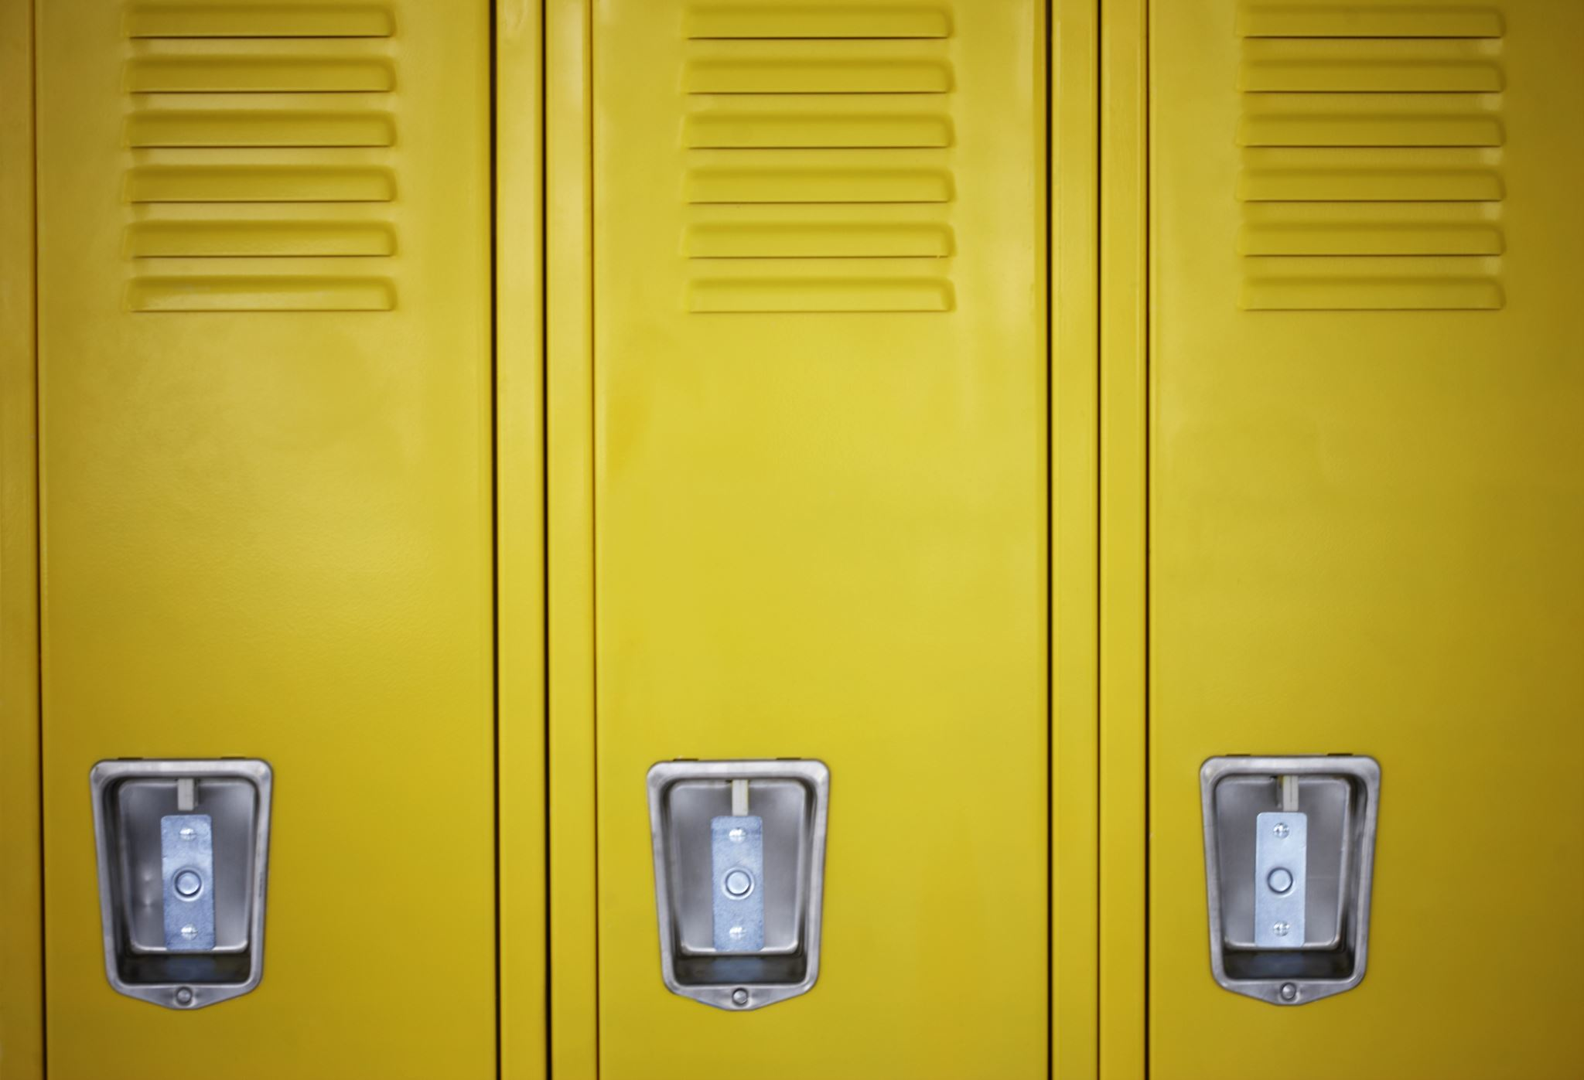
Lockers
Backpacks will remain in lockers throughout the school day.
You may decorate your lockers; however, you may not use tape, stickers, markers or anything that is permanent.
We will watch a video to help teach us or remind us how to open a locker before you try to open your own locker.

Slide 39

Lockers Tips
If you can, practice opening a combination lock at home. The more you can practice with this type of lock, the easier opening your locker at school will be.
Keep your locker combination to yourself. If you do forget your combination, you can ask your Advisory teacher for help.
Your locker number and combination can be found on your class schedule.
Some locks are tricky. You may find you have to tug harder, lean on your locker a bit, or jiggle the latch to coax it open.
If nothing works, ask for help.

Slide 40
Locker Tips
When you're done getting your books or anything you need out, close the locker shut & turn it to zero to begin clearing it. But stop after you have turned it 2 or 3 times. It saves time.
By clearing your locker instead of leaving it on the last number, it prevents other people from opening it.

Slide 41
Lockers
Answer the following questions on your note-taker and discuss as a class.
Explain what you can do if you forget the combination to your locker.
List at least 2 items you may decorate your locker with.

Slide 42

Lockers
How-To Video
1. Watch this video on how to open a combination lock.
2. Practice opening your locker.

Slide 43

Breakfast/Lunch Procedures and Expectations
Students who come into the cafeteria must stay in the cafeteria until the bell rings. There will be no in-and-out.
Students sit in the cafeteria for lunch using a volume no higher than two.
Students must stay in cafeteria for the first 10 minutes of lunch, then students may go outside the the basketball courts/field or library.
Once students have chosen a lunch location students must stay there for the remainder of the lunch period.
ALL food and drink needs to be consumed in the cafeteria.
Food or drink deliveries will not be accepted and thrown into the trash.
If you cut the lunch line you will be sent to the back of the line.
Be responsible and show integrity by cleaning up after yourself when you finish your lunch.
You will be asked to help clean the cafeteria if you are throwing food or leaving a mess.

Slide 44

Extracurricular Activities/Athletics
Follow the S.T.R.I.K.E. Matrix
No food or drinks in the gym
Students must stay in the student section during games unless accompanied by a parent/guardian
Student must remain in the gym for the entire event
Students will need administration permission during a game to go to the vending machine
Students must be present at school that day to attend a game after school

Slide 45
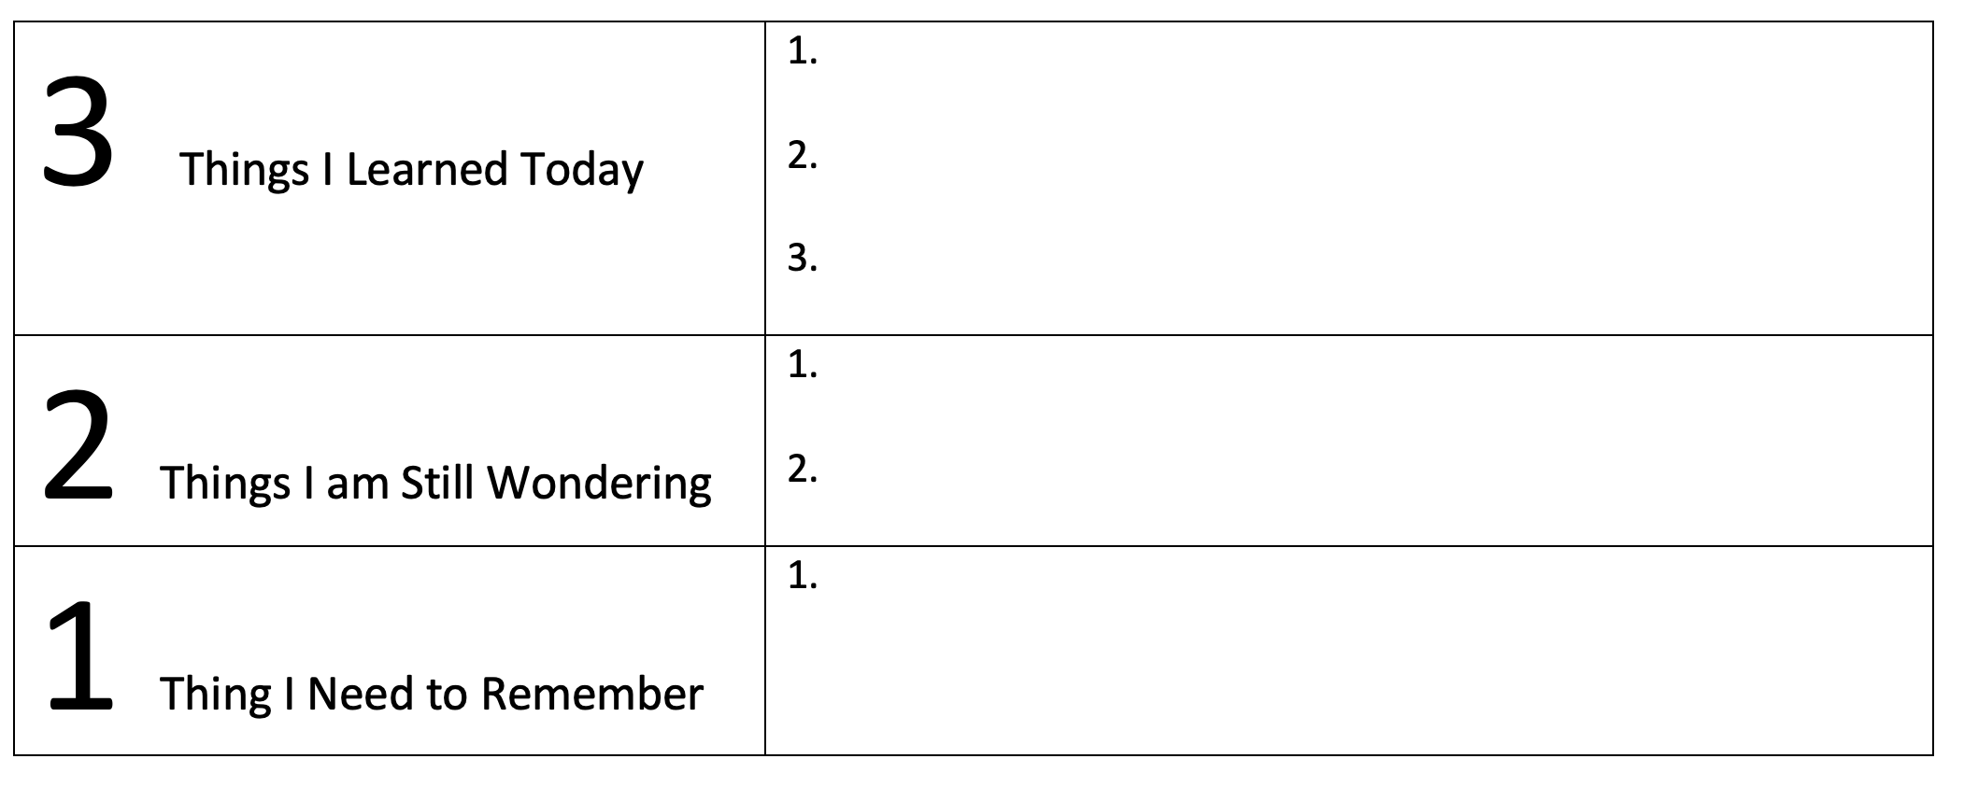
Back to School Reflection
Teachers- You can have students complete this section on their guided note-taker at the end of the day when they come back to Enrichment after 6th Period.

Slide 46
Back to School
Guided Note-taker
Share this note-taker with your family about the expectations and procedures we reviewed today.
Returned it signed to your Enrichment teacher for 3 signatures: Knowledge (1), Responsibility (1) and Strength (1).

