Slide 1
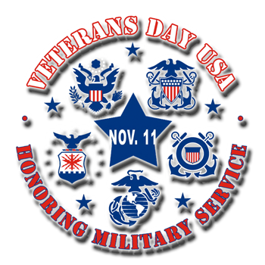
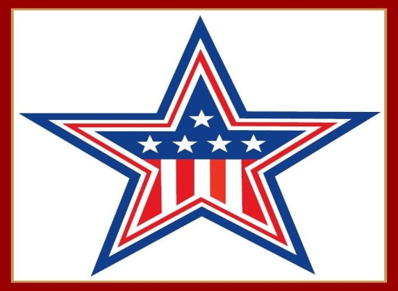
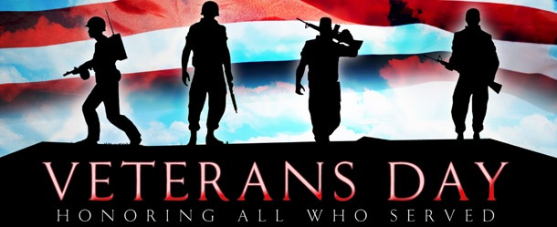

Slide 2
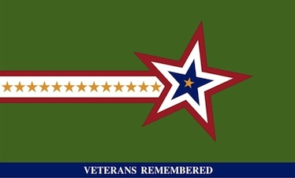
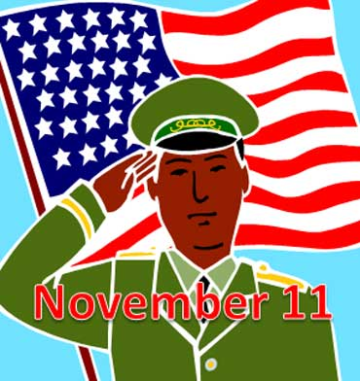
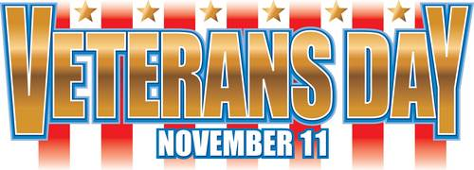
Veterans Day
Veterans Day is an official United States holiday.
The Day honors veterans who severed in the armed forces.
It is a federal holiday on November 11th, each year.
When it falls on the weekend, we usually honor it on either the Friday before or the following Monday

Slide 3
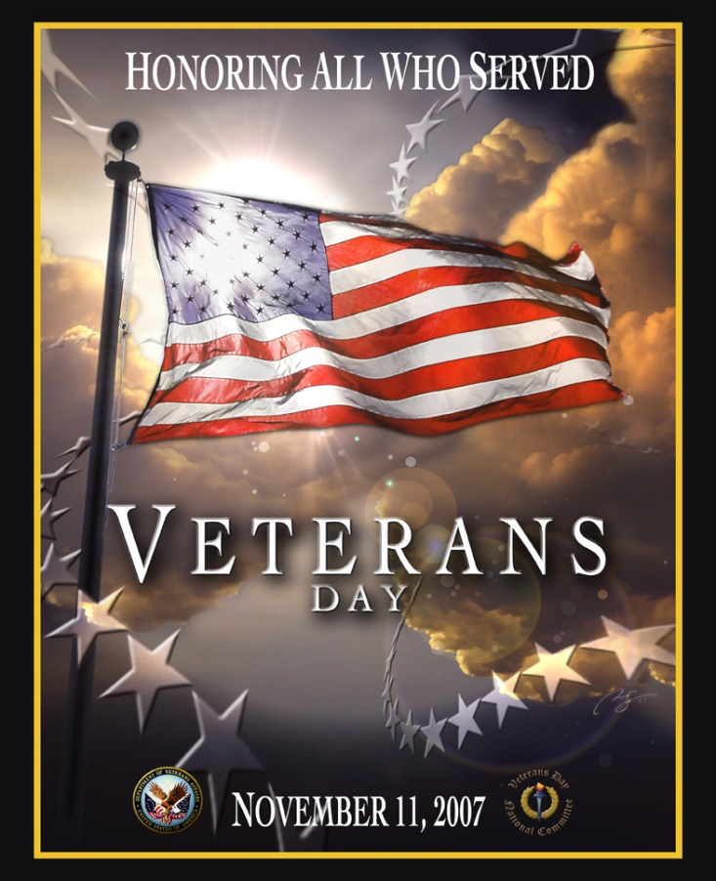
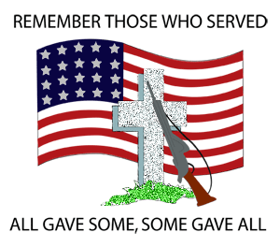
Veterans Day
Veterans Day celebrates the service of all United States military veterans.
On the other hand, Memorial Day honors United States service members who died in combat.

Slide 4
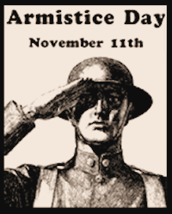
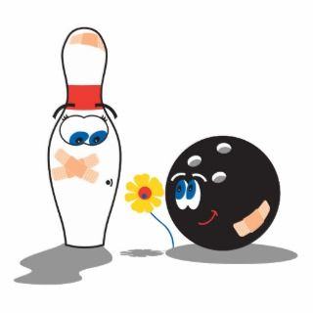
Armistice Day
November 11th is also known as Armistice Day.
An armistice is an agreement made between opposing sides during a war to stop fighting for a certain period of time, or a truce.

Slide 5
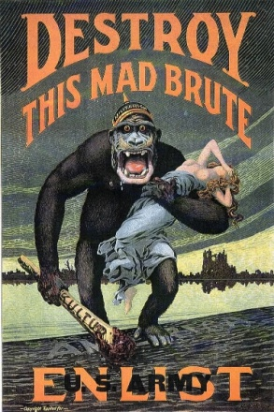
11-11-11
The Armistice was signed on the 11th month, on the 11th day, at the 11th hour! PEACE!!!
The war became known as the War to End all Wars and eventually World War 1.
Why eventually?
They couldn’t call it the World War 1 if there wasn’t a World War 2 yet!
Notes:
Answer: They couldn’t call it the First World War if the Second World War hadn’t happened yet!

Slide 6
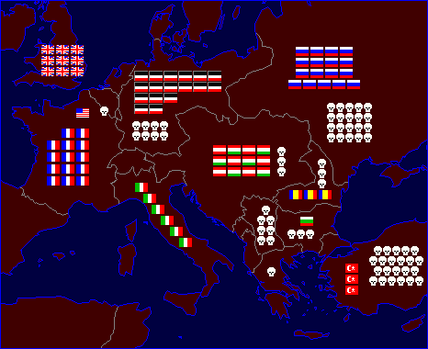
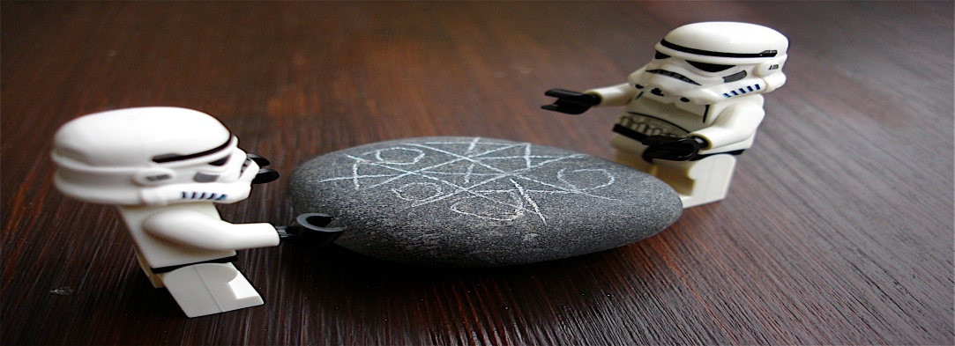
Why an Armistice?
The Great War, or World War I, was fought in Europe and other parts of the world.
Much of the fighting took place in trenches, eventually leading to a stalemate.

Slide 7
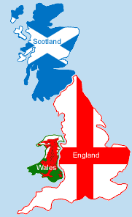
Remembrance
Some others, especially in Great Britain, call the 11th Remembrance Day.
It is also known as Poppy Day because of the beautiful flowers grew in the battlefields after the war was over.
story of the poppy

Slide 8
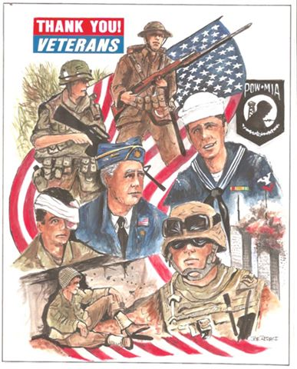
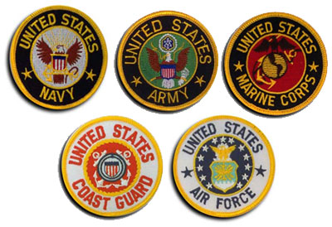
Who is a Veteran?
A veteran is someone who served his or her nation in the armed forces.
There are 5 branches of the United States Armed Forces.
Do you know anyone in the armed forces?

Slide 9
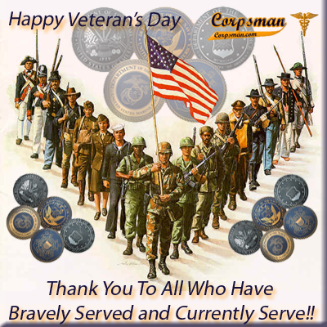
War Time
Veterans have served during many wars in our nations history.
What war do you think was the longest?
What war was the shortest?
What war was the oldest?

Slide 10
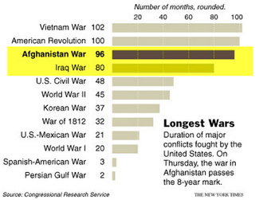

Slide 11
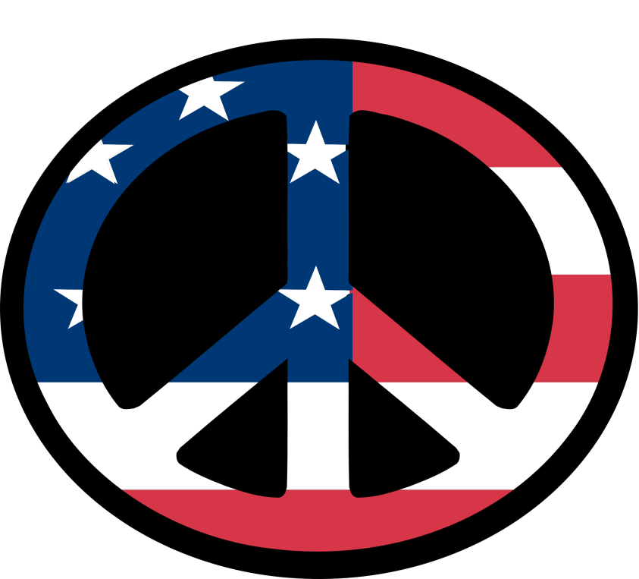
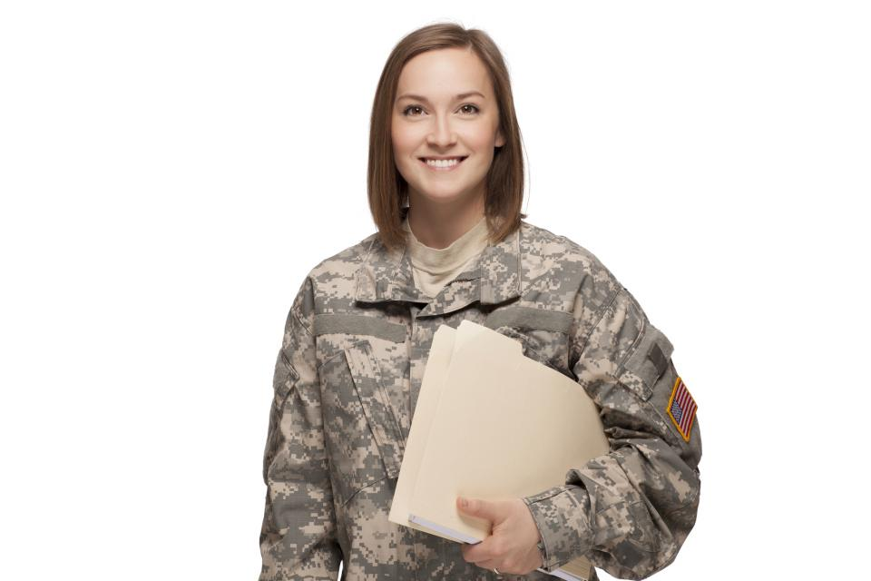
Peace Time
Not all Veterans served in combat or during times off war.
These veterans still served our nation well and deserve our respect and admiration for their duties.

Slide 12
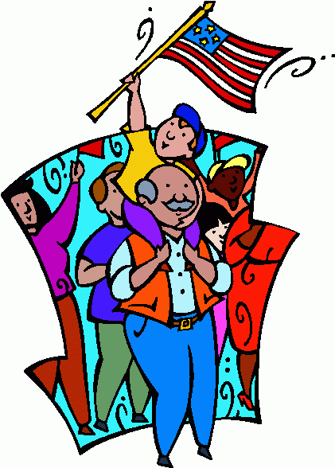
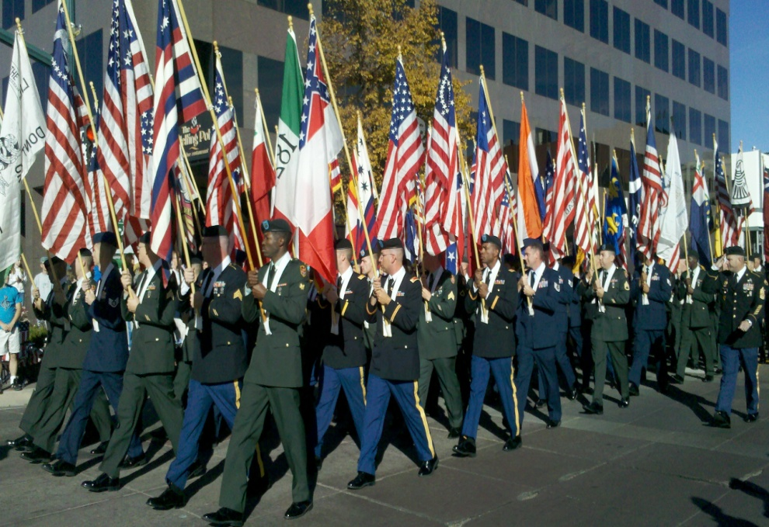
What do I do?
Veterans Day is a federal holiday.
Some government offices and even schools might be closed on November 11th.
Some towns and cities host parades for veterans.

Slide 13
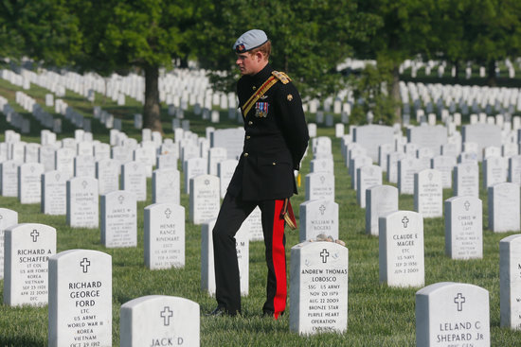
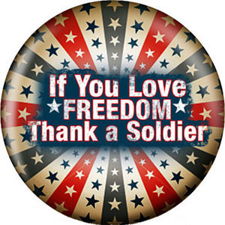
Anything Else?
You could:
1. Go to a parade
2. Visit a grave site
3. Go to a memorial
4. Write a soldier
5. Thank a veteran or soldier

Slide 14
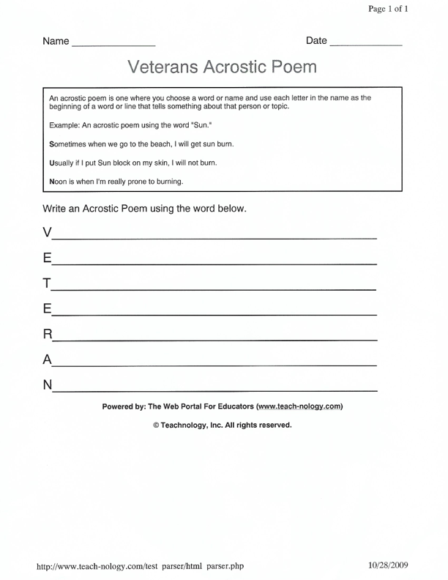
Activity

