Slide 1
S.T.R.I.K.E. Matrix Activity
You and your group will receive a partial filled out matrix.
Your job is to use the behavior expectations (cut-out for you) and sort them into the places where that behavior would be exhibited.
*Students will need a blank matrix with the sort to complete this activity.

Slide 2
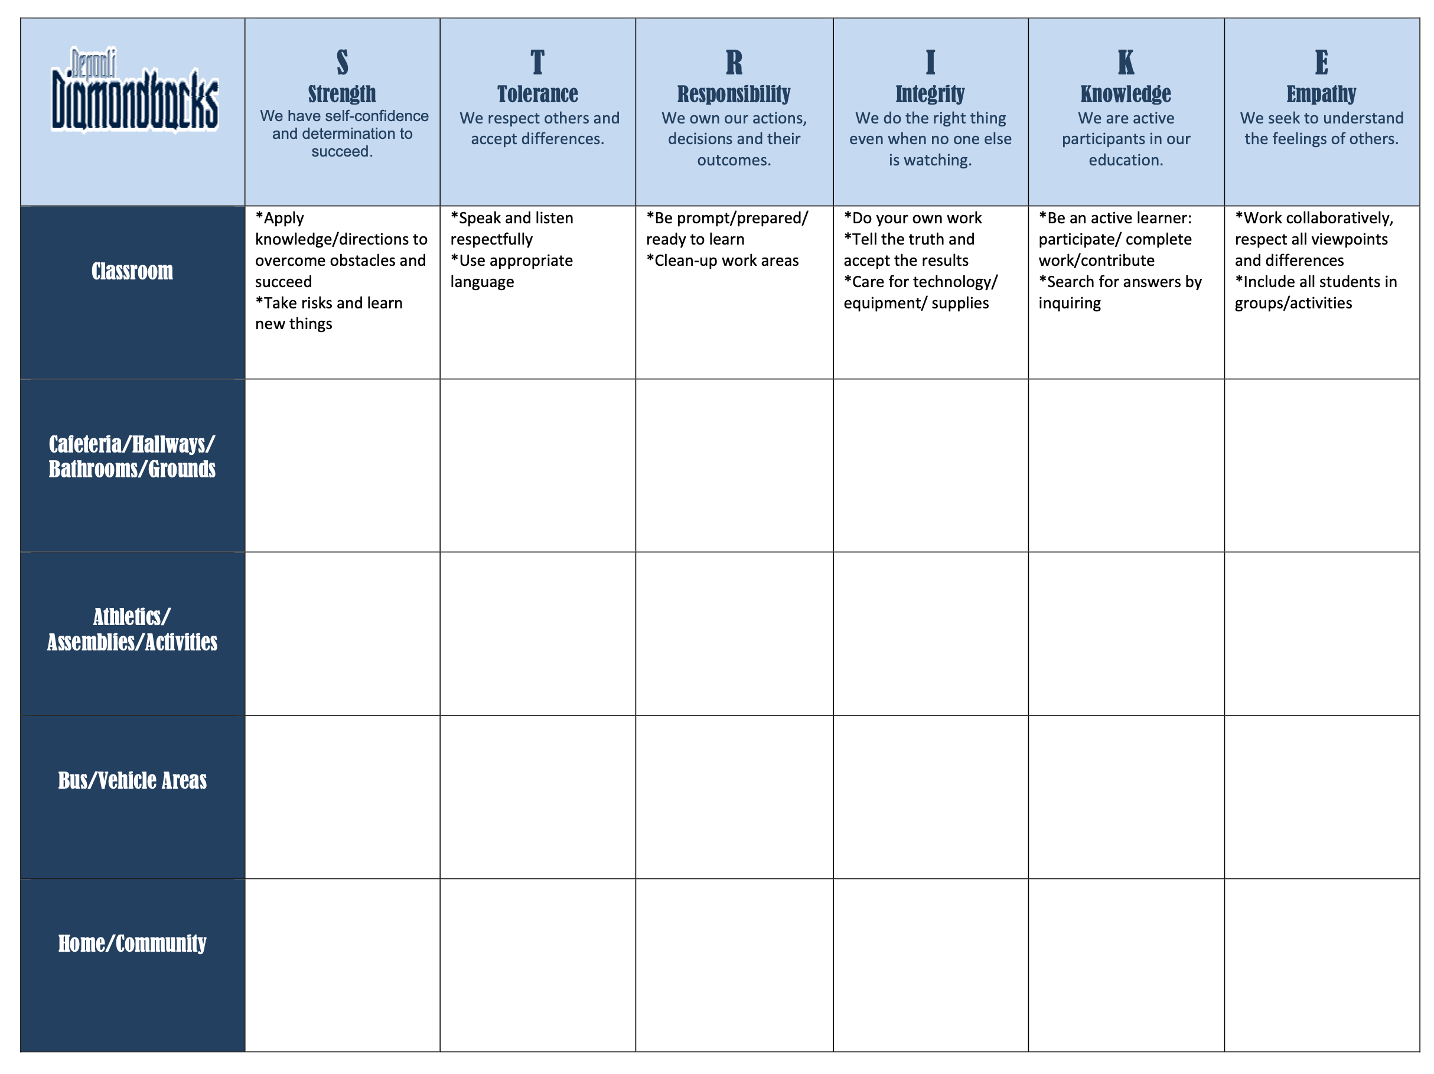
Across the top: behavioral expectations
Down the left: places to exhibit good behavior

Slide 3
Check your S.T.R.I.K.E. Matrix Sort
Open your planner to page 10 to check your answers.
Move behavior expectations to correct spaces if needed.

