Slide 1
Internet Safety
Objectives:
Students brainstorm potential ways the internet could be unsafe
Students reflect on ways they can be more safe online
Students commit to be more careful online

Slide 2
Are there times the Internet could be dangerous?
Brainstorm ways the internet could be dangerous
(either in a group or on paper)

Slide 3
What things should not be shared online?
Name, first and last
Age, gender
Address, not even your city or state
Phone or cell phone numbers, email addresses
School name or location
Friends and family member’s names
Pictures of you or your home/vehicle/school

Slide 4
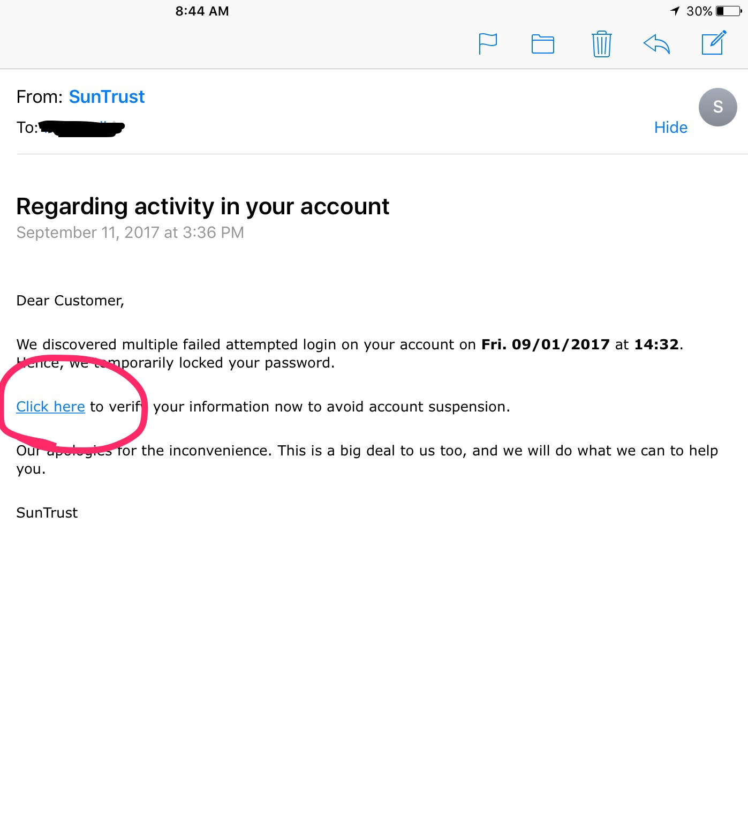
Email scams
DON’T CLICK!!!
Right click on the sender address to see if the email is really from that company
This is called “phishing” where people can access your computer by you clicking on a link. They can also implant viruses to your computer this way.

Slide 5
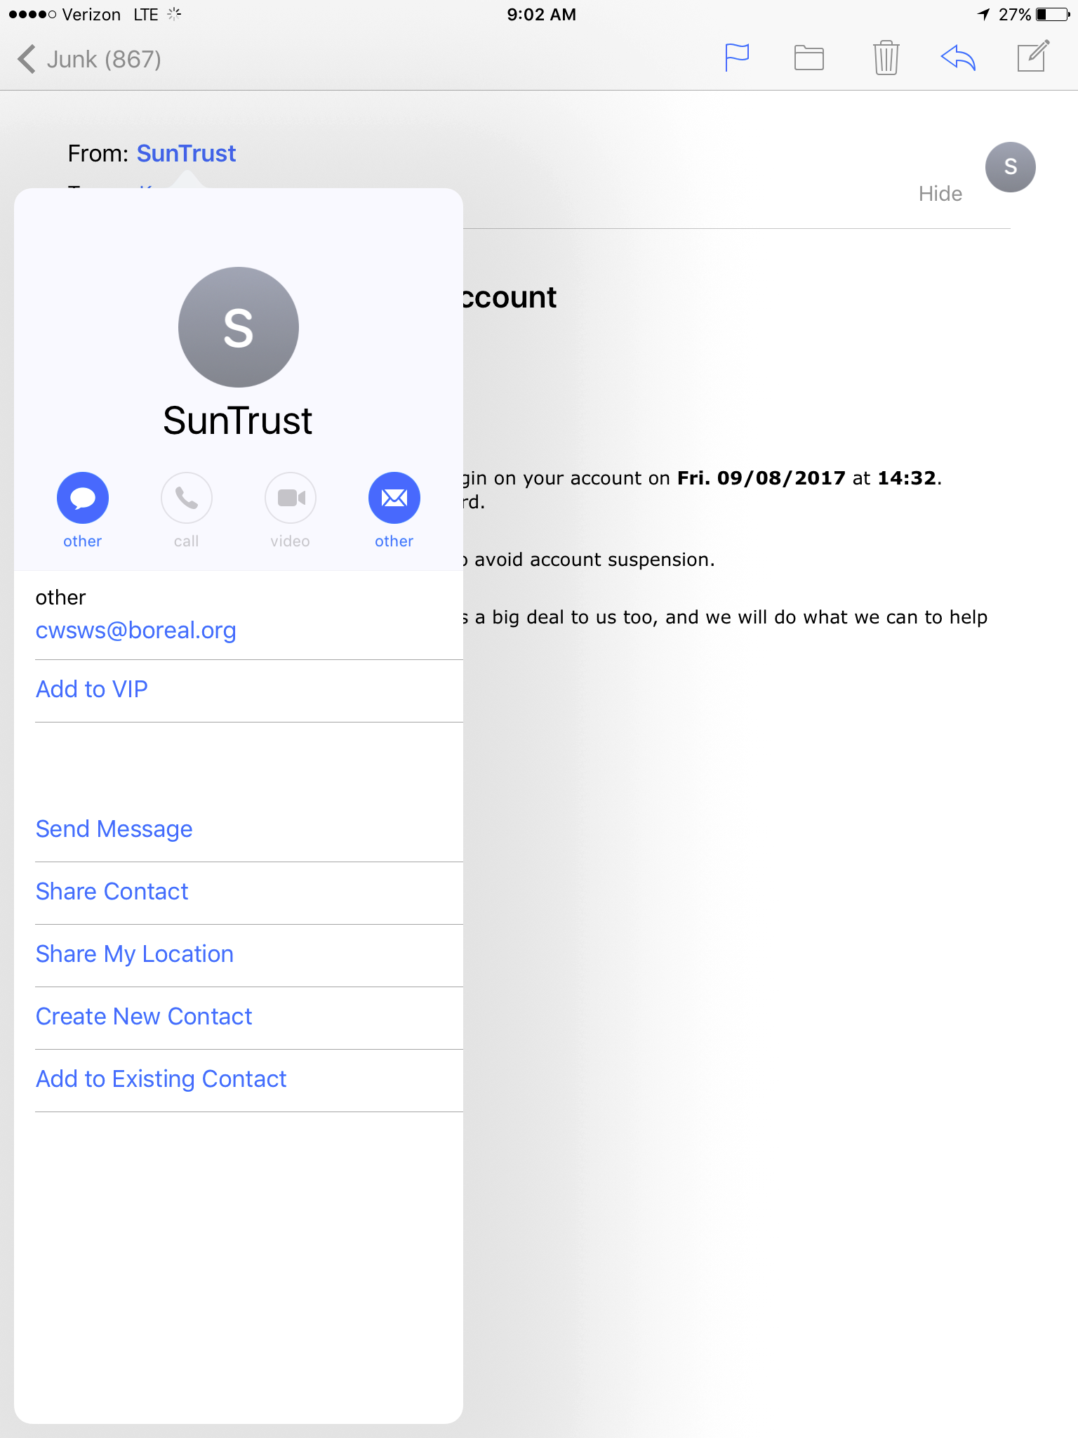

Slide 6
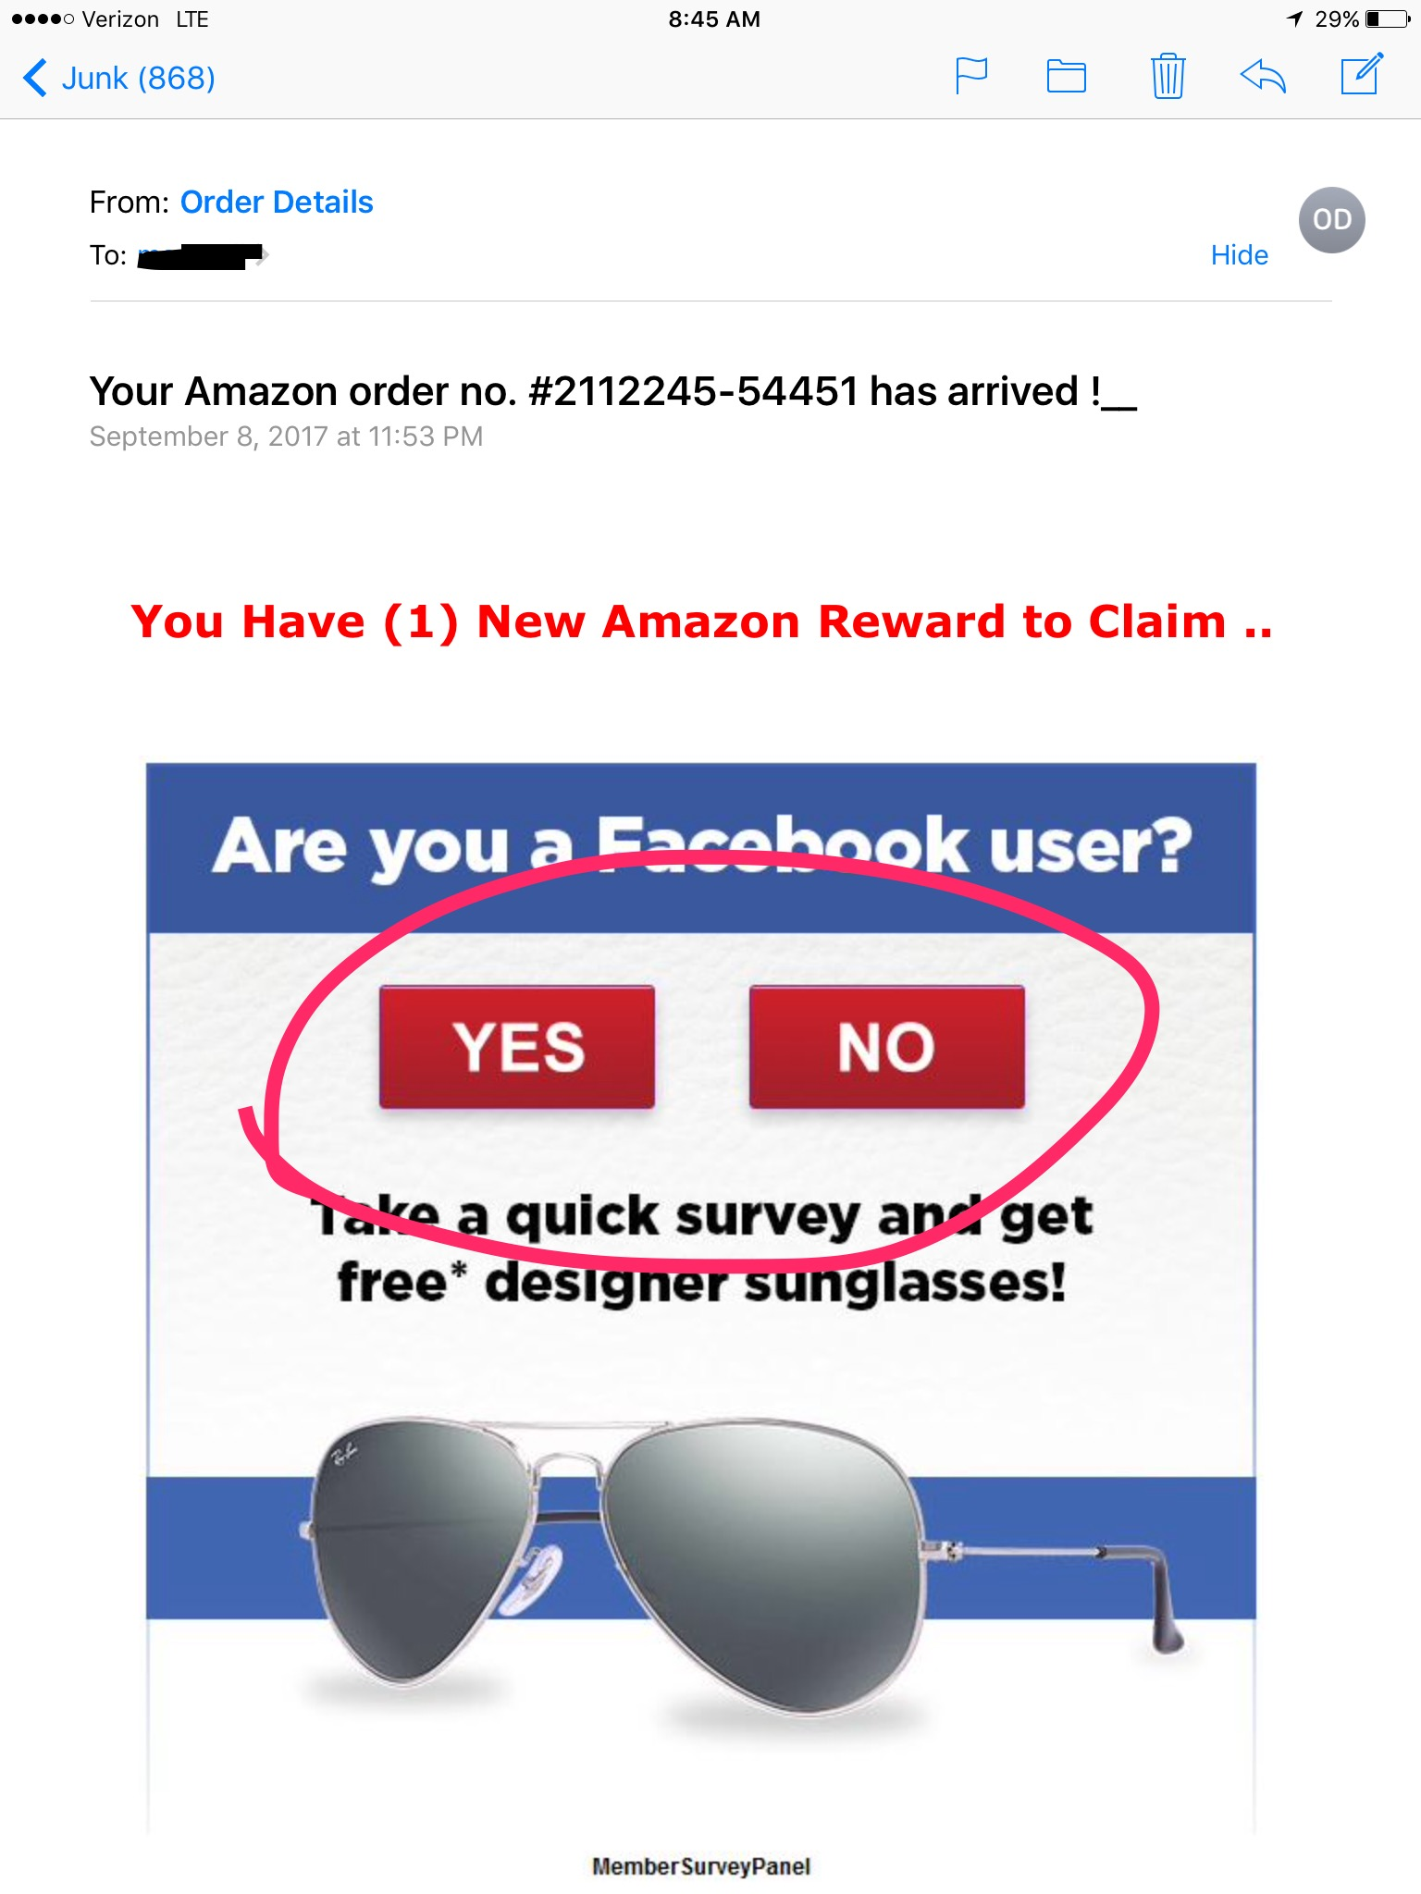
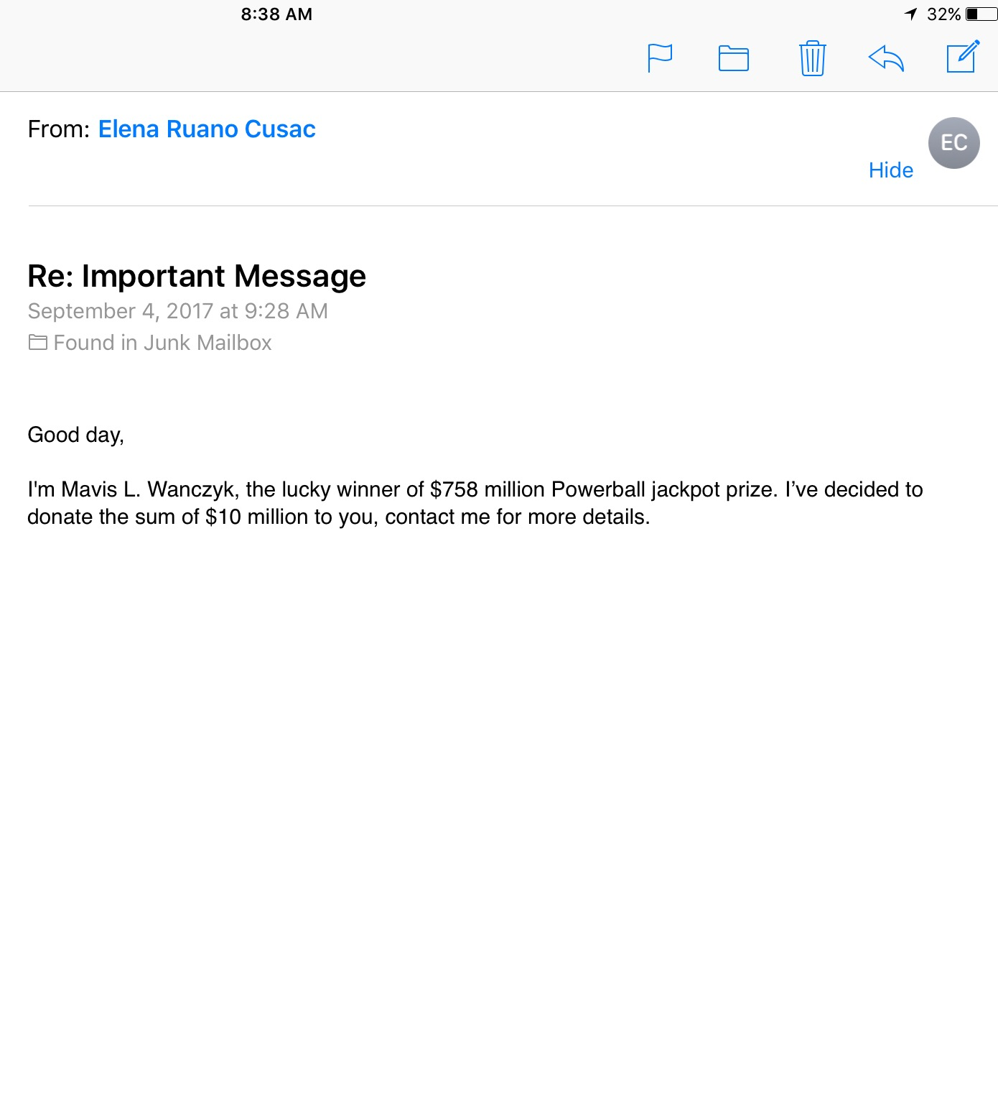

Slide 7
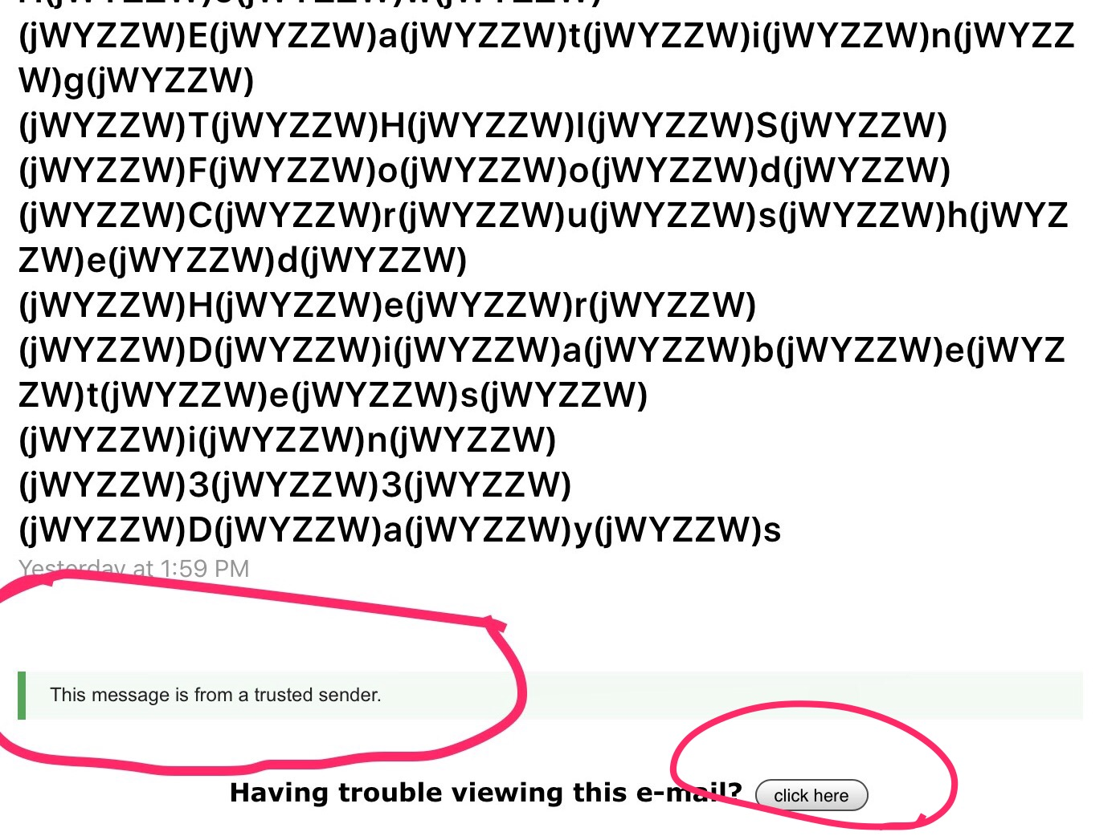

Slide 8
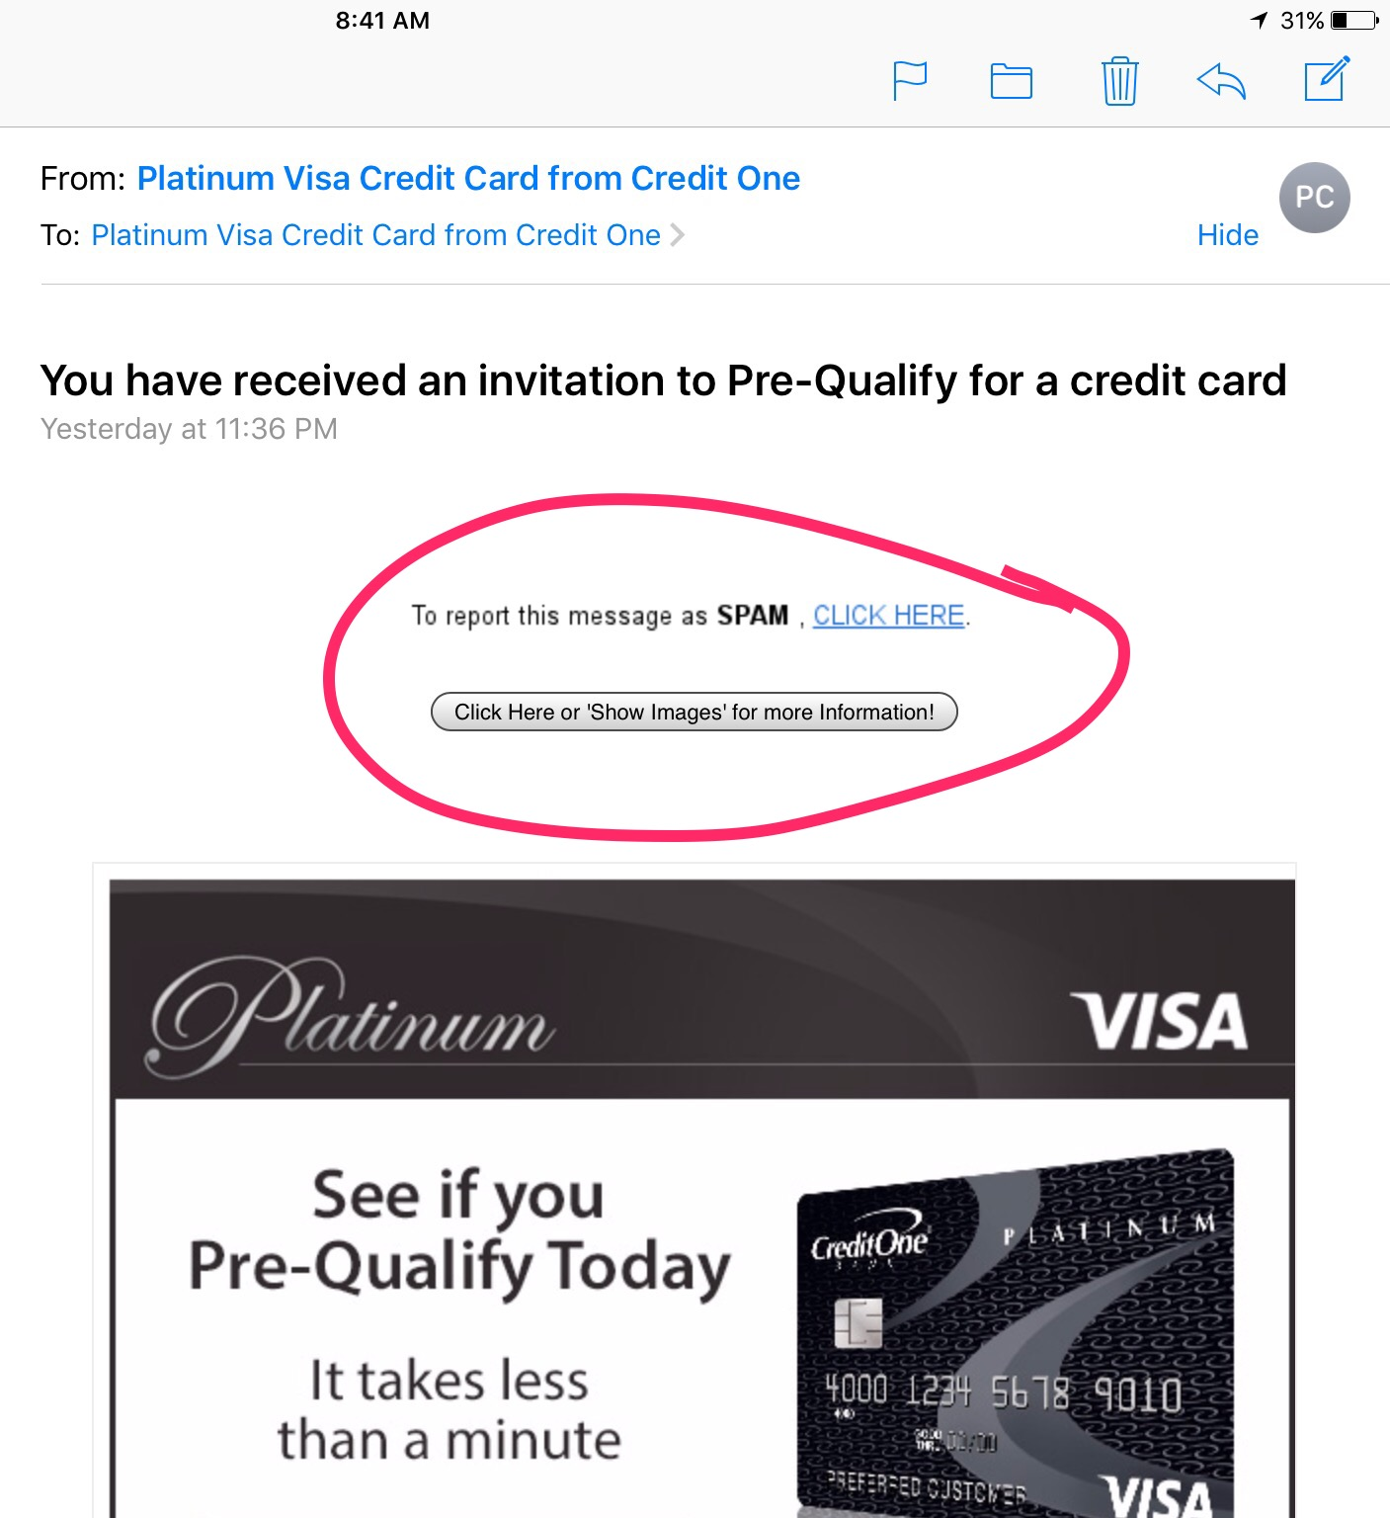

Slide 9
Video
Your photo fate
Two kinds of stupid
If you don’t want your parents or grandparents to see the picture you are posting or sharing, you shouldn’t put it on the internet, or text it to anyone. It’s there forever, even after you “delete” it.

Slide 10
Scenarios
Your teacher will pass out or review some scenarios with you.
What stands out to you?
Do you see any red flags for things that could be dangerous?
What could happen in the scenario?
What could have been done differently?

Slide 11
Did you know:
Most hiring managers and HR departments use
search engines to research applicants?
Men and women Google each other when they first begin dating?
Colleges, Coaches and Sorority/Fraternities Google you also! People have lost scholarships over their internet postings

Slide 12
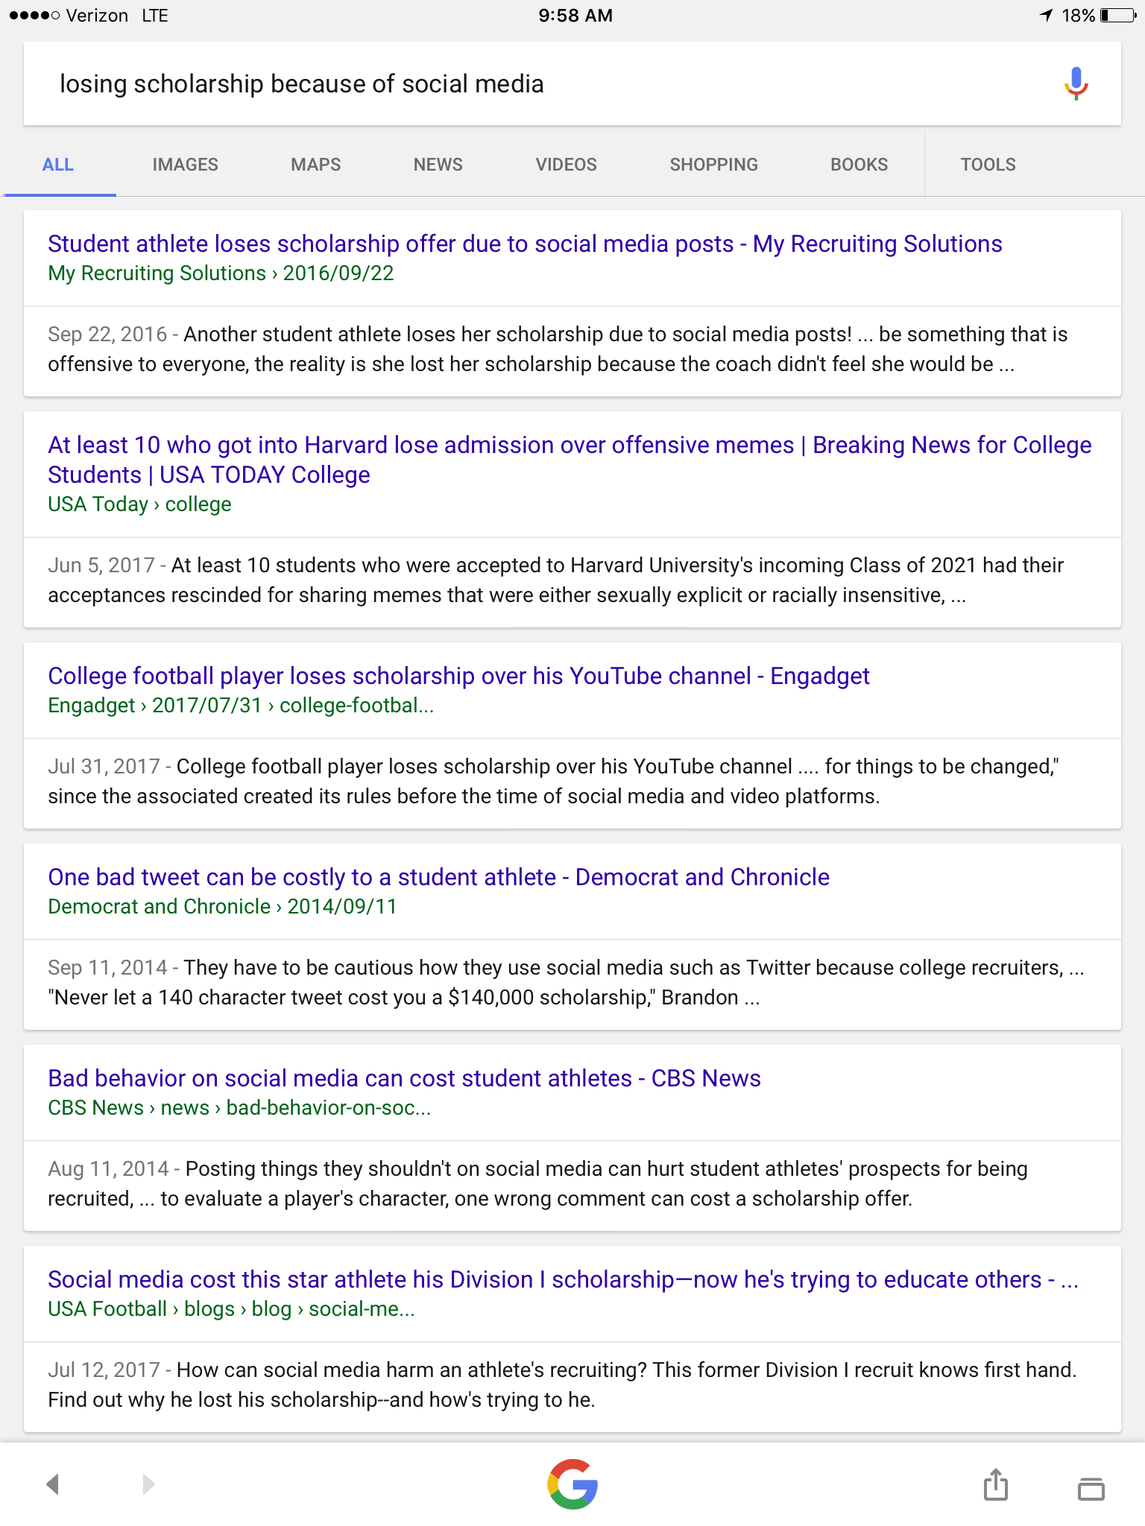

Slide 13
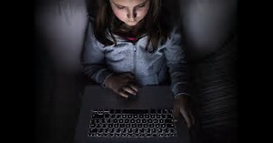
Don’t EVER agree to meet a person that you only know from online and have never met!! If someone asks to meet you in person, tell your parents or another adult and get their opinion.
VIDEO:
Stranger Danger

Slide 14
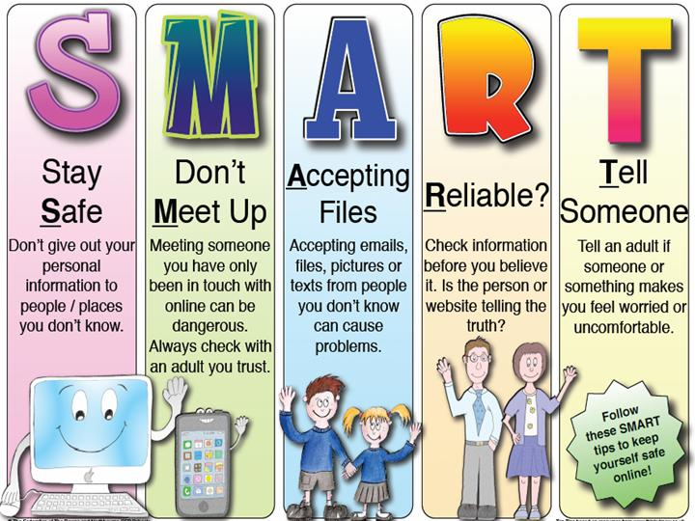

Slide 16
Closure
Either in your notebooks or in discussion:
Determine some ways you could be safer when using the internet.
Read the Internet Safety Contract, sign it and return it to your teacher.
The internet is a great tool, but you have to remember it can also be dangerous.
Be safe!!!!

Slide 17
www.staysafeonline.org
www.onlinesafetysite.com/P1/Teenstats.htm

