Slide 1
Sbac prep
You will need your Advisory notebook or a piece of paper and a pencil.

Slide 2
After break, through Advisory we will begin taking the Smarter Balanced Assessments (SBAC).
We will review test taking strategies you can use before, during and after the assessments.
You will use your Advisory notebook or a piece of paper to record information seen the videos.

Slide 3
List the 10 test taking strategies shared in the video for the SBAC.

Slide 4
ELA SBAC Test STRATEGIES
Reading: you will read and analyze literary and informational texts.
Read the questions first, then the passage.
Take your time answering questions.
Go back into the test to find answers.
Remember it's not a race.

Slide 5
ELA SBAC TEST WRITING
Writing: you will read a series of short texts that you will use to compose your essay.
Essay could be argumentative, explanatory, informational or narrative.
Remember to use transition words to start a new paragraph as well as when adding evidence.
Don't forget to give credit to the author when using evidence from one of the texts.

Slide 6
Math SBAC TEST
Math: You will complete two components for math, the Performance Task (PT) and Computer Adaptive Test (CAT).
Use your critical thinking skills.
Read each question and all answers before making your selection. First, eliminate incorrect answers.
Underline and/or circle the task in each problem.
Use the scrap paper you're given to work out each problem. You can always ask for more.
There will never be more than one correct answer on standardized tests.
Watch out for distractors (unnecessary information) within a problem.
Use mathematical shortcuts:
Cancel / simplify fractions
Estimate
Remove decimal points when possible

Slide 7
Testing violations
You must follow all of the directions given by your teacher during testing to avoid testing violations.
Testing violations can result in not only your test being invalidated, but all students in the class having their tests being invalidated as well.

Slide 8
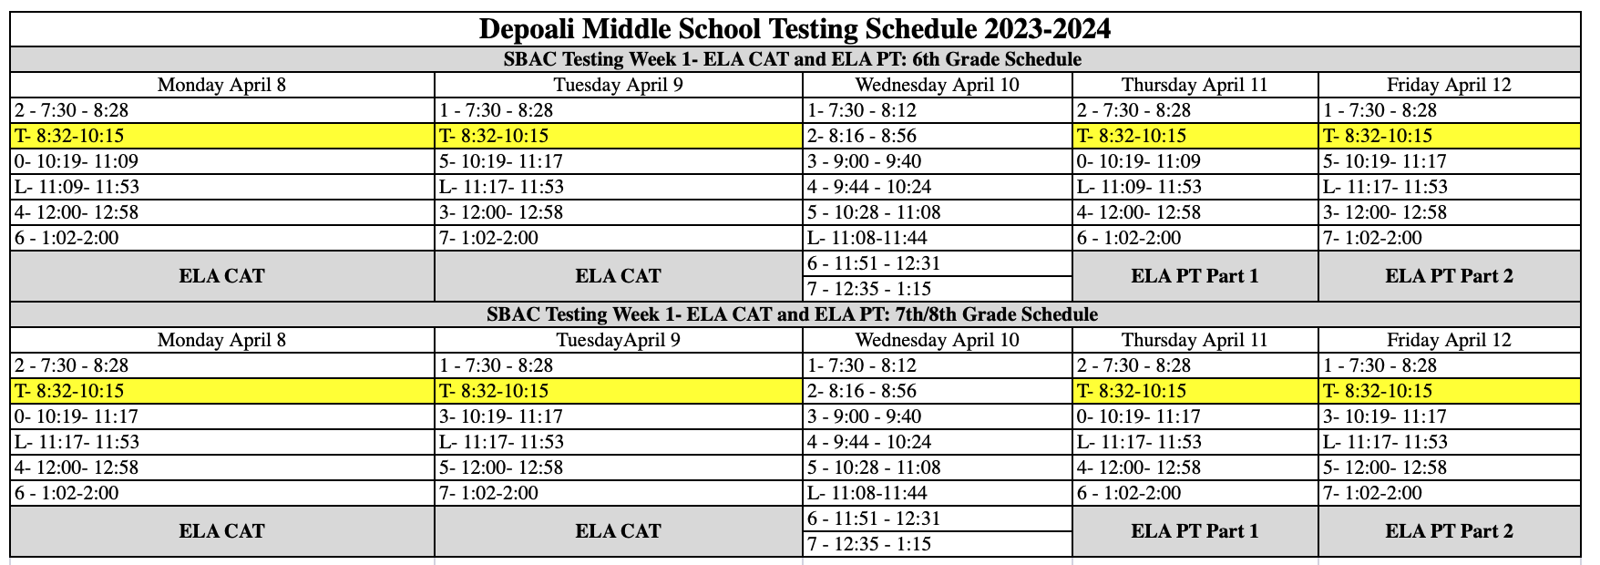
SBAC SCHEDULE Week 1

