Slide 1
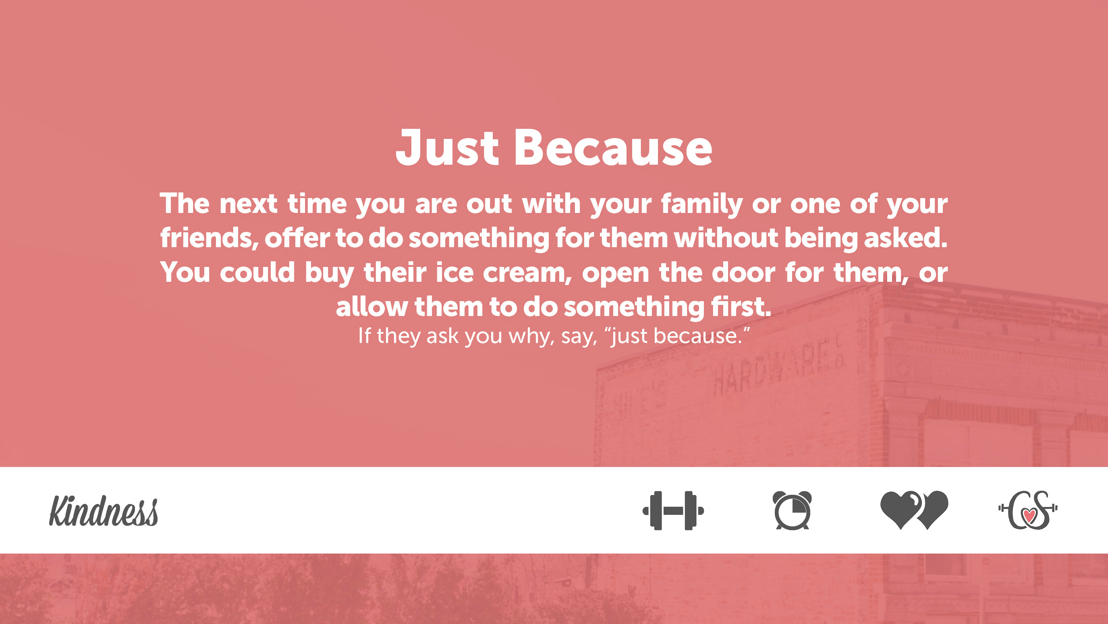
Objectives:
Students will reflect on their own character and identify ways they could improve it.
Students will understand what Mindfulness is
Students will understand the first state of mind, the Emotion Mind.
Character Dare:
Last week’s Character Dare
Turn and talk with a partner about last week’s dare
TRUTH: What do you think about last week’s Dare?
Dare: Reflect on your experience with last week’s Dare

Slide 2
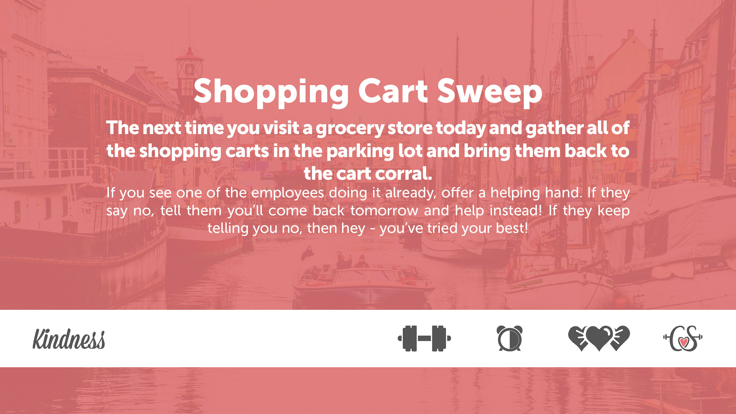
This Week’s Character Dare:
Video link:
Mindfulness explained

Slide 3
Raise your hand if you have ever made decisions or took action without even really thinking about it- you were just doing it without thought?
Raise your hand if you have ever been unable to control your attention?
Raise your hand if you have ever gotten into an argument with a friend, boyfriend/girlfriend, parent, etc., and then had trouble thinking about the present moment because of that argument?
Share out

Slide 4
Mindfulness Definition:
Being able to control our own thoughts, feelings, and actions, instead of letting them control you; it is putting your mind where you want it to be.*
“What problems could occur if you can’t focus on what is going on in the present moment?”

Slide 5
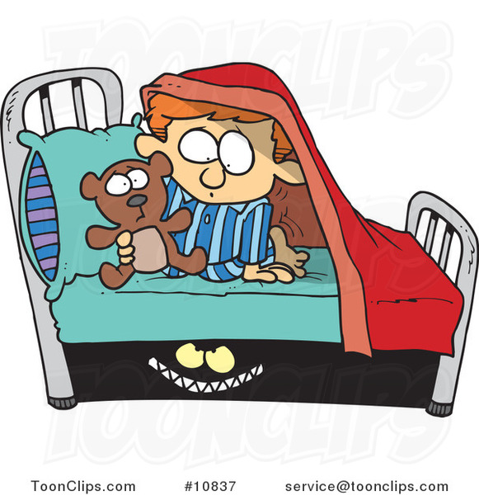
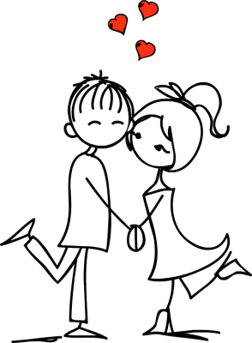
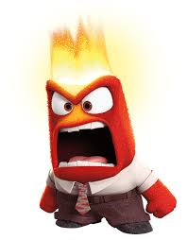
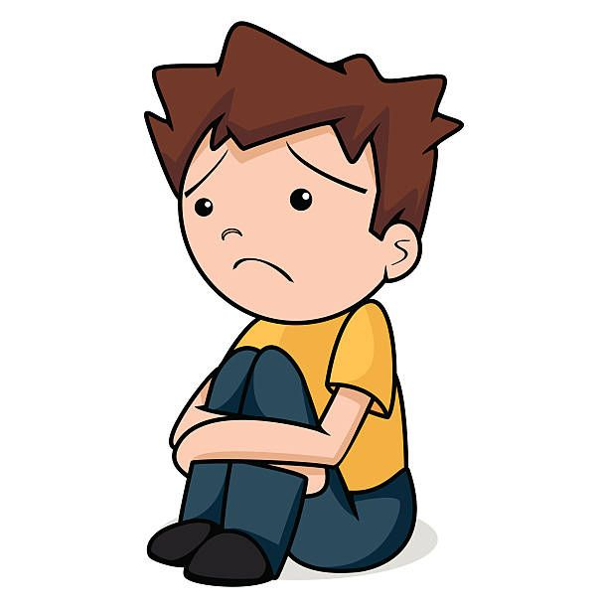
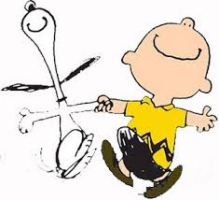
Over the course of our time together, we will complete a few lessons that teach different strategies that help us control our thoughts, feelings, and actions and be more present in the current moment. But first, we need to learn about the 3 states of mind we can be in, starting with ‘Emotion Mind.’

Slide 6
You have one minute, and I want you to write down on a piece of paper as many emotions as you can think of.
Share with a neighbor and add to your list any that your neighbor came up with that you didn’t.
After you have written down these emotions, circle the positive emotions and underline the negative emotions.
Once you are done, write down how many positive emotions you had and how many negative emotions.
THINK: Why do you think some of us came up with more negative than positive? What does this tell us?
Answer: Often times they will come up with more negative ones because of the intense feelings these contain. These emotions cause us to pay attention more when we are feeling this way.

Slide 7
Emotion Mind

Slide 8
Write one of the scenarios we discussed or create a new one that leads you to live in an emotional mindset.
Your goal is to be more aware of how it controls your behavior.
Our next mindfulness lesson will focus on the other two states of mind. Today, it is important to understand that by simply being aware of our emotions and how they can control us, we take the first step in improving our mindfulness

