Slide 1
Part A
Celebrating Black History Month

Slide 2
Black History Month
African American and the Arts

Slide 3
What is the significance of Black History Month?
Promoting awareness
Raises awareness about the history and experiences of people of African descent.
Educational Impact
Provides a platform to educate about the struggles, triumphs, and contributions of black individuals.
Cultural Impact
Celebrates the influence and achievements of black culture across various fields

Slide 4
Carter G. Woodson is known as the “Father of Black History.”
Woodson chose February to cover the birthday of Frederick Douglass and Abraham Lincoln
In 1976, President Gerald Ford officially recognizes Black History Month.
Black History Month is also celebrated by Canada, Ireland, The Netherlands, and the United Kingdom.
The first novel published by a Black author was in 1853.
Nat King Cole was the first Black American to host a Television Show
Hattie Mc Daniel was the first Black person to win an Oscar in 1940.
Thurgood Marshal was the first Black justice to serve in the US Supreme Court from 1967-1991
Barack Obama was the first Black president of the United States.

Slide 5
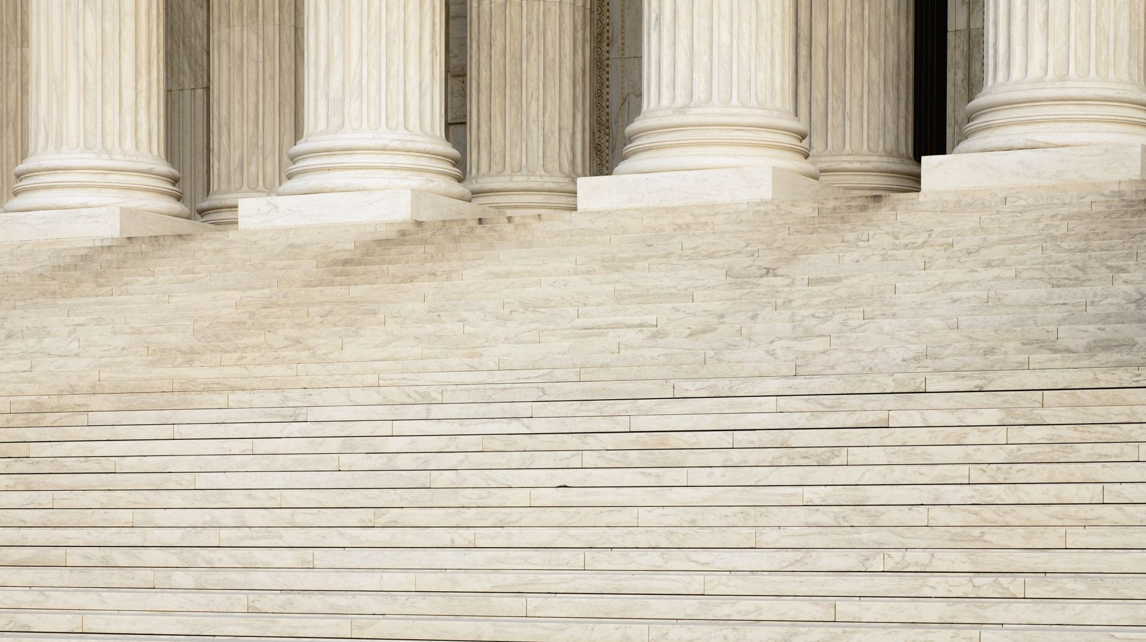
African American and the Arts
Discuss the impact of historical achievements of African Americans and the arts.
Harlem Renaissance, The Great Migration, and The Civil Rights Movement.

Slide 6
African American and the Arts
Explore how art forms like music ,dance, visual arts, literature reflect cultural
experiences and inclusion.
Present videos and documentaries highlighting achievements of historical, social and cultural contributions of African Americans.
https://www.history.com/news/harlem-renaissance-photos

Slide 7
African American and the Arts
Discussion on the biographies and stories of American leaders who contributed to the American culture.
Frederick Douglas, Louise Armstrong, Langston Hughes, James Baldwin
W.E.B DuBois, Dr. Martin Luther King, and Maya Angelo

Slide 8
Part B

Slide 9
Lesson Plan
DEPOALI Middle School

Slide 11
Understanding and Practicing Tolerance
What is tolerance? ( S.T.R.I.K.E)
Explain inclusion, diversity, stereotypes, biases and positive race relations.
Discuss why tolerance is important in school and the community.
Emphasize the importance of active listening and empathy in practicing tolerance.
Assign students to create posters or drawings that represent tolerance.
Display a tolerance wall at the school.

Slide 12
What is Tolerance?
The ability or willingness to accept the existence of opinions or behavior that one dislikes or disagrees with.
The Matrix T in S.T.I.K.E
We respect others and accept differences.

Slide 13
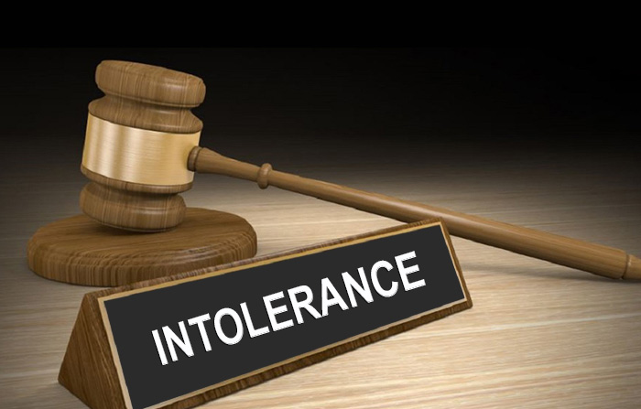
Do you tolerate intolerance?????
Are you someone who rejects things that are different?
Do you immediately say no to outside, strange ideas, and even end up looking down on them?
Are you a person who gets annoyed when people with different opinions seem to have more opportunities to express them?
Do you think everyone should think the same way as you?

Slide 14
Traits of Tolerance

Slide 15
Tolerance & Inclusion
Tolerance and inclusion are an important value in our diverse and complex world.
Tolerance refers to being open-minded and showing respectful attitude towards others.
It is also the willingness to accept feelings, habits, beliefs or culture that are different from your own.
Inclusion means welcoming and embracing all individuals.
Inclusion recognizes our universal “oneness” and interdependence even though we are not the same.

Slide 16
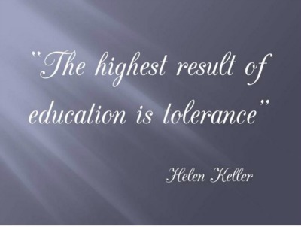
Step out of comfort zone
Respect differences and opinions
Appreciate diversity
Be polite
Show empathy

Slide 17
Building Tolerance
Take Ownership of Your Feelings. Recognize that no one can make you feel a certain way without your permission.
Develop Curiosity. In many cases, when we lack tolerance towards others it's simply because we don't understand them.
Change Your Perspective.
Practice Respect.

Slide 18
Tolerance and Inclusivity
HELLO - a short film about tolerance & diversity (1ST PLACE in the Nikon Cinema Z Film Fest 2019) (youtube.com)
Encourage students to discuss their thoughts and ideas in a small group.

Slide 19
Importance of Tolerance and Inclusivity
Tolerance and inclusivity are both essential in building a harmonious society.
promote peace and reduce conflicts
encourages diversity and inclusivity
fosters a culture of empathy and respect
learn from others and broadens our worldview
build stronger and more resilient communities

Slide 20
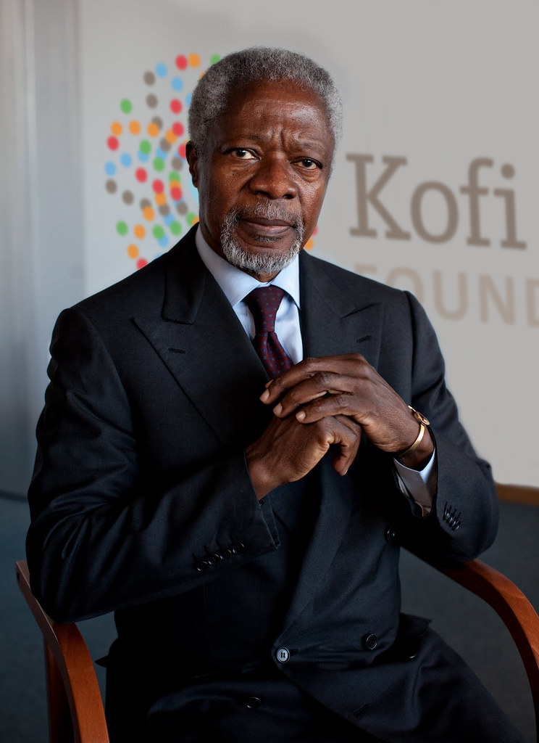
Tolerance
Create and display a Tolerance wall at the school involving famous quotes, sayings or pictures.
“Tolerance is a virtue that makes peace possible”.– Kofi Annan( Former UN secretary General

Slide 21
Tolerance and Inclusion
Introduce key concepts: tolerance, inclusion and building a community.
Explain diversity, stereotypes, biases, and positive race relations.
Help students reflect on their own stereotypes, biases and prejudices.
Students create a visual portrait that represents their identities, beliefs and values

Slide 22
Social Justice

Slide 23
Embracing diversity means
Understanding and appreciating individual differences.
Creating inclusive environments where everyone feels valued and respected.
Promoting mutual understanding and empathy.

Slide 24
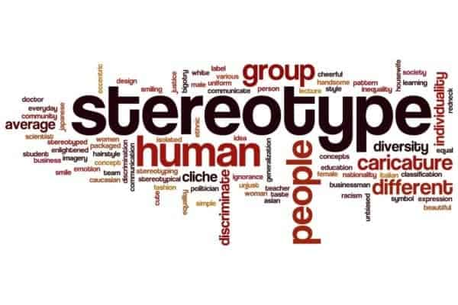
Stereotypes refers to overly simplifies and often inaccurate beliefs or assumptions about a group of people
Stereotypes can be based on race, gender, ethnicity and nationality.
Stereotypes can lead to:
-discrimination and prejudice
-limited opportunities and expectations
-misunderstandings

Slide 25
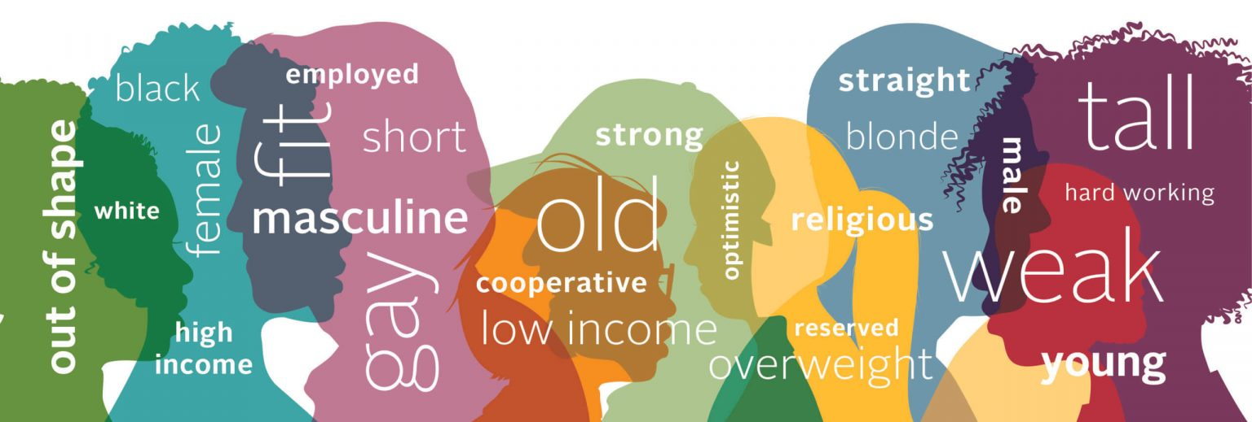
Recognizing and understanding biases
Biases are systematic errors in thinking and decision-making that results from mental shortcuts or heuristics.
They can also lead to inaccurate judgements and discrimination.

Slide 26
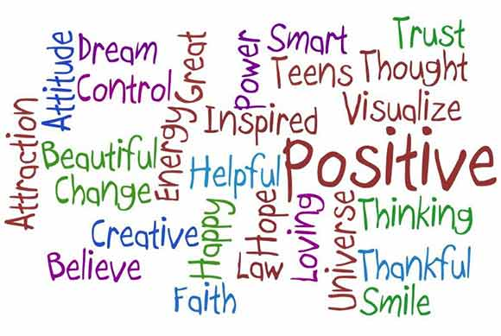
Positive Race Relations
Means fostering an inclusive and respectful interactions between individuals of different racial and ethnic backgrounds.
Recognizing and celebrating diversity
Promoting equity and inclusion, and working together to break down barriers and stereotypes

Slide 27
Benefits of Positive Race Relations
Improved understanding and empathy
Enhanced cultural competence
Increased diversity and inclusion
Reduced discrimination and bias
Stronger, more inclusive communities

Slide 28
Social Justice
Discuss justice and fairness with students.
Analyze “I have a dream speech.” - Dr. Martin Luther King, J.R.

Slide 29
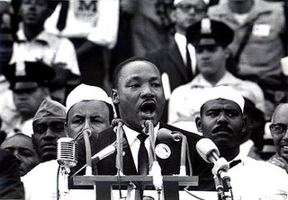
Civil Rights - Dr. Martin Luther King
‘I Have a Dream’ is one of the greatest speeches in American history. Delivered by Martin Luther King, Jr. (1929-68) in Washington D.C. in 1963, the speech is a powerful rallying cry for racial equality and for a fairer and equal world in which African Americans will be as free as white Americans.

Slide 30
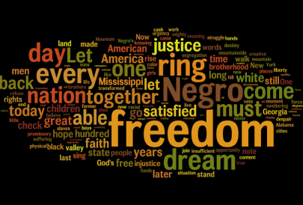
“I HAVE A DREAM”
https://archive.org/details/i-have-a-dream-video

Slide 31
https://www.youtube.com/watch?v=OOxoeGL3tTo

Slide 32
References
https://www.nea.org/professional-excellence/student-engagement/tools-tips/black-history-month-lessons-resources
https://www.loc.gov/classroom-materials/united-states-history-primary-source-timeline/post-war-united-states-1945-1968/arts-and-entertainment-1945-1968/
https://www.npr.org/series/4823817/the-history-of-hip-hop
https://www.history.com/topics/black-history/i-have-a-dream-speech#civil-rights-movement-before-the-speech
www.witnesstree institute.org.

