Slide 1
How to Behave on and off Campus
By:Joey Butler, Aidan Chauvin, Shawnnessy Crawford, Maddy Jaggers

Slide 2
BehaviorOn Campus
How should you act during school?
Respect everyone
Use school supplies responsibly
Pick up after yourself
Act how you would act in front of your parents
Try your hardest to succeed

Slide 3
Behavior On campus
How should you act in the classroom?
How should you act in the cafeteria?
How should you act in the hallway?
You should be quiet and respect the teacher and your peers. You should stay on task and be responsible.
You should sit and eat your food. (No duh.) but don’t throw food or other objects. Don't cut in lines.
You should stay on the right side of the hallway. Also remember to not run. And have integrity for others.

Slide 4
Behavior Off Campus
Talk in your groups about how you should behave off campus.
Always behave how the owner of the area expects you to act
Treat the area around you with kindness
Act appropriately to the environment and other people
Make sure that you are in a safe area
Never do anything reckless while you are in public

Slide 5
Behavior Off Campus
How do you behave in the park?:
Play how you want as long as it is appropriate and have fun.
How do you behave in a store?: Purchase the items or item you are looking for and don’t mess around too much.
How do you behave in a restaurant?: You should have proper manners when ordening your food and try not to take too long.

Slide 6
Actions
Do you act the same at school as you do at home?
Well you should.
You should treat teachers the way you treat your parents/guardian
Clean up after yourself at school and at home

Slide 7
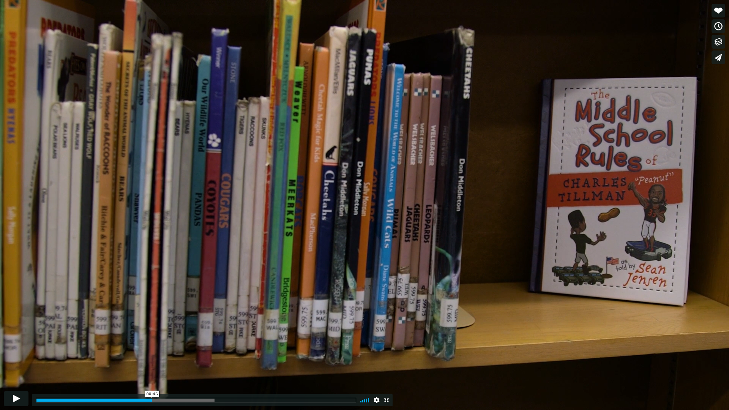
Watch this video to learn why acting and behaving in the classroom is so important for education.
https://vimeo.com/176497706

Slide 8
How your actions in school and off school effect each other
Finishing work form school can help you boost your grades
Tutoring other students can help them
Ignoring schoolwork like homework can affect your grades
Doing bad things outside of school can make your behavior at school inappropriate
Staying up late can ruin performance during school

Slide 9
Bad Behavior
Good Behavior

Slide 10
Conclusion
Now you should know how to act on and off campus. Use this knowledge to help yourself and others.

