Slide 1
How cell phones affect us STRIKE LESSON
Brandon, Zach, Bennie, and Vanessa

Slide 2
Discuss with your group the pros and cons of cell phones. Make a T-Chart with a list of each.
Pros of cell phone use
Cons of cell phone use
As a class, share your ideas. (Advisory teacher will create a chart based on your thoughts and ideas)

Slide 3
How Cell Phones be a negative influence on students
Students can become addicted to cell phones.
Students can be seen playing games, chatting, and talking to their friends most of the time.
Students are more interested in spending their time on cell phones, rather than spending it on studying.

Slide 4
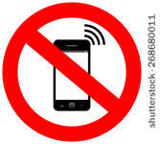
appropriate times to be using your cell phone
Don’t use your cell phone during class, because you should be listening to your teacher or working on your assignment.
Don’t take your cell phone out during lunch unless you have a self-manager badge.
When you are allowed to be using your cell phone, make sure you are using it responsibly. No social media, games, or texting is allowed.

Slide 5
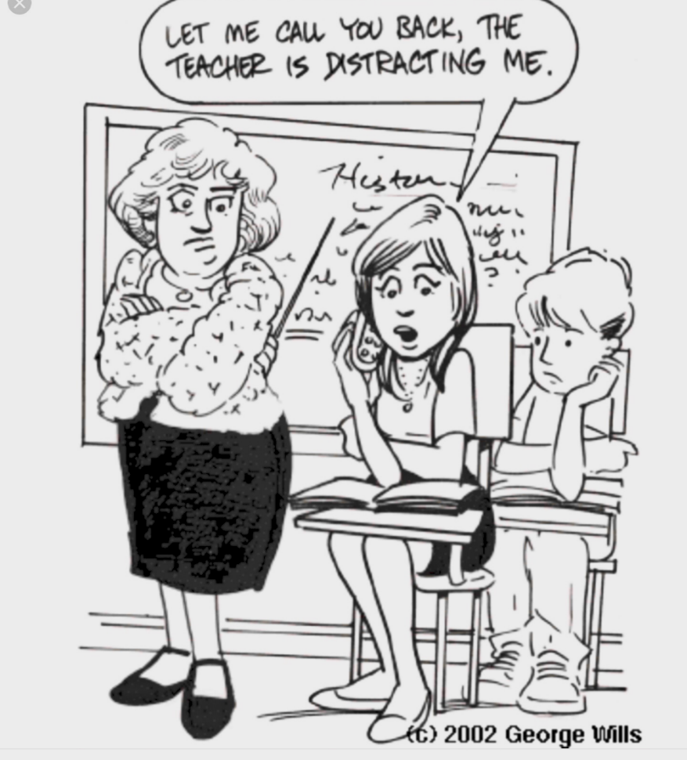
Why is it important not to use your cell phone in class
It’s distracting to you and your class mates. Cell phone use distracts your teacher because you're not listening to him or her and they have to stop their teaching to address the issue.
You are allowed cell phone use in the classroom ONLY when your teacher gives you permission.

Slide 6
No cell phone use during homework
You should only use your cell phone during research.
Don’t FaceTime your friends during homework, you could lose focus.

Slide 7
Don’t use your cell phone to cyber-bully
As new technology is being created more and more people are being bullied over social media.
People think it’s cool to bully people online because they are too scared to say it in their face.
There are severe consequences for cyber-bullying.

Slide 8
class activity (if time)
In your small group, create a scenario based on one of the following:
Appropriate cell phone use during class, homework, lunch, and before and after school.
Inappropriate cell phone use during class, homework, lunch, and before and after school.
Present to the class and have your classmates determine which scenario you are re-enacting.

