Slide 1
Washoe County School District: Lesson 4- Embracing and Respecting Differences

Slide 2
Lesson Objective
Our objectives for today’s lesson:
To assist students in identifying and understanding the importance of diversity and inclusivity in the classroom, community, and school.

Slide 3
Shared Agreements
We can be different
We can talk differently
We have the right to be ourselves
We will respect the opinion of our peers even if we don’t agree
We may see things differently than someone else
We will honor the differences each of us brings to the lesson
We will respect the confidentiality of others – what is said here stays here – what is learned here leaves here
We will listen with open ears

Slide 4
Shared Agreements
We will use respectful language. We avoid teasing, name calling, hitting, throwing shade (putting others down, etc.)
We will treat each other the way we would like to be treated
We will Speak Up if we see others being treated unfairly
We know that our differences make us interesting and unique
* These are examples- generally six to eight agreements will suffice- you may use any of the examples if appropriate, or ask the students to make their own.

Slide 5
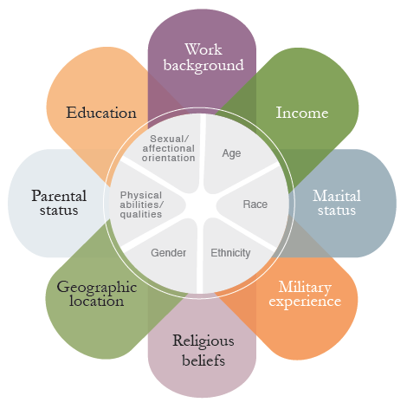
Lesson Activity
The Identity Wheel

Slide 6
Aspects of our Identity
Inside of the Circle
Pieces of our identity that “typically” do not change. Set in place.
Outside of the Circle
Pieces of our identity that “can” change at any given time and place in our lives.

Slide 7
Who are you?
Phase 1
Choose what you “want” to identify (3 to 5 characteristics)
Share with your partner(s)
Place your dots
Phase 2
Choose 3 to 5 characteristics of identity that you think you see in your schools culture/climate/
Place your stars
Discuss connections and differences
Phase 3
Make your own, or classroom poster

Slide 8
Final Closing Reflection
Popcorn Closing: (time permitting) Quickly share a word to describe how you felt about today’s lesson.

Slide 9
Check-in/Questionnaire
Complete Lesson 4 Questionnaire

